Slide 1
The PACS Photometer:
Overview and Products
Roberta Paladini
NHSC/IPAC

Slide 2
PACS Photometer @ NHSC
Roberta Paladini (PACS Team Lead)
Cate Liu (developer, photometer)
Kevin Xu (calibration scientist, photometer)
Yi Mei (system engineer, archive)
For any questions and help with your PACS data, contact the NHSC Help Desk:
http://nhsc.ipac.caltech.edu/helpdesk/index.php

Slide 3
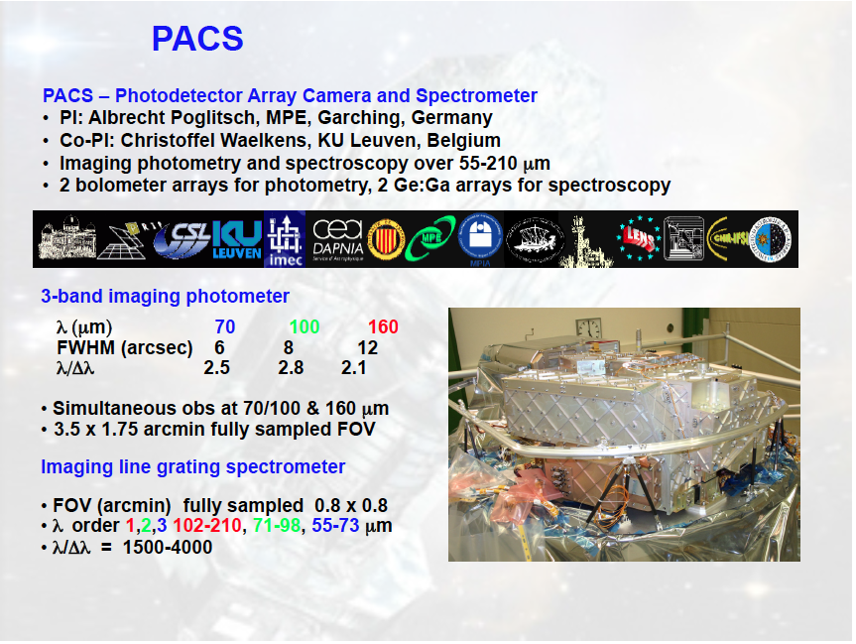

Slide 4
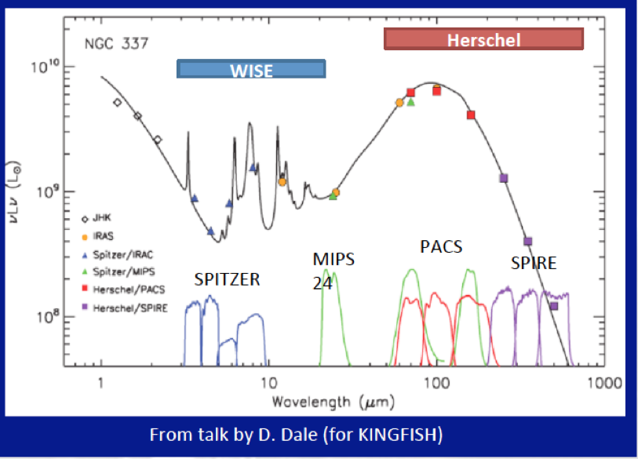

Slide 5
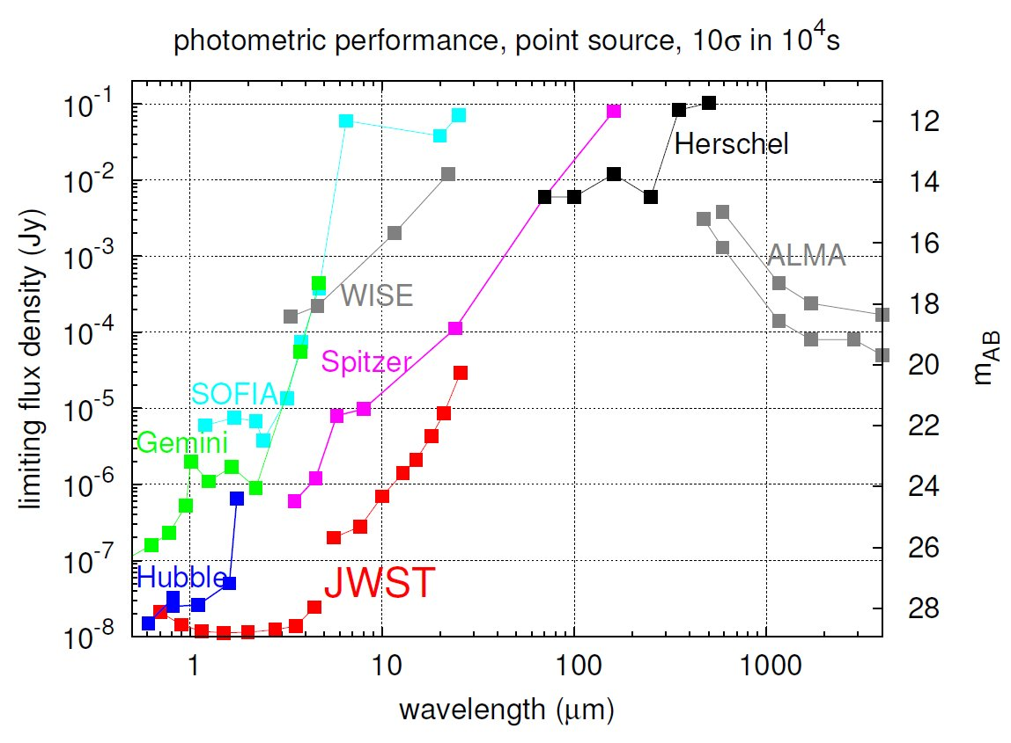

Slide 6
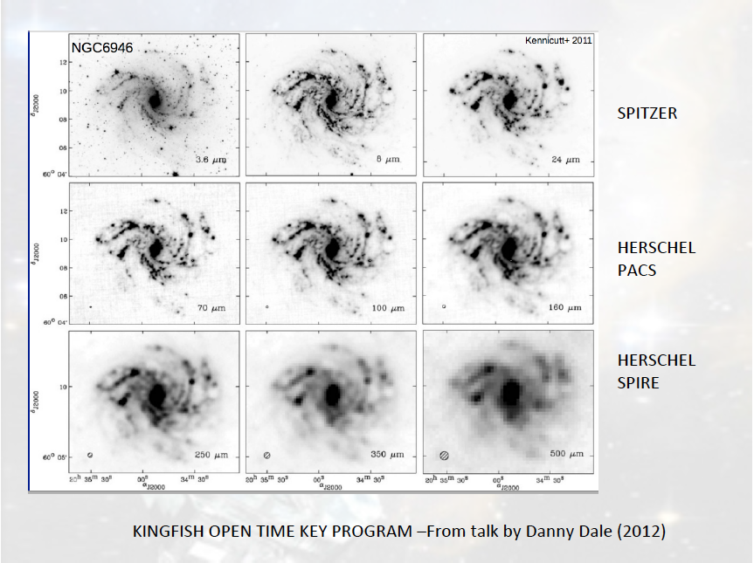

Slide 7
PACS Photometer Observing Modes
There are 3 PACS photometer observing modes:
Chop-Nod mode → this mode was deprecated in
Cycle 1/ Cycle 2 and only used for
calibration purposes
Scan map mode
Parallel mode

Slide 8
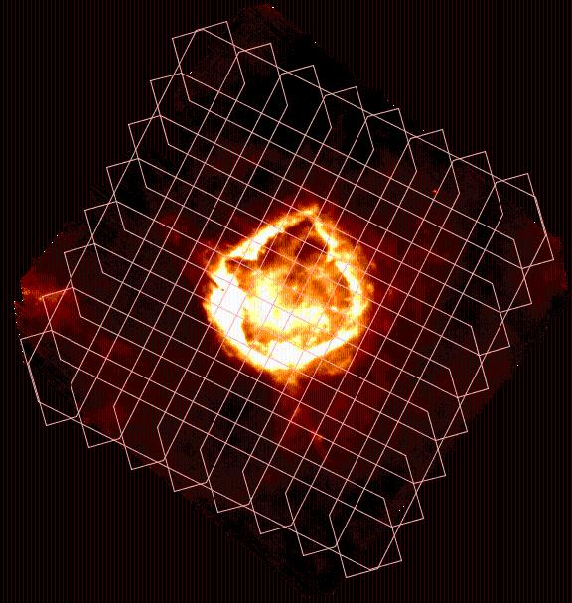
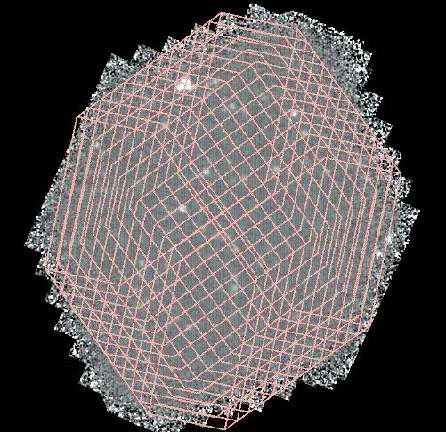
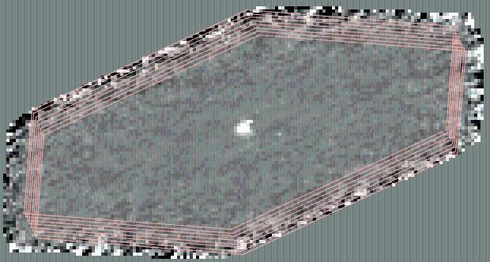
Scan Map Mode
Large Galactic fields
Deep cosmological fields
Small fields centered on point-sources

Slide 9
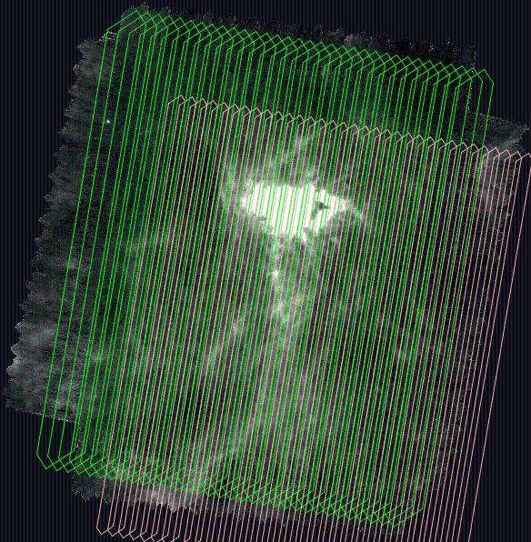
Parallel Mode: PACS & SPIRE
This mode is efficient for large maps, i.e. > 45 arcmin in size (PACS and SPIRE are separated by 21 arcmin on the focal plane)

Slide 10
Science Highlights

Slide 11
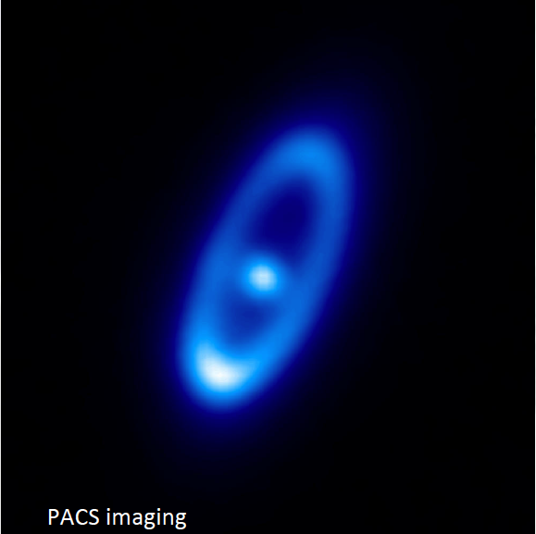
PACS imaging of Formalhaut, one of the most well-studied IR excess main-sequence stars, reveals a dusty belt beyond130 AU which needs to be sustained by the grinding down of the equivalent of 2000 1 km-sized comets per day !
Acke et al. 2012

Slide 12
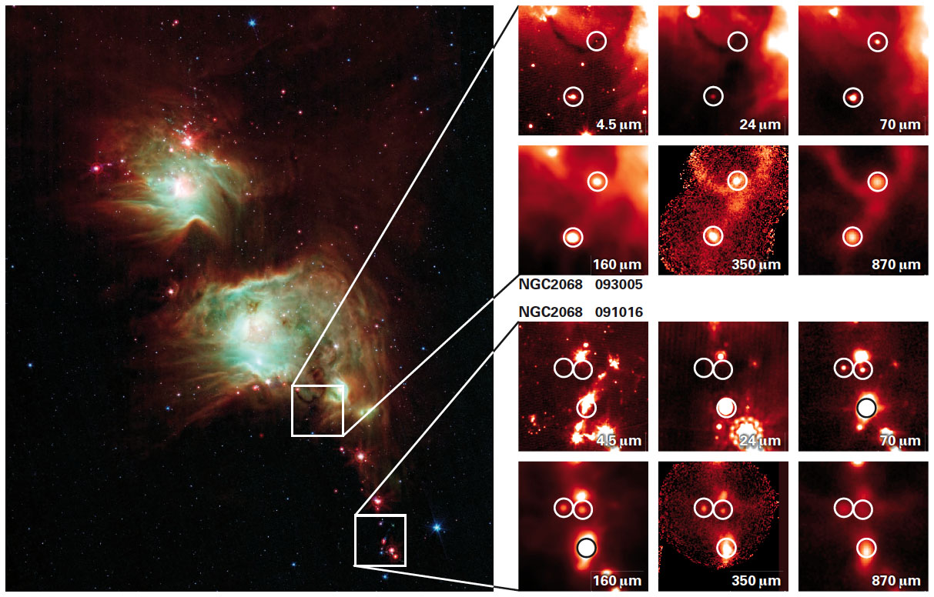
PACS observations have revealed in Orion the youngest protostars likely ever observed !
Stutz et al. 2013

Slide 13
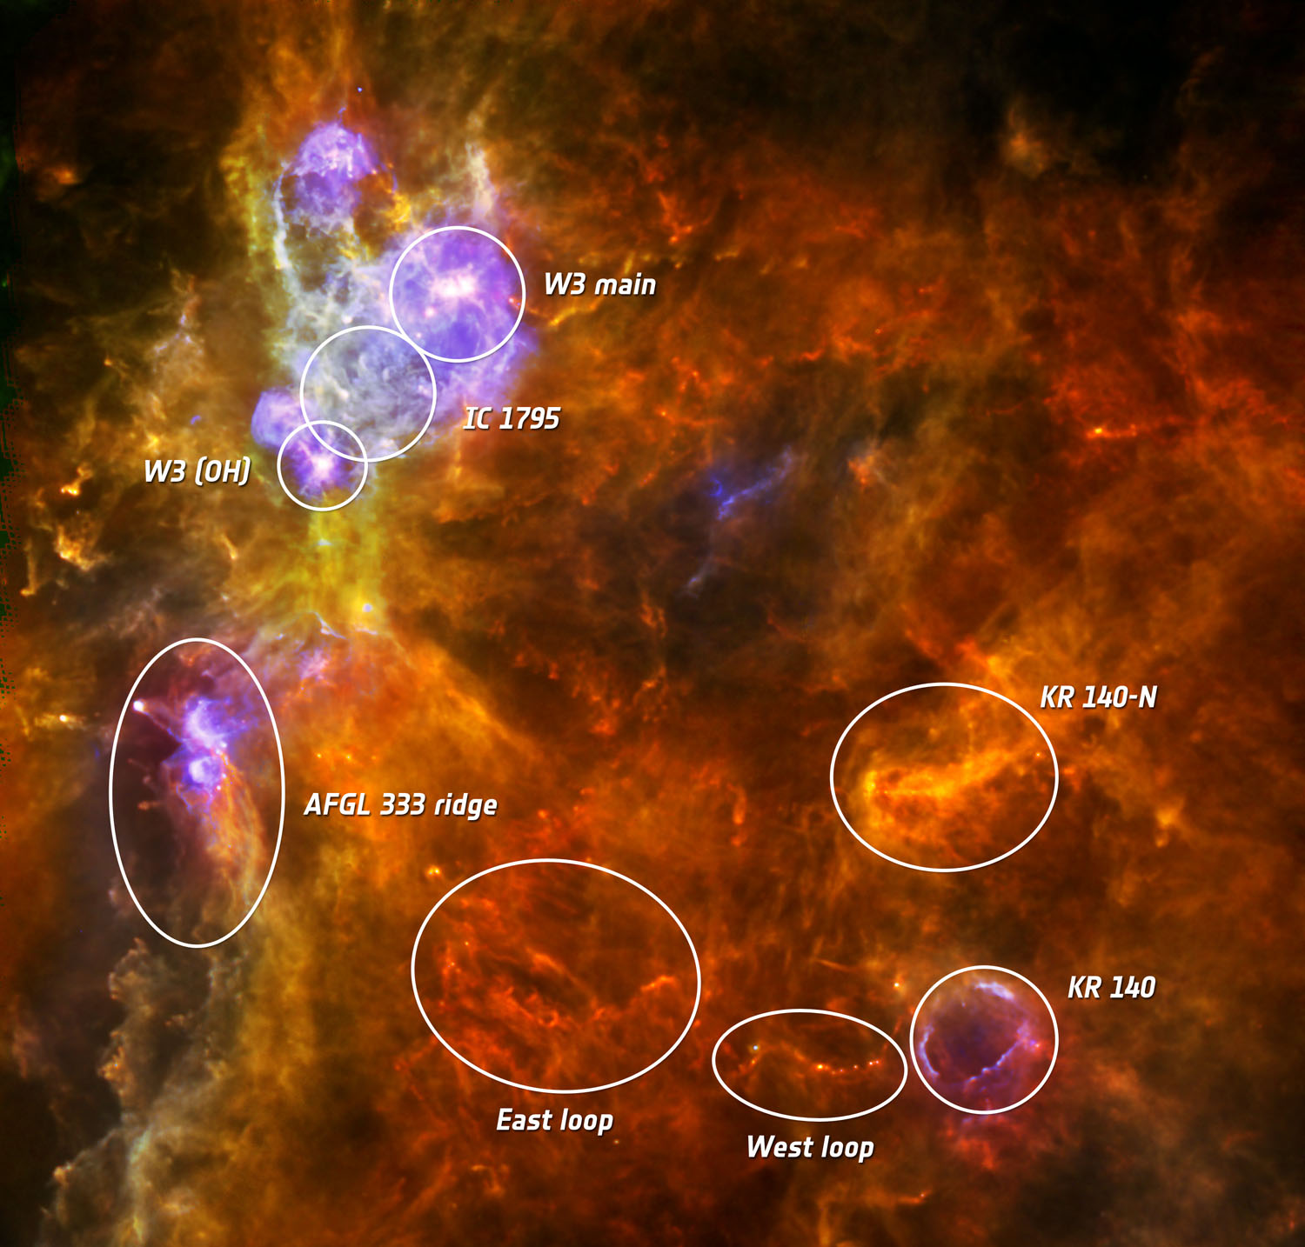
PACS is shedding light on how massive stars form, like in the W3 GMC !
Rivera-Ingraham et al. 2013

Slide 14
PACS Photometer Data & Products
(or: how do I get the data I need and…where are the maps ?)

Slide 15
How do I find the PACS data I need ?
Each PACS data set (photometer or spectrometer) is uniquely associated with a 10 digit number, i.e. an OBSID. Ex: 1342191353
Therefore, we always first need to identify the OBSID or list of OBSIDs which correspond to the data set we are interested in
To this end, we go to the Herschel Science Archive (HSA)

Slide 16
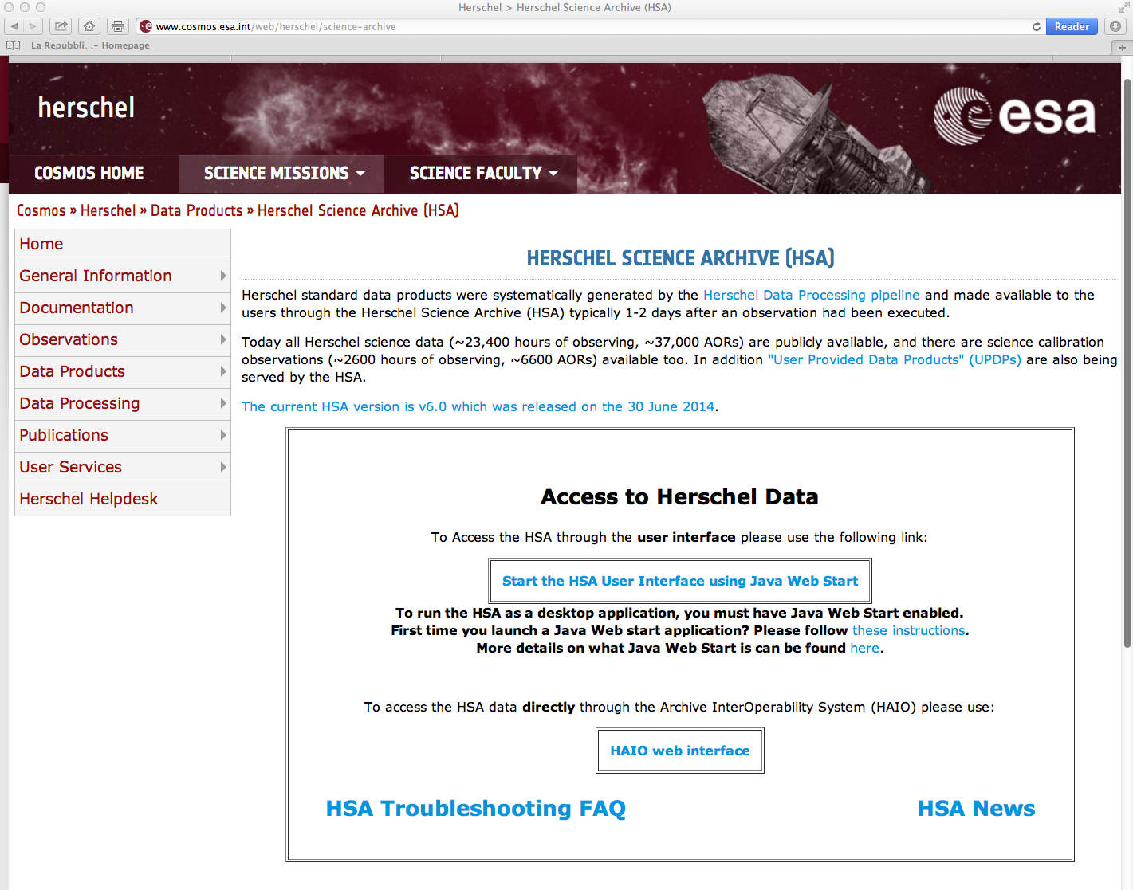
Click here to start the HSA interface

Slide 17
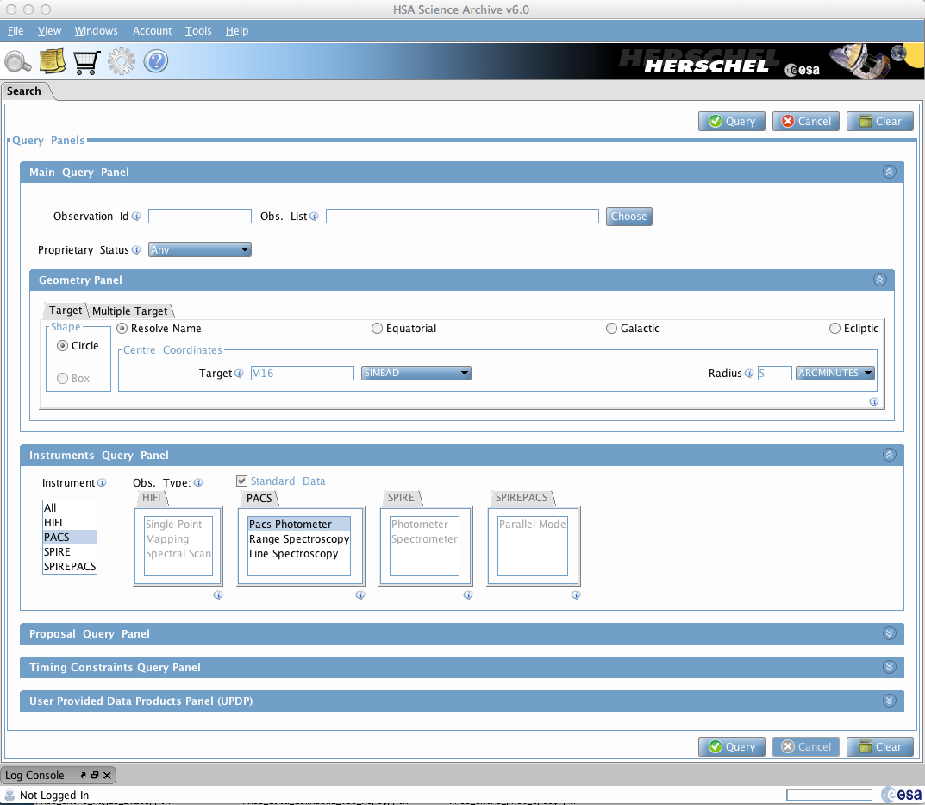
Ex:
Search in the HSA for PACS photometer data for M16 within a 5’ radius
NOTE:
by selecting “PACS Photometer”
you will also search for PACS scan maps, NOT parallel mode maps

Slide 18
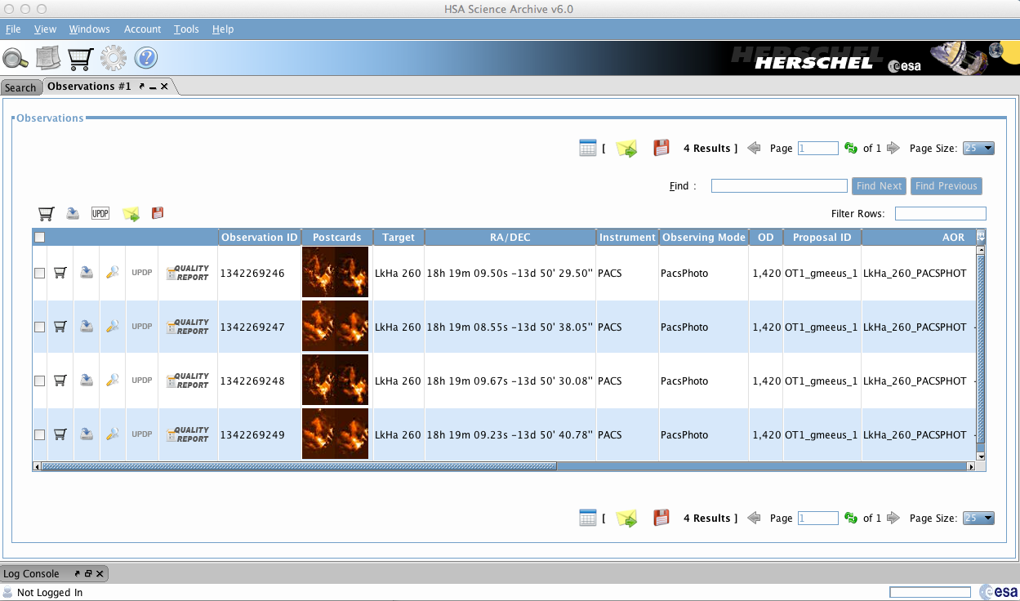
Result of the query:

Slide 19
How do I visualize the PACS data
I have found in the HSA ?
The best way to visualize the data in HIPE

Slide 20
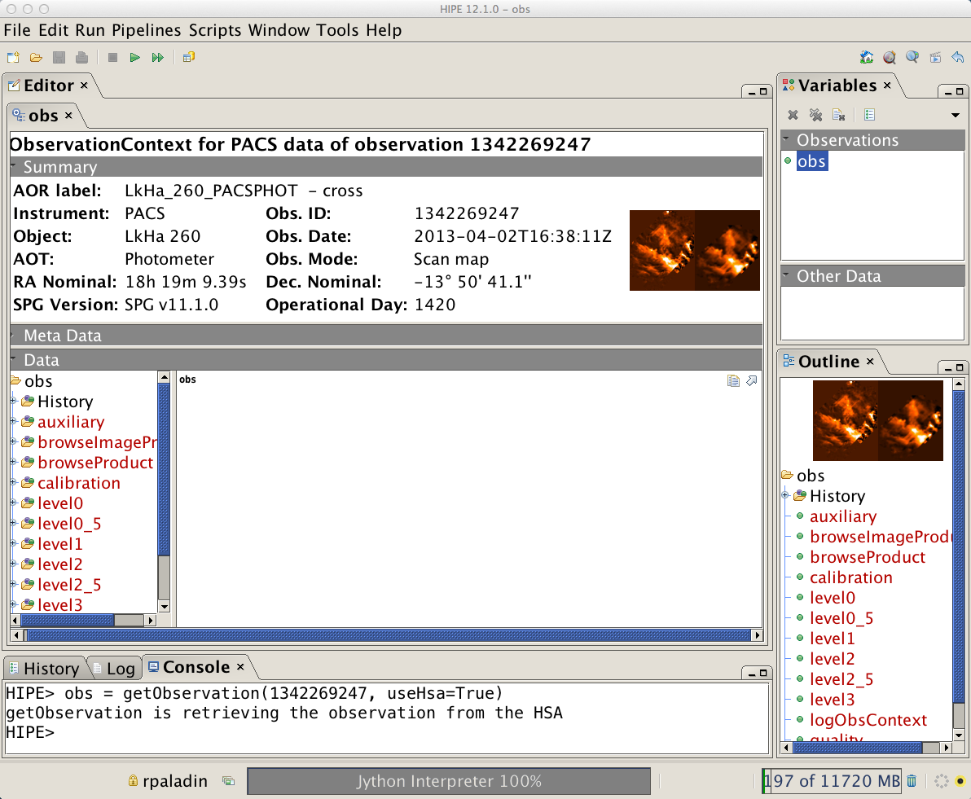
In our example: M16 – OBSID: 1342269247
3
Double click on the “obs” variable
1
2

Slide 21
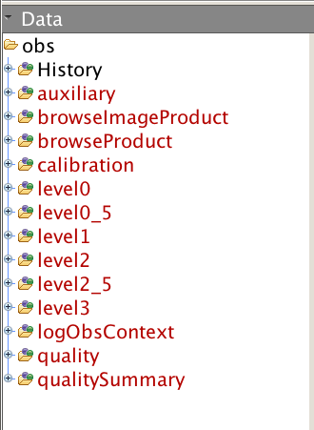
What is the meaning of level0, level 0_5, etc. ?
}
These are different levels of processing: the higher the level, the more advanced the processing

Slide 22
Level 0: raw data cubes → we will not talk about these: users never need to go back to Level 0 in the case of PACS photometer data (..different story for the spectrometer)
Level 1: data cubes calibrated in Jy/pixel, instrument effects removed and propagation of “flagged pixels” (cfr. masks). Astrometry (cfr. pointing) attached
NOTE: Level 1 is the typical starting point for re-processing
Level 2: maps created by projecting high-pass filtered (HPF) data cube on a grid using pointing information
NOTE: one map per OBSID / extended emission is filtered out
Level 2.5: maps obtained by combining pairs (cfr. Scan/X-scan) of OBSIDs – Three flavors: MADmap, JScanam and HPF
NOTE: MADMap and JScanam preserve emission on all angular scales
Level 3: maps obtained by combining all observations of a given field from the same program – MADmap and Jscanam

Slide 23
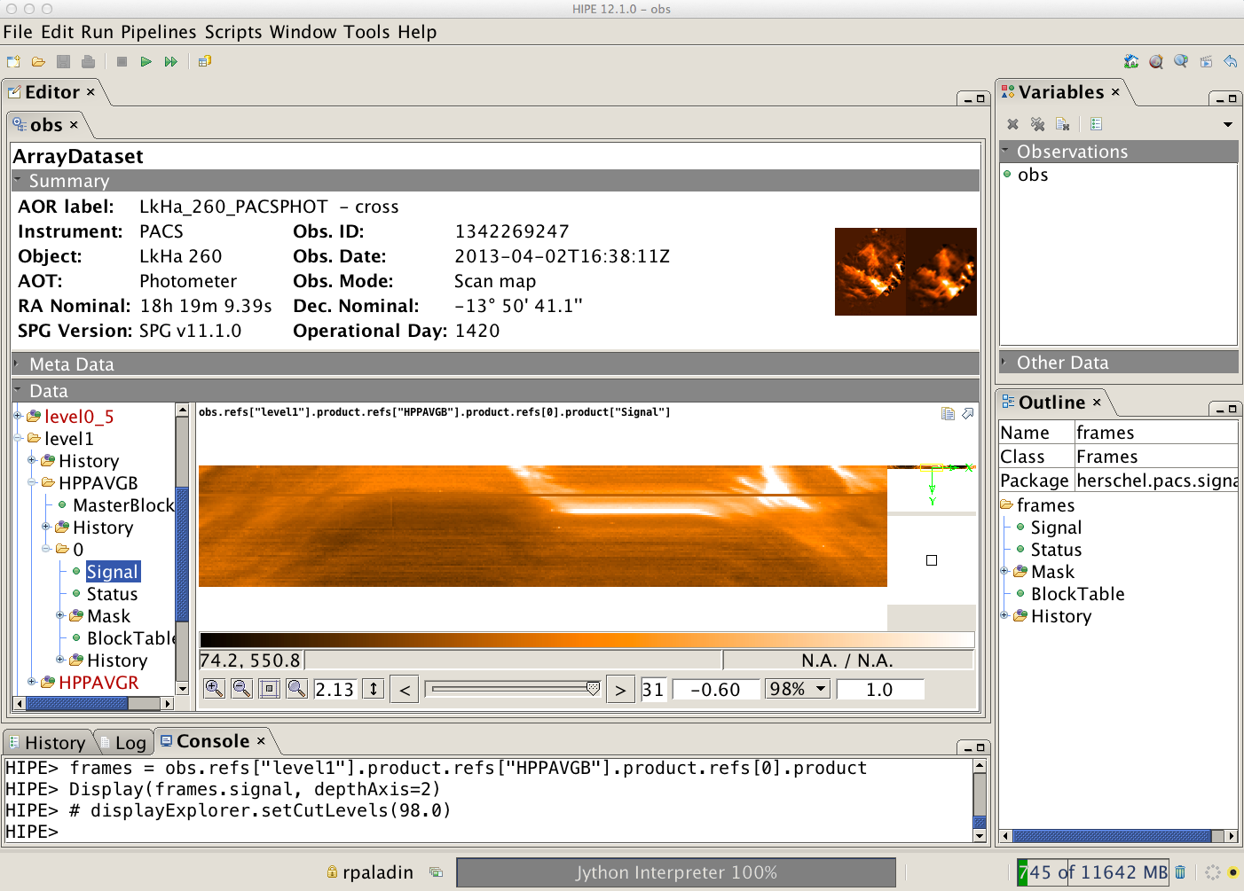
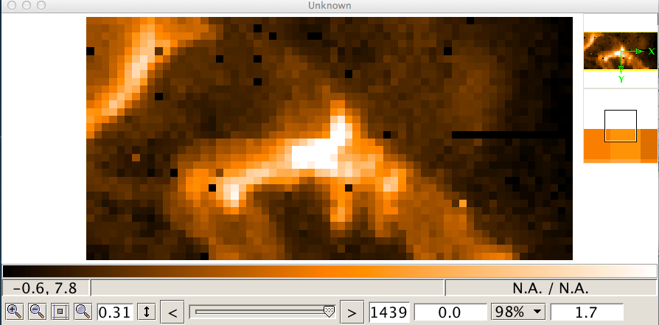
Level 1: calibrated frames
This is the starting point for reprocessing your data
Spatial frame at a time sample
NHSC PACS Webinars – July 2014

Slide 24
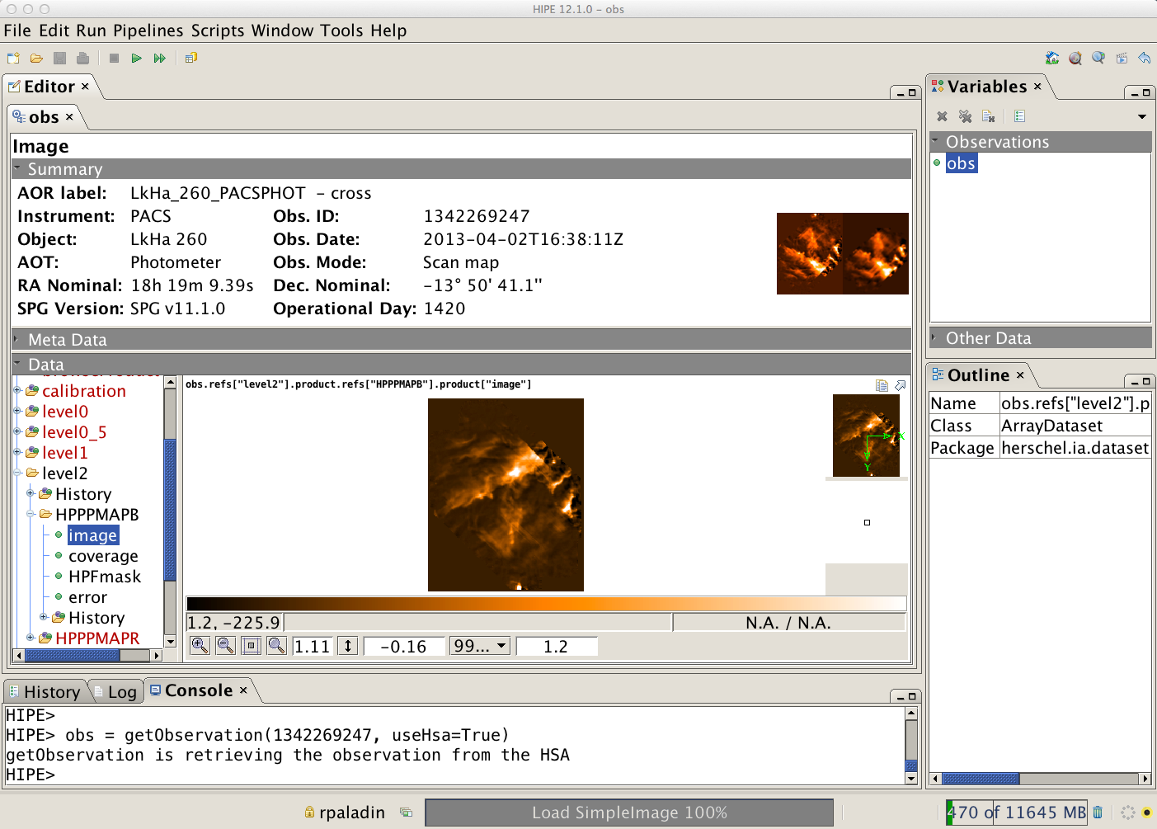
Level 2: per-OBSID map
NHSC PACS Webinars – July 2014

Slide 25
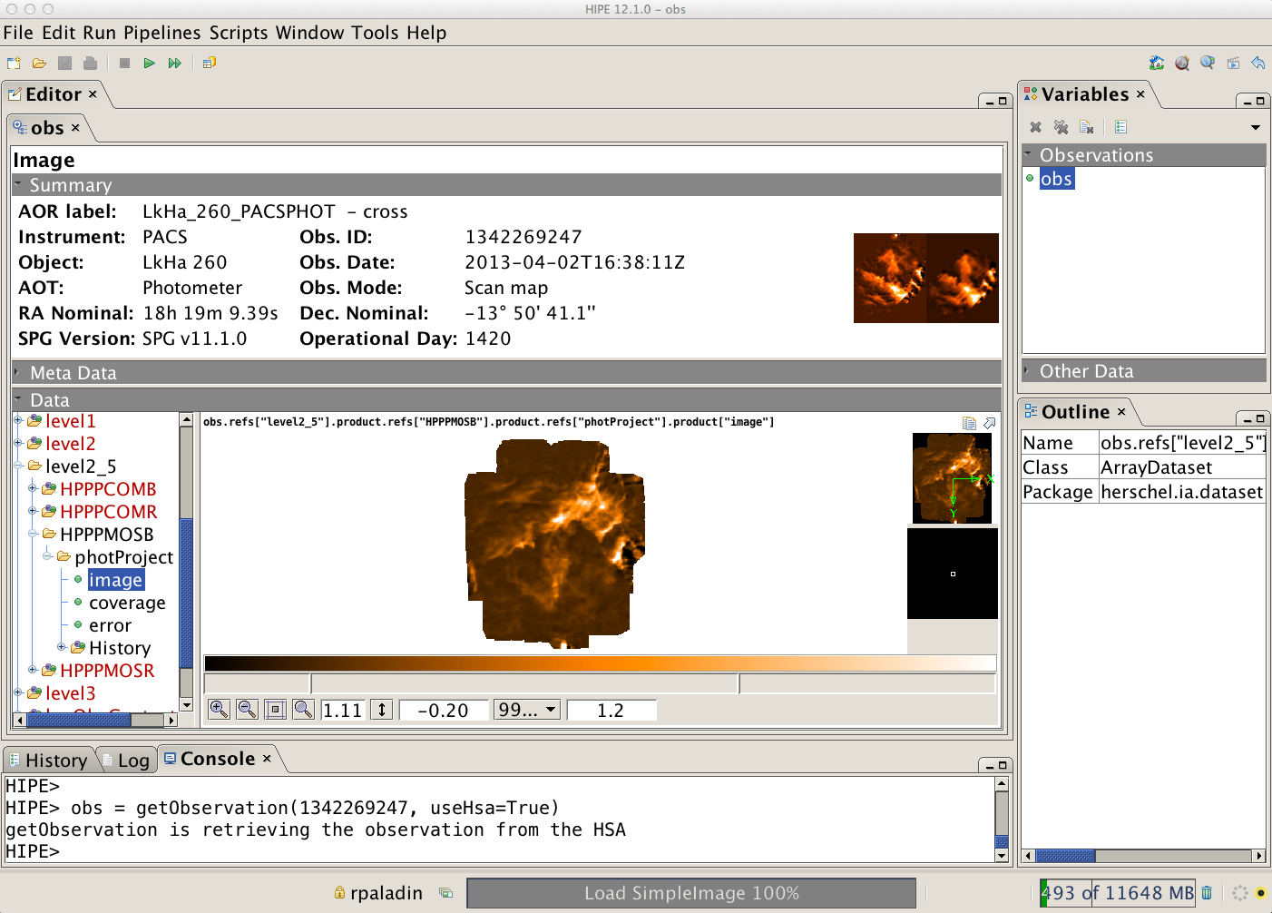
Level 2.5: OBSID pair (scan/X-scan) HPF map
NHSC PACS Webinars – July 2014

Slide 26
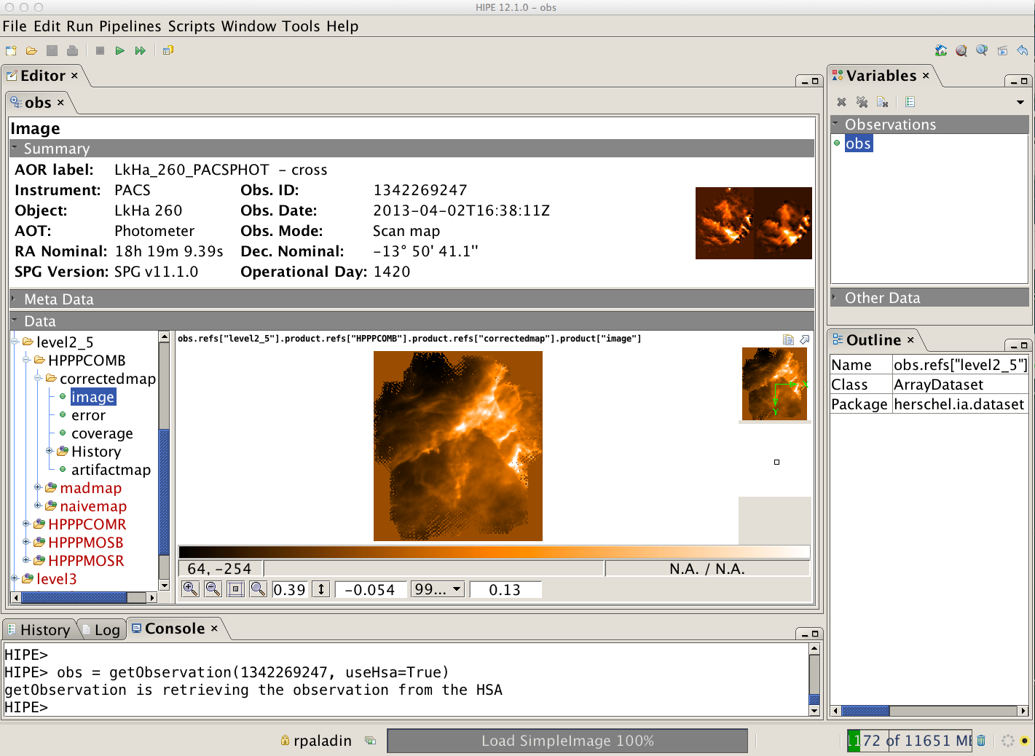
Level 2.5: OBSID pair (scan/X-scan) MADMap map
NHSC PACS Webinars – July 2014

Slide 27
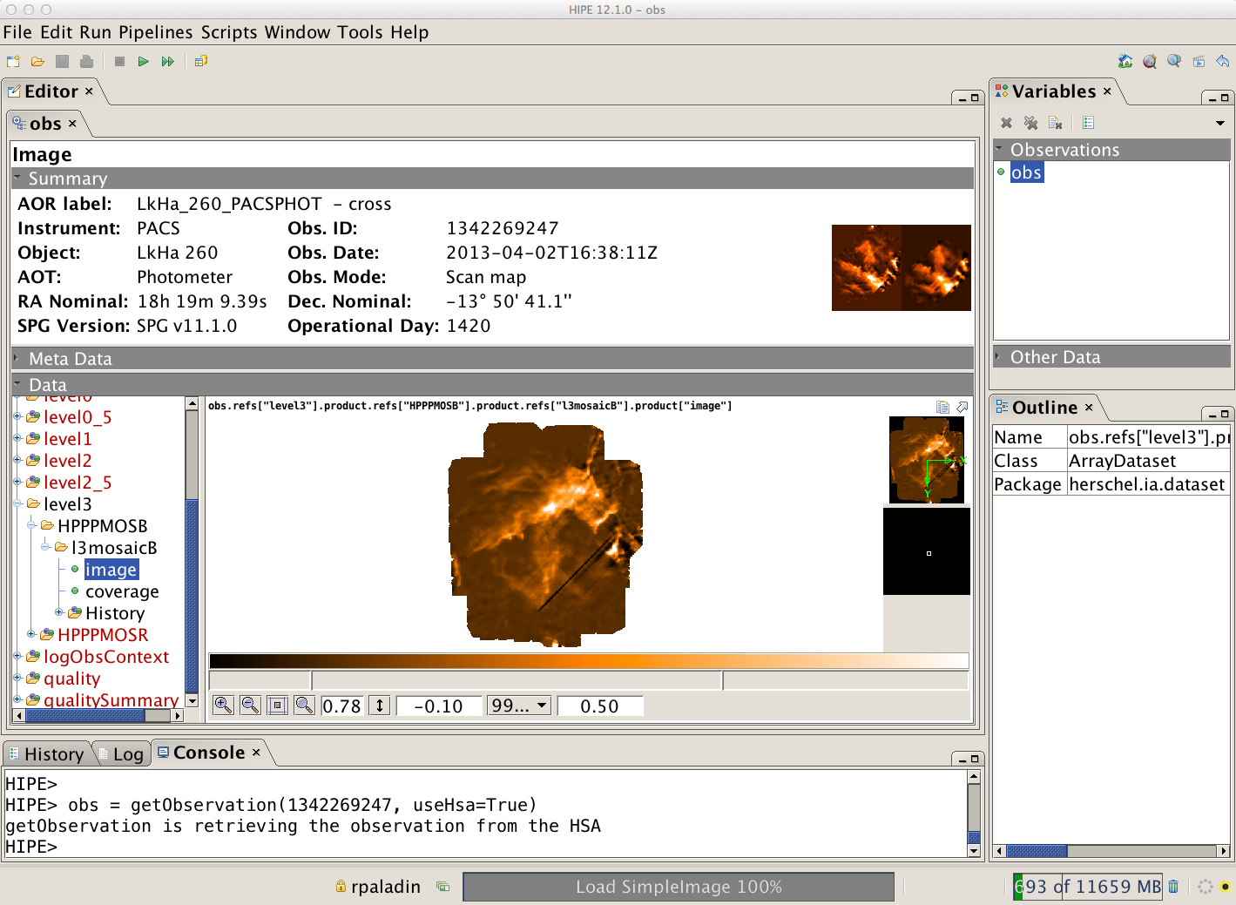
Level 3: all OBSID pairs from the same program / HPF
NHSC PACS Webinars – July 2014

Slide 28
Summary of PACS photometer archived products
level 0:
HPENG: engineering
HPGENHK: housekeeping
HPPAVGB/HPPAVGR: Herschel PACS Photometer Averaged Blue/Red Data (→ “Signal” in /0)
HPPDMCB/HPPDMCR: raw data (blue/red)
HPPHK: housekeeping
level 1:
HPPAVGB/HPPAVGR: Herschel PACS Photometer Averaged Blue/Red Data (→ “Signal” in /0)
level 2:
HPPPMAPB/HPPPMAPR: Herschel PACS Photometer Phot-project Map Blue/Red
(→ “image”, “error”, “coverage”)
level 2.5:
HPPPCOMB/HPPPCOMR: Herschel PACS Photometer Combined MADMap Blue/Red
(→ “image”, “coverage”, “error” in /correctedmap, /madmap, /naivemap)
HPPPMOSB/HPPPMOSR: Herschel PACS Photometer Phot-project Mosaic Blur/Red
(→ “image”, “coverage”, “error” in /photProject)
level 3:
HPPPMOSB/HPPPMOSR: Herschel PACS Photometer Phot-project Map Blue/Red
(→ “image”, “error”, “coverage”)

Slide 29
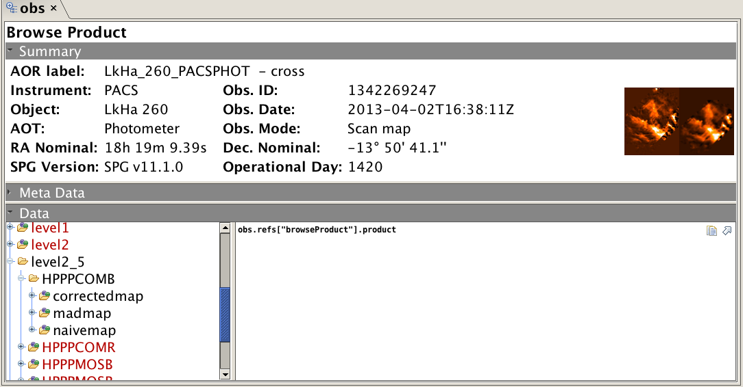
Note about MADMap products
(..this is a recurrent question)
These 3 products are different flavors of MADMap maps and correspond to different levels of the MADMap processing
correctedmap: MADMap map after PGLS correction
madmap: MADMap map before PGLS correction
naivemap: MADMap naïve map, i.e. map not corrected for uncorrelated 1/f noise
but corrected for drift

Slide 30
Heads up: different photometer products in the HSA soon..
{
SPG 11.1
Photometer Products:
HPF (up to Level 3)
MADmap (Level 2.5)
SPG 12.1
(i.e. current bulk-reprocessing)
{
Photometer Products:
HPF (up to Level 2.5)
JScanam (up to Level 3)
MADmap (up to Level 3)

Slide 31
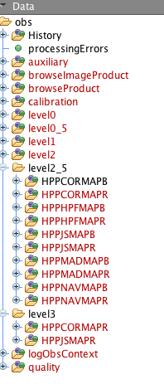
SPG 12.1
Heads-up !
New products names in SPG 12.1
}
MADMap (corrected map)
}
HPF
}
JScanam
}
MADMap (madmap map)
}
MADMap (naïve map)

Slide 32
PACS Photometer:
Calibration

Slide 33
Photometer:
Point-source flux calibration is estimated from a set of 5 fiducial stars (primary calibrators). Additionally, a set of asteroids and planets is also used (secondary calibrators);
Based on this set of calibrators, the point-source flux calibration error is ~5% in all bands, with 1-2% reproducibility;
http://herschel.esac.esa.int/twiki/bin/view/Public/PacsCalibrationWeb

Slide 34
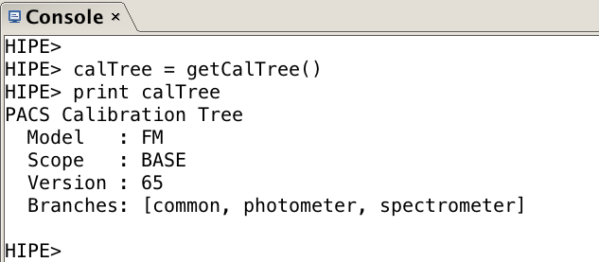
PACS calibration tree (calTree)
http://herschel.esac.esa.int/twiki/pub/Pacs/PacsCalibraBon/The_PACS_CalibraBon_Framework_-.‐_issue_0.13.pdf
The calibration tree is a tree-like structure which points to all the calibration products
The PACS calibration tree has three branches:
1) common
2) photometer
3) spectrometer

Slide 35
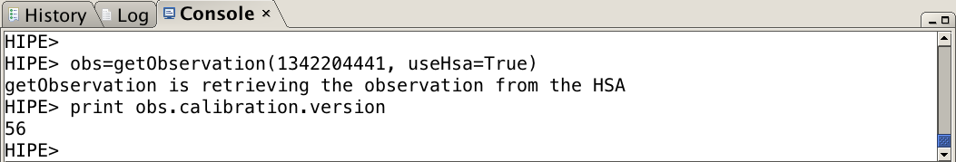
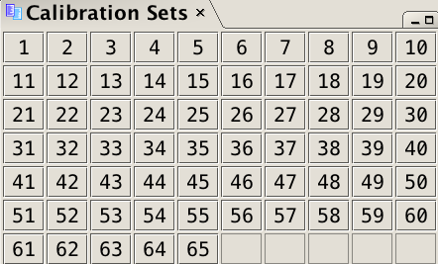
IMPORTANT
One of the most important reasons to reprocess your PACS data is to make sure that you are using the latest versions of the calibration files. This is true for both the photometer and spectrometer
To check the calibration files version of the data downloaded from the HSA, first load your OBSID into HIPE and then type the command below:
Compare the number you get (e.g. 56) from running the command above with the last number (e.g. 65) showing in the Calibration Sets table in HIPE
Window → Show View → Workbench → Calibration Sets

Slide 36
Documentation

Slide 37
PACS Observer’s Manual (last update: July ‘13)
http://herschel.esac.esa.int/Docs/PACS/pdf/pacs_om.pdf
PACS Data Reduction Guide: Photometer
http://127.0.0.1:8082/print/pacs_phot/pacs_phot.pdf#pacs_phot
NHSC PACS tutorials:
https://nhscsci.ipac.caltech.edu/sc/index.php/Pacs/DataProcessing

