Slide 1
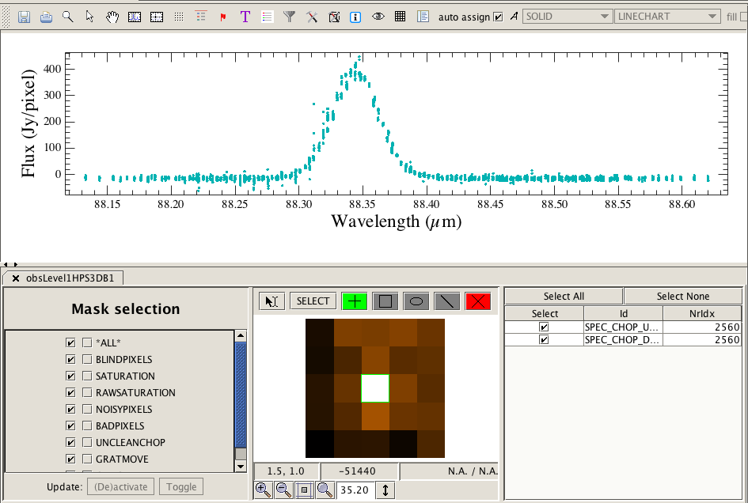

A Tour of HIPE’s Spectrum Explorer (SE) for all 3 instruments
Pat Morris
HIFI Task Lead

Slide 2
What is SE?
If you have spectroscopic observations that you wish to inspect or manipulate in HIPE, you will use the SE. It has many bells and whistles.
Once appropriate data from any of PACS-S, SPIRE-FTS, or HIFI are loaded into your HIPE session, the SE offers an environment for
  displaying the data and their attributes,
  access to “built-in” toolboxes for manipulating and fitting spectra.
It opens very easily, and handles differences in spectral attributes between instruments (e.g. units, flagging, data selection).
It can display single or multiple spectra, including spectral cubes.
It can also display non-Herschel spectra, as long as they have been imported into a product format recognizable to SE.
It is not a plug-in or standalone environment, thus cannot be run outside of HIPE.

Slide 3
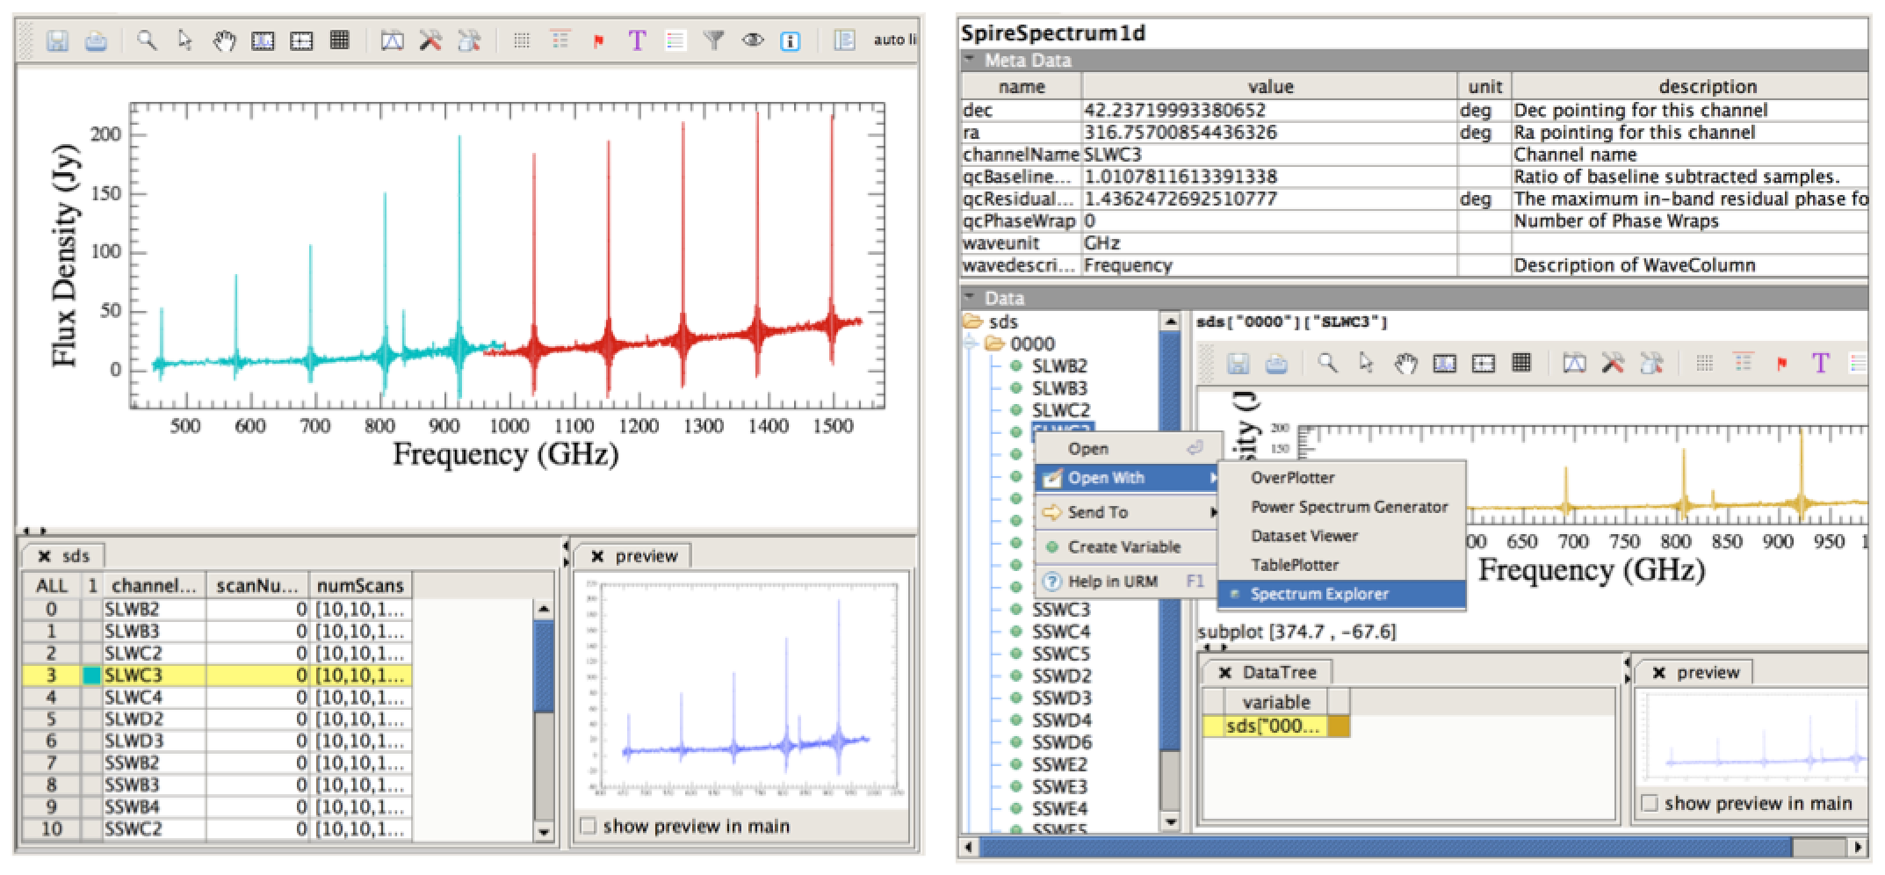
How to open SE on a spectroscopic observation
With any observation context for a spectroscopic observation loaded into HIPE, you can navigate in the Context Viewer down to the products containing the spectral datasets, and right click to open SE.
E.g., for SPIRE it looks like this:
Alternatively, if you have a spectral product or dataset defined as a variable, you can do the same thing from the Variable View in HIPE.
From the command line: HIPE> myPlot = openSE(MySpectrum) or openSE(MyCube)

Slide 4
The SE View
The main attributes of the SE view are
  A main plot area
  Data selection panel (what to put in the main plot)
  Preview panel, especially useful for cubes.
  A toolbar, giving access to functions and toolboxes.
1
2
3
4
4
The Data Selection panel will look different for each instrument.
SPIRE PACS
1
3
2

Slide 5
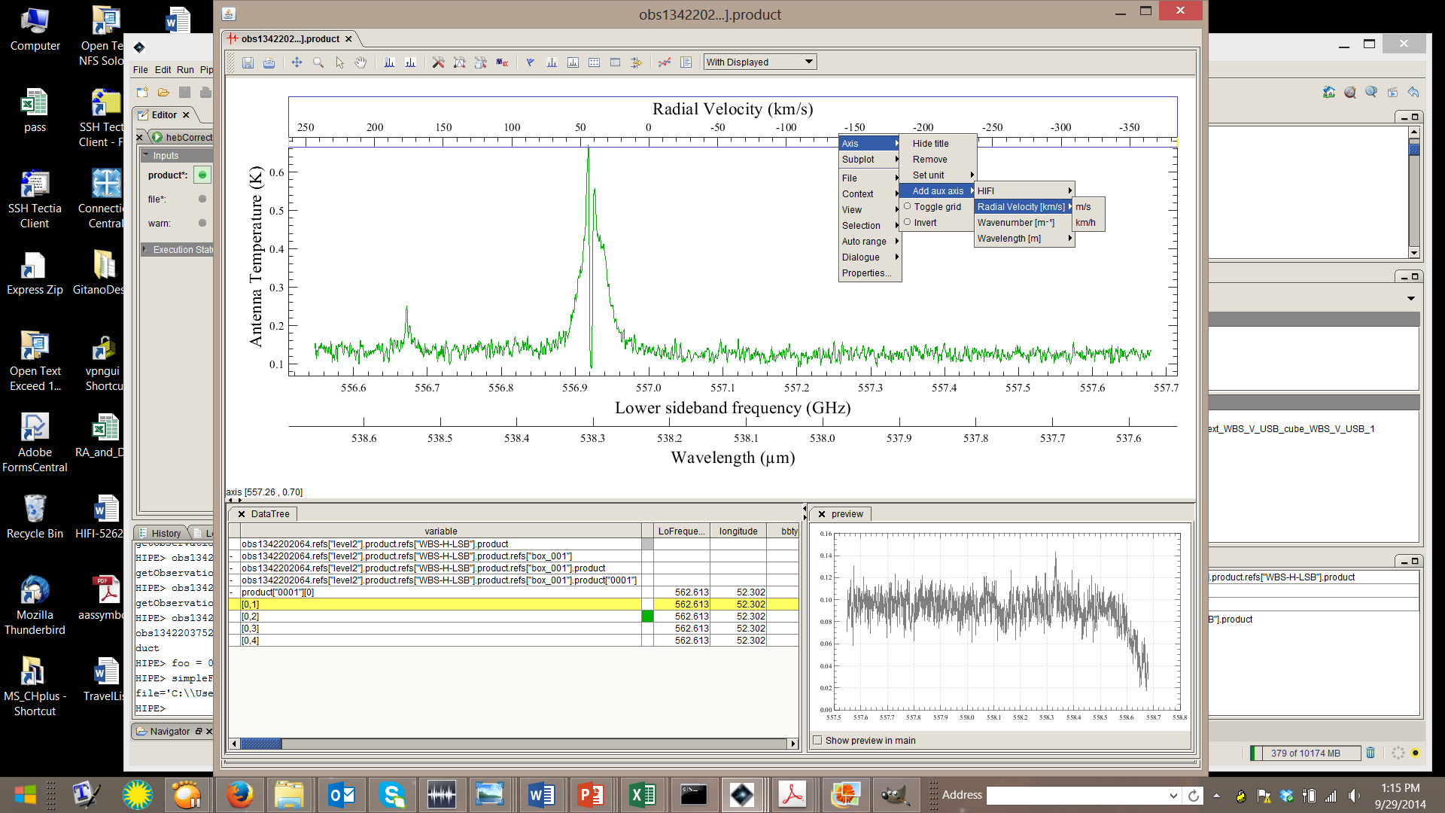
Plot manipulation
Zooming and panning on spectra in the main plot window is very easy, using selections and in the toolbar. SE default is zoom.
Auxiliary axes can be added anywhere around the plot.
  Most common are different wavelength or frequency scales, or a velocity scale set by a user input reference wavelength or frequency.
Right click on one of the main axes where you wish to add an aux axis.

Slide 6
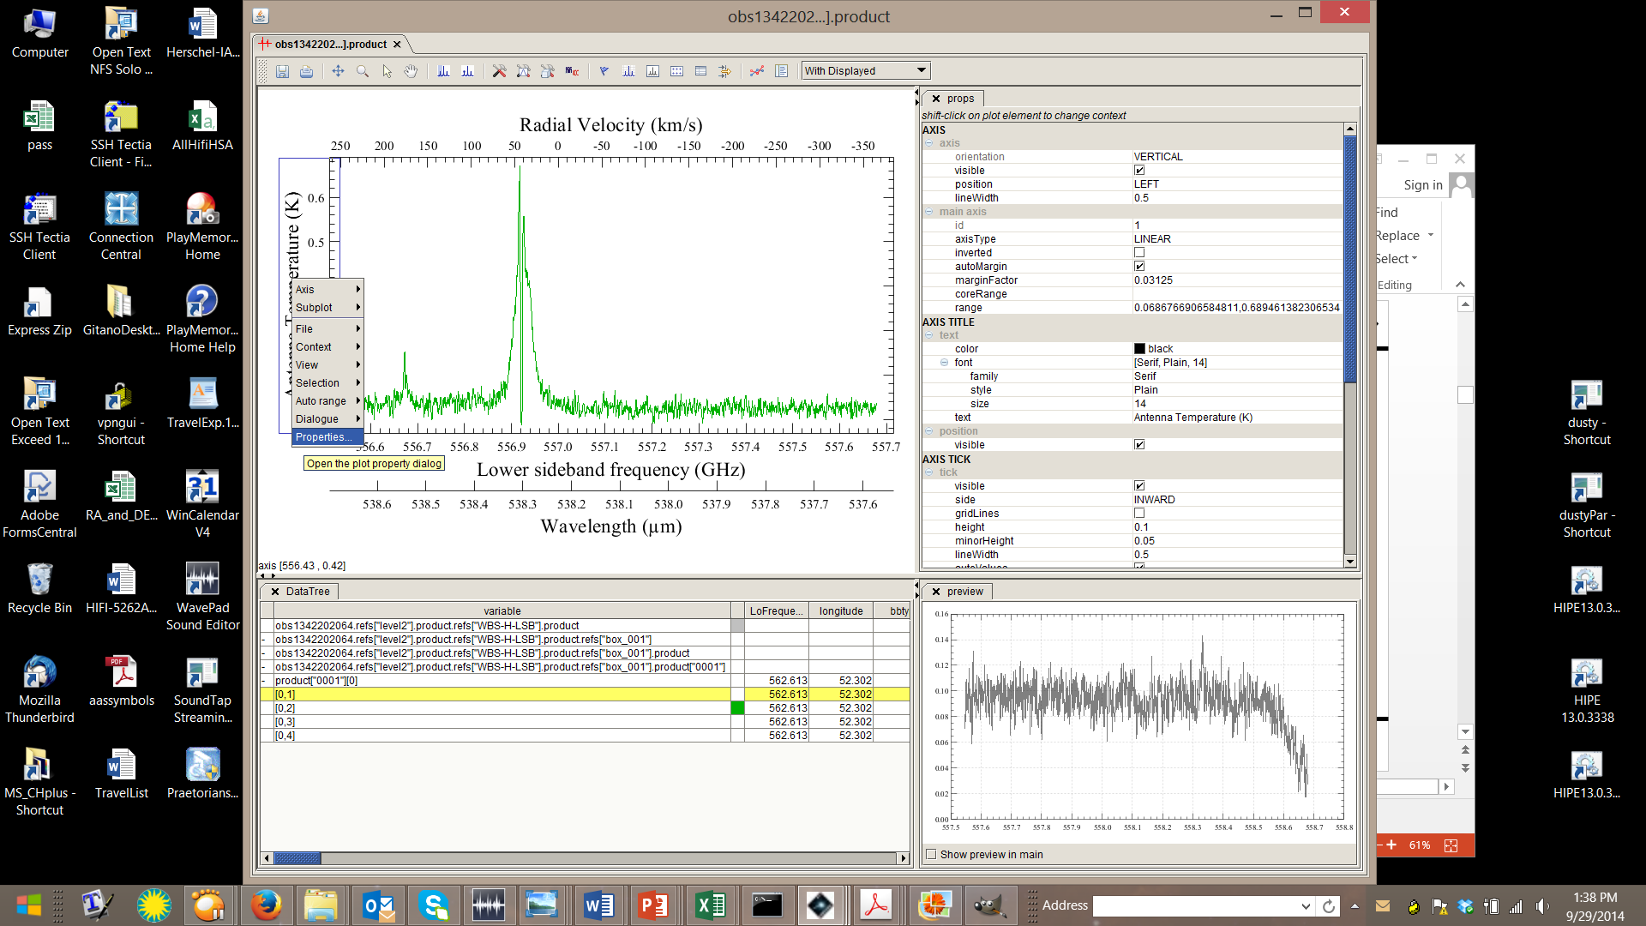
Changing Plot Properties
SE attempts to read appropriate units and set scales, labels, ticks, etc, automatically. You may wish to change any of these.
This is most easily (but not trivially) done in the Plot Properties dialog by selecting in the toolbar, or right click inside either the plot panel for general properties, or on an axis to change labels, titles, ticks, etc.

Slide 7
Spectral Cubes have a different view in SE
The HIPE Cube Viewer is integrated into the Data Selection Area.
The Cube Viewer offers scrolling through the frequency / wavelength axis with a scroll bar.
By right mouse click on the 2D display, the layers can be ‘blinked’ (played, similar to DS9), and individual layers can be extracted as a SimpleImage into HIPE.
Different color tables and intensity scales are available.
SE adds the ability quick look ability to see full spectra from individual pixels/spaxels with the mouse cursor.

Slide 8
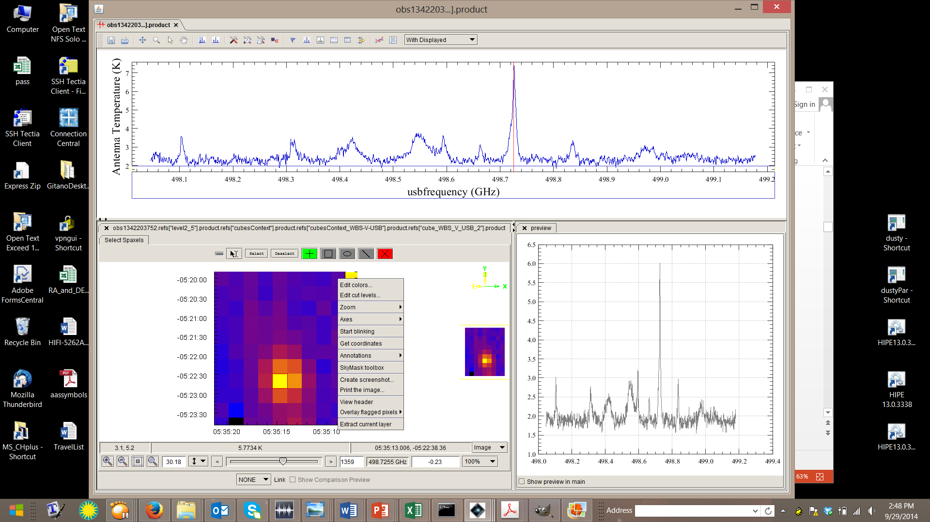
SE Cube View
The red vertical line indicates the frequency (wavelength) plane which is being viewed in the Cube Viewer.
This spectrum corresponds to this left-clicked pixel.
Multiple pixels can be selected, and spectra are overplotted.
The Preview area shows the spectrum at the position of the mouse cursor in the Cube Viewer.

Slide 9
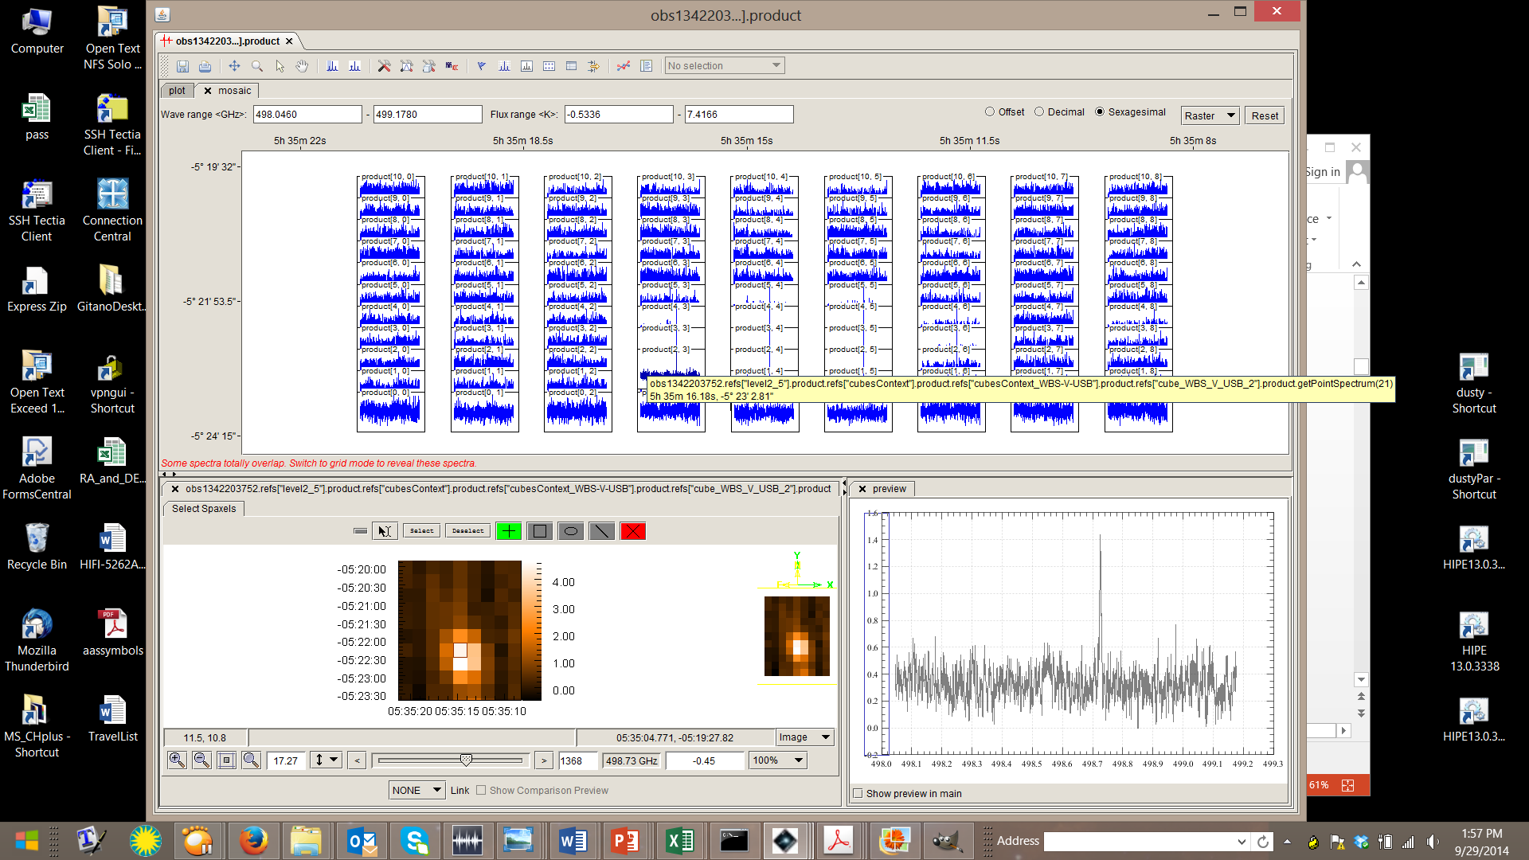
The mosaic view for cubes
On the toolbar , or by right click inside the plot area, SE has a nifty mosaic function for showing all the individual spectra in a cube. Can be done as a grid ordered by index, or by location on the sky, or as a raster.

Slide 10
Toolboxes in SE
Several toolboxes which can be opened from the HIPE Task View or on the command line are also plugged into SE, accessible from the toolbar.
In fact when these tools are opened from HIPE Task View or command line, a new instance of SE is opened for that purpose.
These toolboxes are:
  The Spectrum Toolbox
  The Spectrum Fitter GUI
  The Cube Spectrum Analysis Toolbox
    The CSAT contains cube-level applications from the Spectrum Toolbox and SFG.
Pat demo on Thursday.
Phil demo next.

Slide 11
Documentation
Help is available with HIPE documentation.
http://herschel.esac.esa.int/hcss-doc-12.0/
See mainly Sec. 5.3 of the Herschel Data Analysis Guide.
More is variously contained in each instrument’s Data Reduction Guide (DRG) or Data Analysis Guide (DAG).

