Slide 1





HIFI Intro Webinar
Aug 24, 2014
HIFI Spectral Maps
Pat Morris (NHSC)

Slide 2


Topics
Familiarity with HIFI’s mapping modes
Inspection
Cleaning the input spectra (baselines)
Regridding
Cube toolbox
Image analysis
Line fitting with the spectrum fitter tool

Slide 3
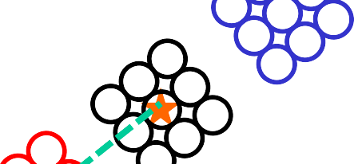

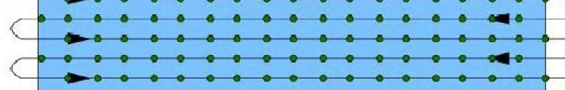



The Mapping AOTs schematically
DBS raster map On-the-fly Mapping
OFF2
Sampling:
Fixed: 10, 20, 40”
Half-beam Nyquist
ON1/ON2
3 arcmin
Sampling:
Fixed: 10, 20, 40”
Half-beam Nyquist
Possible referencing scheme:
Position Switching (“standard” OTF),
≤ 2 deg
OFF
OFF1
Load-Chop, Frequency Switch (Sky REF optional)
The main purpose of the OFF positions is to provide baseline removal of drift + standing waves.
The OFFs may sometimes be contaminated with line emission (most often CO and [CII], sometimes others because of the fixed DBS throw). You can check for this in the data --- response calibrated OFF spectra part of the data tree in HIPE ≥ 13.
The OFFs may sometimes not fully correct the ripples, due to short Allan times (rapid drift cross-over from radiometric noise).
- page 3

Slide 4
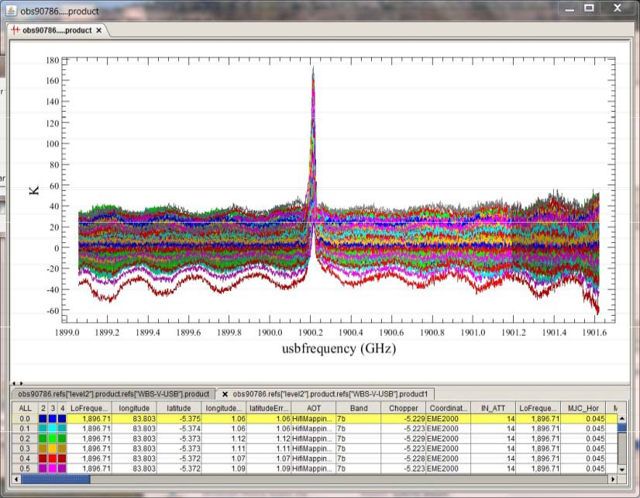
C⁺ + 1900 GHz + continuum + drift

Slide 5


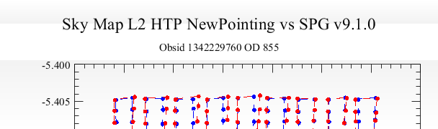
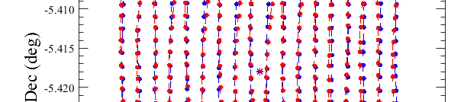
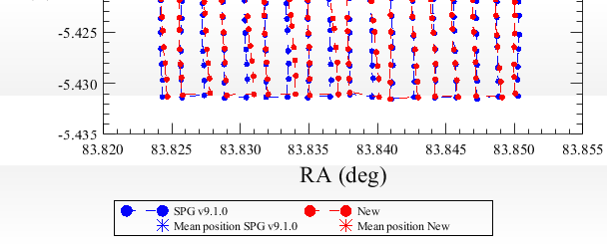
Effects of imperfect line scanning on OTF maps
Drift and slew effects (over- / under-shoot after slews) producing departures along the intended scan path.
Improvements in pointing reconstruction, better jitter characterizations, provide more reliable WCS in gridded cubes.

Slide 6

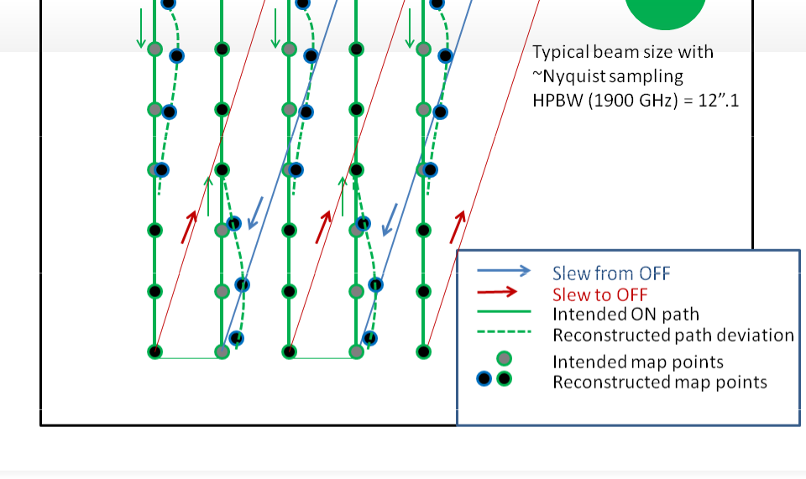
Our current picture
The “zig-zag” has components of slewing errors (not due to timing errors in HIFI).
Errors are projected in both α and δ.
The deviations are clearly correlated with the slews from OFF, Looks like slew → deceleration → scan transition bugs.
- page 6
6

Slide 7

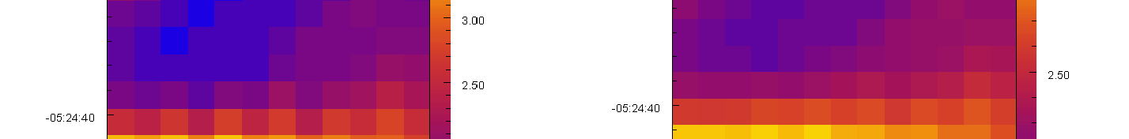
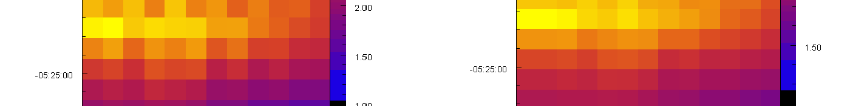
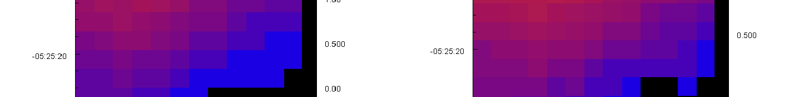
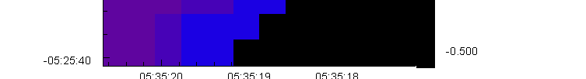

Impact of the anomalous line scanning
The consequence is that sampling requested in HSpot is not perfect.
New pointing reconstruction available in HIPE 13 for re-assignment of attitudes, will reduce “zig-zag” pattern noise.
will exhibit a form of “zig-zag”
Visually a significant improvement!
Spectral cuts taken here (next slide)
- page 7

Slide 8
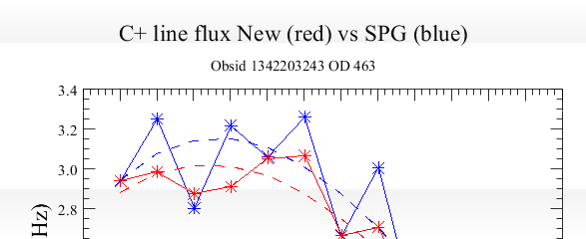
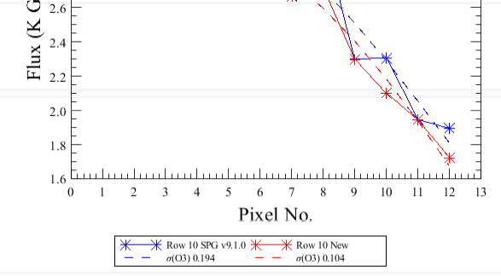
The new pointing history reduces the zig-zag
C+ line fluxes in spectra extracted from the cube in a slice across the Orion Bar.
Red is based on New pointing and shows ~2x lower noise around an approximating (3rd order) fit to the flux gradient across the PDR.
- page 8
8

Slide 9
Browsing Map Products
This is a tour. A detailed set of tutorials using HIPE will be given in NHSC’s workshop for newcomers in October.
Today:
  Load a H₂O and ¹³CO OTF map of massive SFR W51.
  Inspect metadata for the map layout on the sky, noise performance parameters.
  Visually ID “artifacts” in the Level 2 spectra.
  More discussion of artifacts (ripples).
  Regrid into spectral cubes.
  Show the Cube Spectrum Analysis Toolbox (CSAT)
  Highlight some image analysis tools.

Slide 10
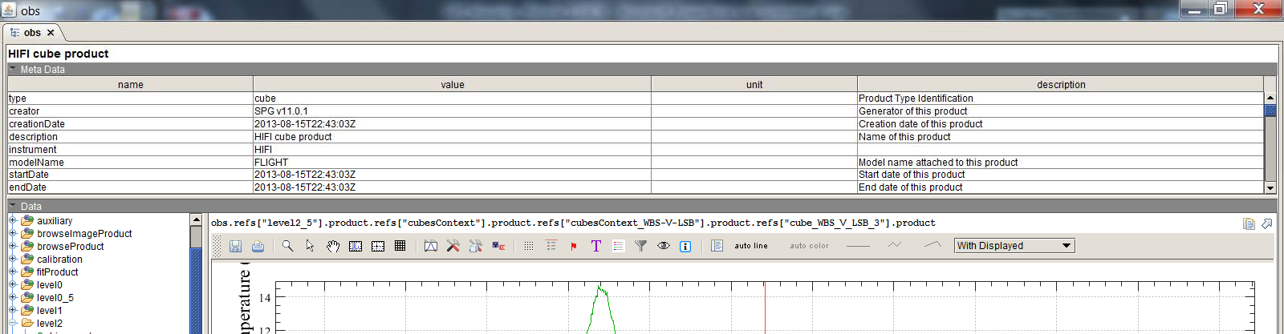

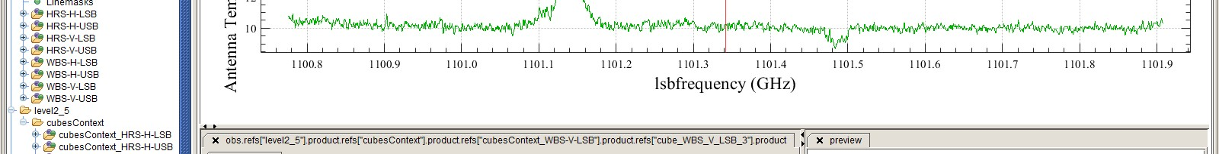

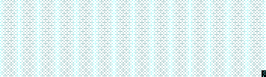
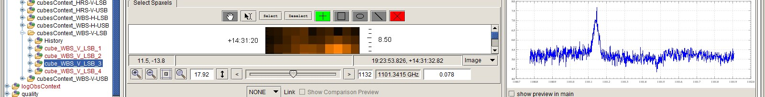

2. Browsing the data
Familiarizing with the data tree for a spectral map, inspection of the Level 2 HTPs in Spectrum Explorer (for data quality / artifacts), and locating the metadata that describe the map pattern and expected noise.

Slide 11
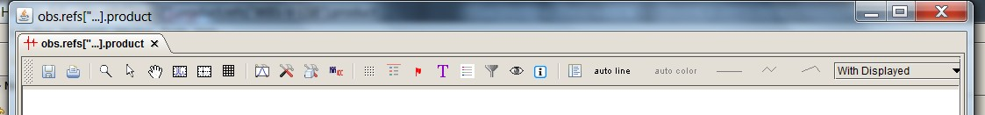
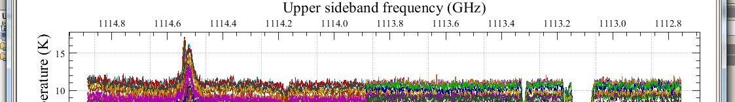
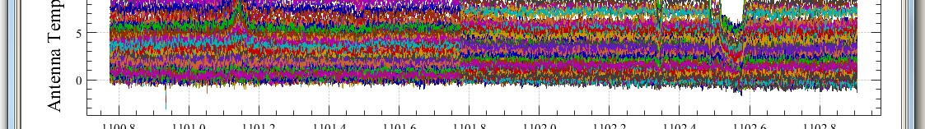
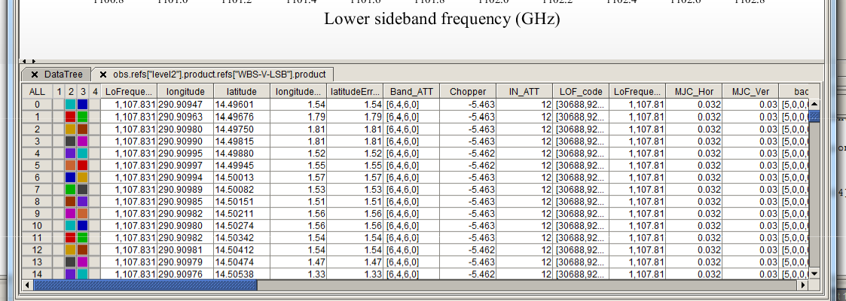
2. HTP inspection
H2O 1(1,1)-0(0,0)
Strong continuum!
13CO 10-9

Slide 12
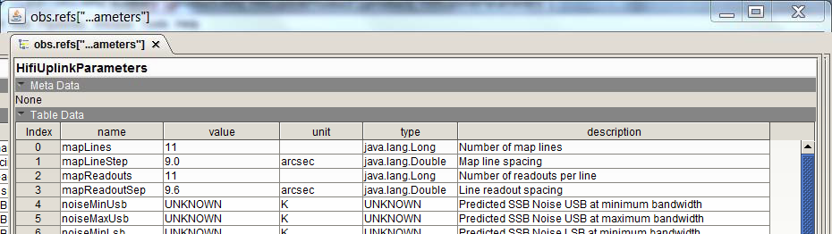
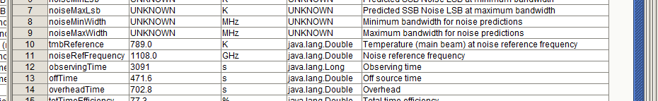
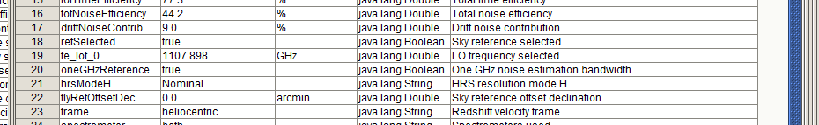
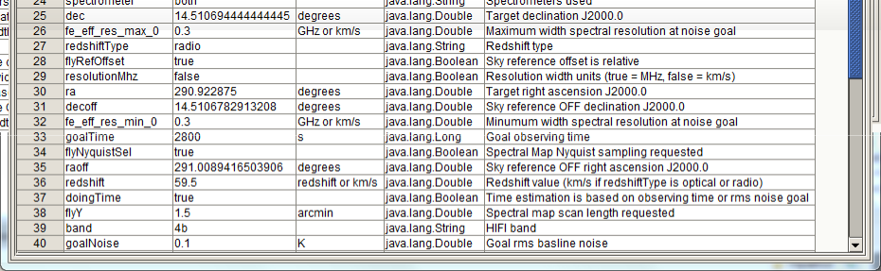
2. Important metadata
obs.refs["auxiliary"].product.refs["HifiUplinkProduct"].product["HifiUplinkParameters"]
Selected key parameters
are also stored in the observation context header.
Esp. for advanced searches in the HSA.

Slide 13
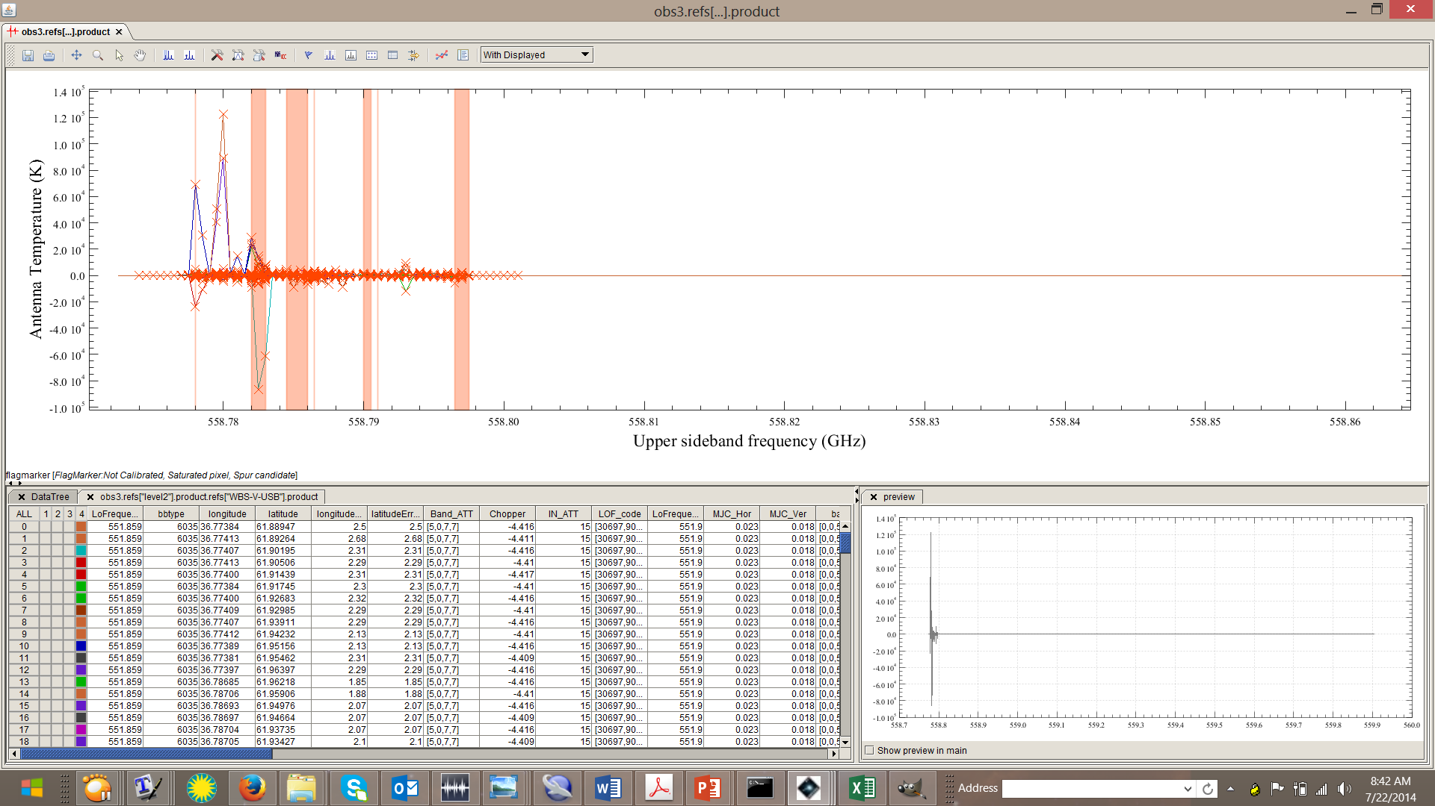
3. Artifacts in Maps
Many maps are well-behaved. Some cases (treatable) that may come up:
1. Spurs or spurious response.
  Cataloged and visualizable in HSpot. Some are mission phase dependent.
  Some unruly but important LO freqs were stabilized by tuning mixer currents, gains.
  Normally avoided during observation planning of the selected LO setting, unless the feature was not known at the time, or the user had no options (or simply missed the warning).
  Mitigations: these regions are masked out during ripple fitting + correction. However only saturated IF frequencies are avoided during map (spatial) convolution.
An early ugly case near H2O 110-101 557 GHz
Band 1a. Has been since corrected in the instrument.

Slide 14
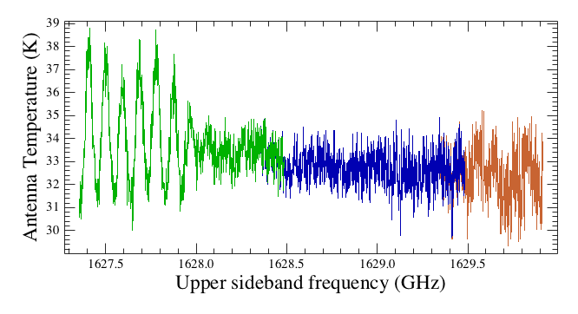
3. Artifacts in Maps – cont’d
2. Sub-band resonances.
  Also cataloged, visualizable in HSpot. These are more common in the HEB bands 6 and (less frequently) 7.
Band 6 isolated ripple usually in last 600-700 MHz of IF (sub-band 4).
Mostly in 6b but also exists in upper end of 6a and lower end of 7a.
Mitigations: might be treatable with the hebCorrection task --- under investigation.

Slide 15
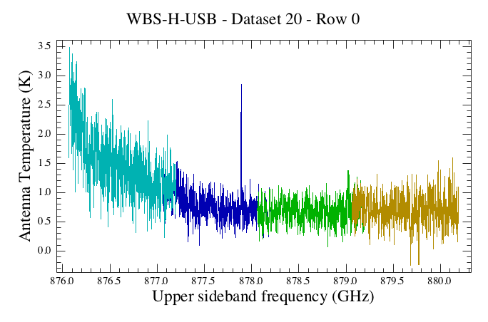
3. Artifacts in Maps – cont’d
3. Baseline distortions.
  Generally at unstable LO frequencies, but not accompanied by large increases in noise. Thus line information is still usable.
Typically in the diplexer bands (3, 4, 6, 7).
Mitigations: treatable with baseline fitting (fitBaseline task), but information on the continuum (if present) is likely to be lost.

Slide 16
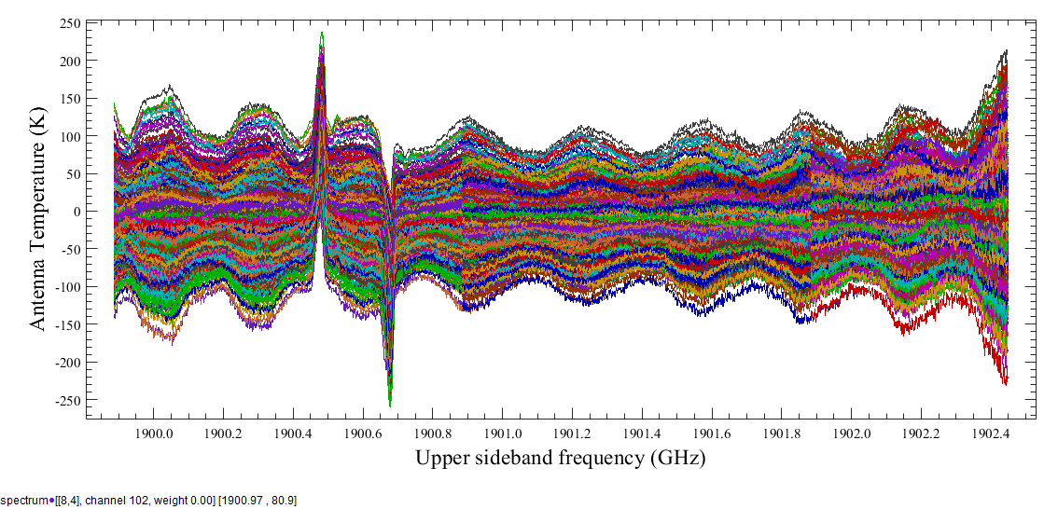
3. Artifacts in Maps – cont’d
4. Residual standing waves + drift.
More typical in bands, ranges, or at specific LO frequencies with instabilities or short Allan times.
  Map observing mode dependence is mainly in total power (OTF), if OFF calibration timing (sky and/or internal load measurements) do not well-match drift timescales.
  Also DBS Raster, if fast chop option was not used where high drift noise was expected.
  Mitigations: treatable with fitHifiFringe (sine waves, OK for optical standing waves), and hebCorrection task (non-sinusoidal electrical standing waves in Bands 6, 7) →
Band 7b, [CII] OTF map (frequency switching)
Note ripple amplitude increases with offset, phase reversal.

Slide 17
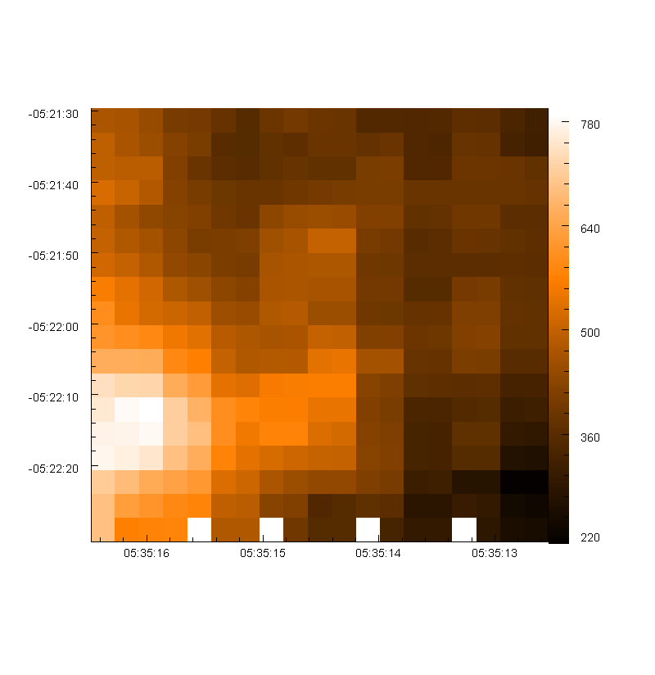
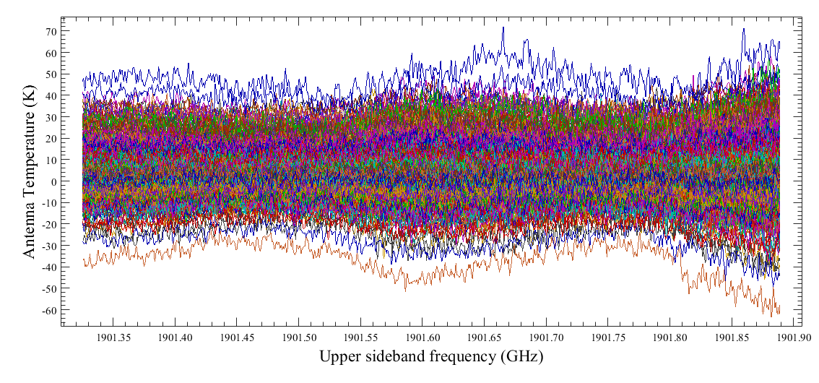
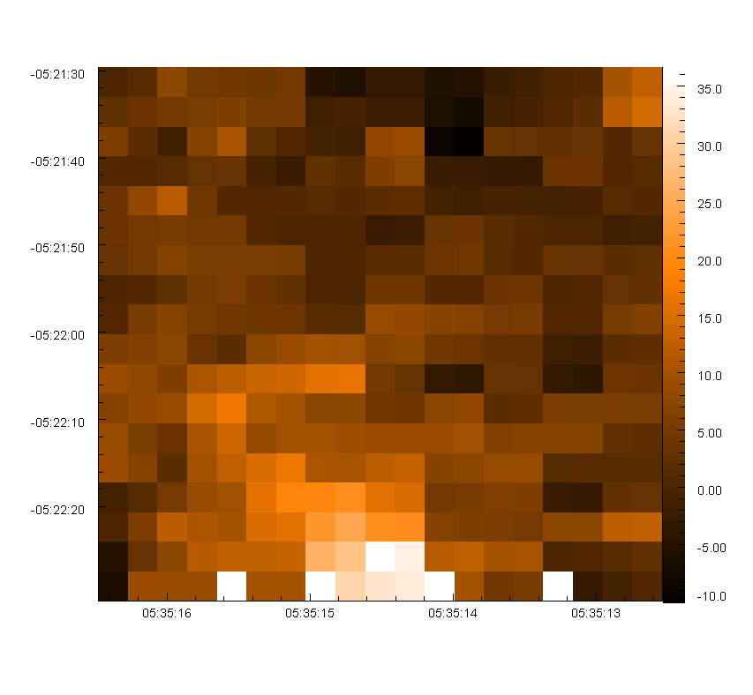
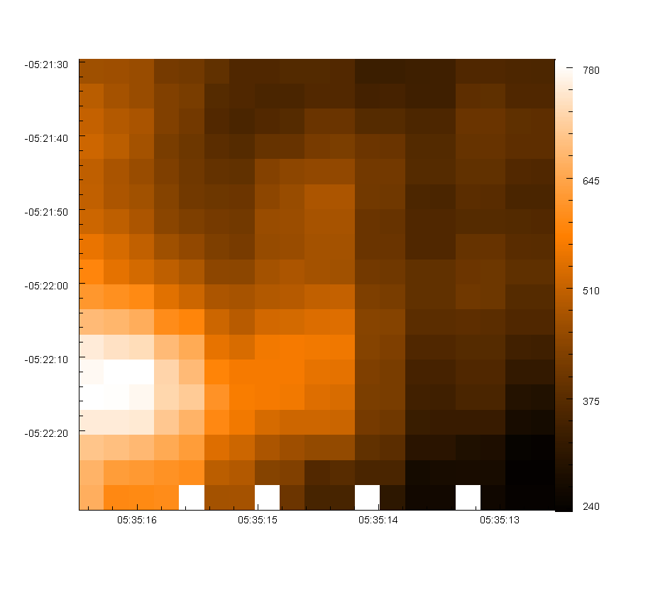
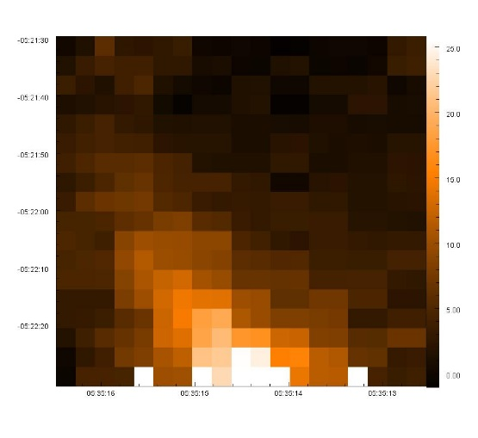
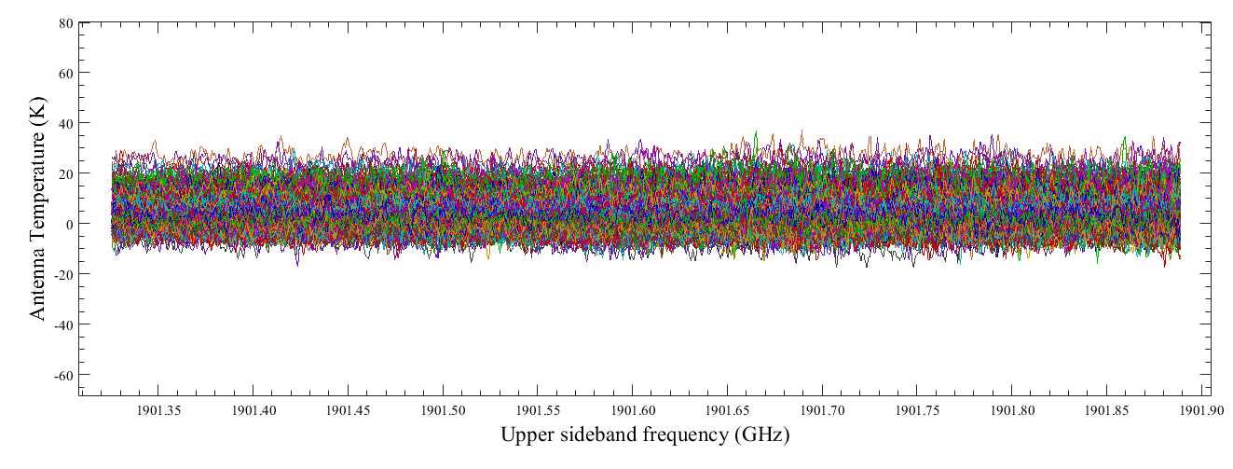
hebCorrection task
Level 2 WBS-V sub-band 2
HSA/SPG 11.1
Integrated C+
Integrated Continuum
hebCorrection HIPE 12.1

Slide 18
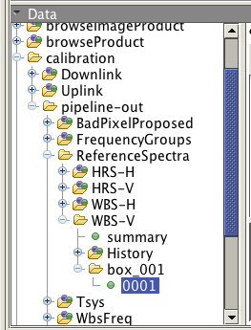
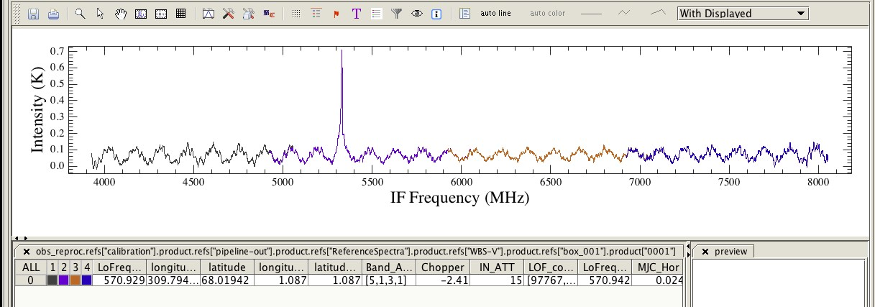

4. Other Non-Instrumental Effects
OFF-source (sky) contamination
  Observations using Position Switch (standard OTF, or in conjunction with either Load Chop or Frequency Switch), and DBS Raster (with 3 arcmin chop/nod to either side of the source) may sometimes pick up extended line emission, which becomes “chopped” from the ON-source data.
  Watch out especially for [CII], [NII], low-J CO.
HIPE 13

Slide 19
4. Other Non-Instrumental Effects
Pointing pattern noise
  In OTF observations, this is the “zig-zag”, caused by (a) problems with deceleration and transition to line-scanning; (b) low fidelity pointing reconstruction (deviations are smoothed over).
  Present to different degrees in other modes, easiest to visualize in maps.
  Mitigation: New pointing reconstruction algorithm uses gyro-drift estimation much better, resolves pointing history to better accuracy. The deviations don’t go away, but lower attitude history errors helps convolution.
  Better pointing products can be produced in HIPE 13, hopefully also in SPG 13/14 for the HSA.

Slide 20
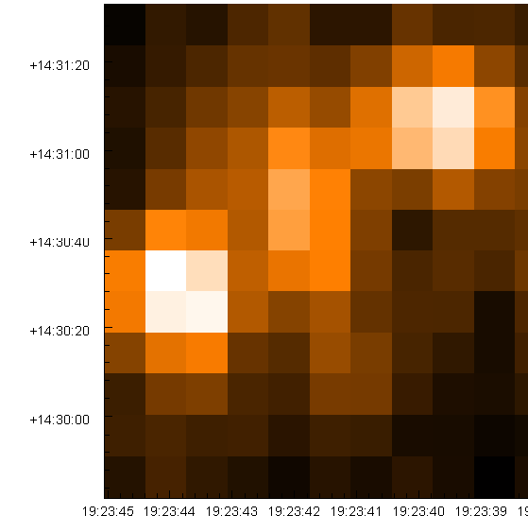
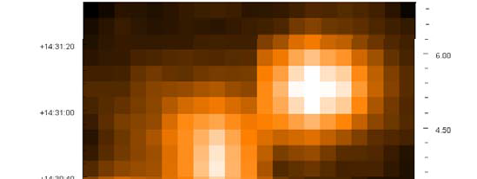
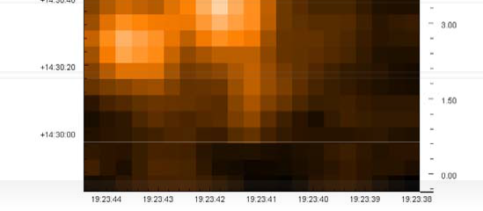
5. Resample with doGridding
S/N is good experiment with oversampling to ~2 x Nyquist.
  Remember that structures are resolvable to at least ~1/10 the beam size when S/N is very high.
  Noise is computed on a map point basis; does not take the convolution into account (thus generally better than predicted).
  Changing the pixel scale is the most common application, and we do not do a complete experiment with all possible parameters, e.g. altering WCS references. For this consult the HIFI DRG.

Slide 21
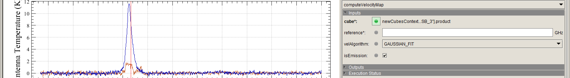
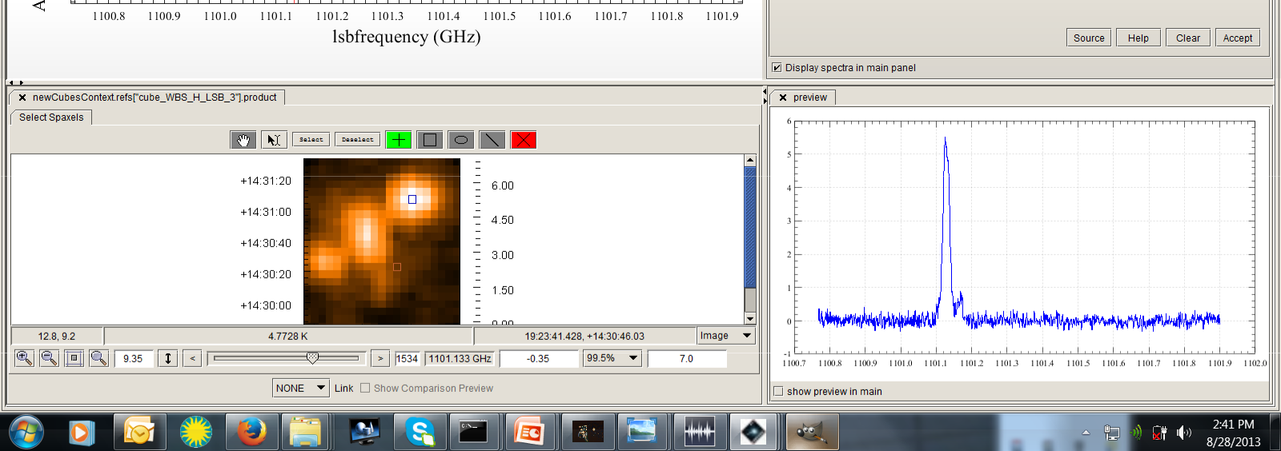
6. Cube Spectrum Analysis Toolbox (CSAT)
Can extract spectra in various apertures, crop in frequency, create a PV map, convert the cube units (GHz to velocity), make a velocity map, and integrated intensity map. We can also subtract baselines in the CSAT (not as sophisticated as fitBaseline, but a good means to create a continuum map).

Slide 22
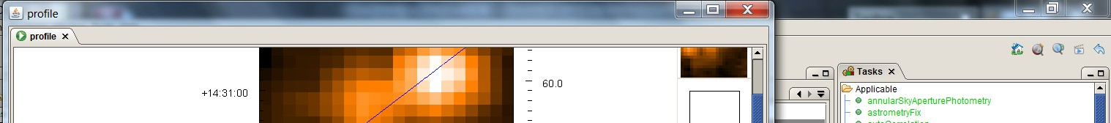
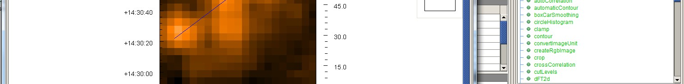
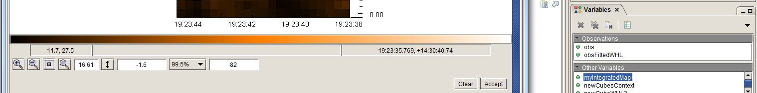
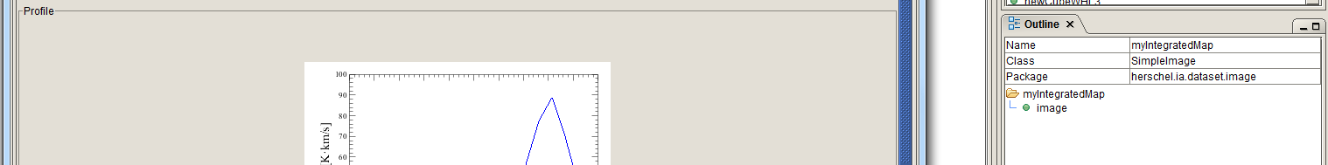
7. Image analysis
Image analysis tools have been developed by PACS/SPIRE, usable on any HIFI 2D map image.
Smoothing, contour overlays, source fitting, etc etc.

Slide 23
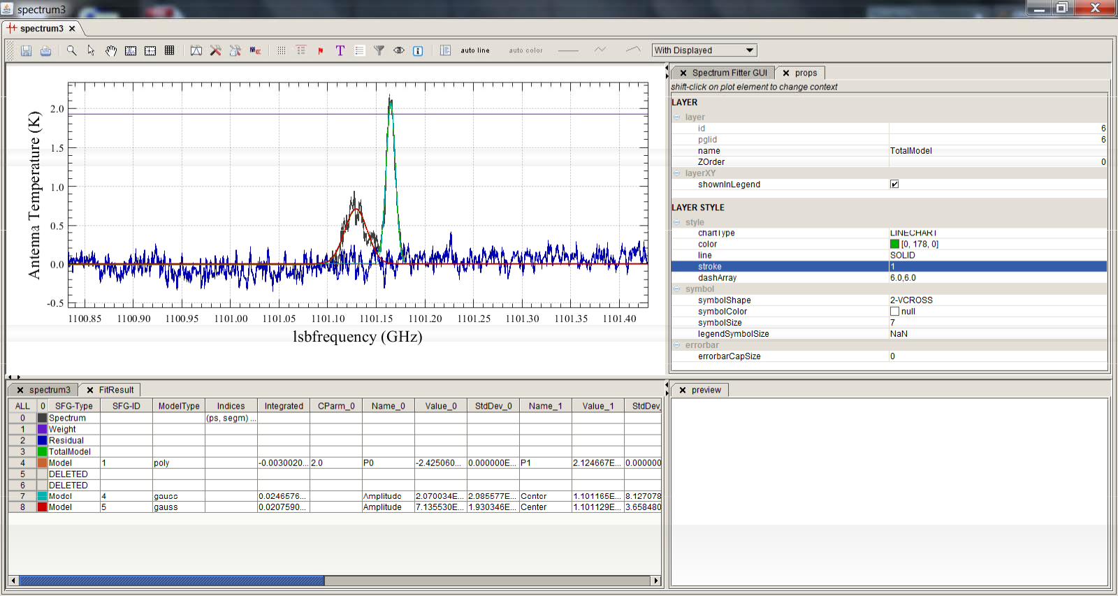
8. Line fitting: CSAT + Spectrum Fitter Toolbox (teaser)
Multi-component fitting can be done on individual spectra extracted from a cube, and applied to the entire cube if desired, creating products for each component.

