Slide 1
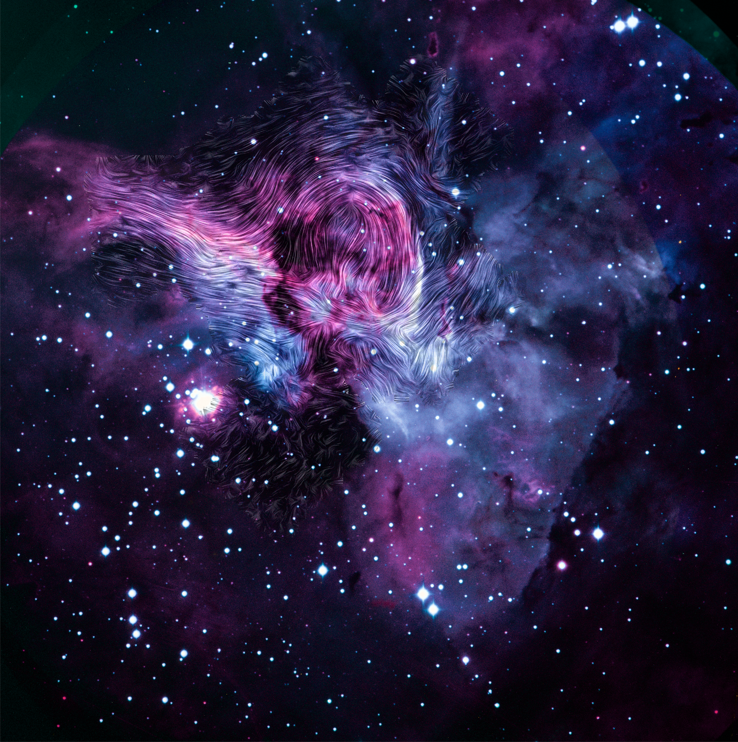


Role of Magnetic Fields in Cloud Destruction in the Keyhole Nebula
SOFIA/HAWC+ provided a detailed polarization map of the dust continuum emission of the Keyhole Nebula, an excellent testbed in which to study the role of magnetic fields in a cloud undergoing extreme stellar feedback. The observations reveal that the magnetic field orientation in the bar structure is almost identical to that of the large-scale magnetic field in the complex, while the magnetic field in the loop is not correlated with the large-scale field structure.
The orientation of the field in the region between the bar and the loop exhibits a fan shape that aligns with the direction of η Carinae's stellar wind. These features clearly demonstrate that the magnetic fields are disturbed by stellar feedback.
The results imply that while magnetic fields dominate during star formation, they play only a minor role in the cloud evaporation and destruction processes governed by stellar feedback.
Paper: “Probing Polarization and the Role of Magnetic Fields in Cloud Destruction in the Keyhole Nebula”
Seo, Young Min, et al., 2021/08, ApJ, 917, 57.
Image credit: NASA, the SOFIA science team, Y. Seo; ESO
Notes:
Paper DOI: http://doi.org/10.3847/1538-4357/ac0c80
High-res image link: https://www.sofia.usra.edu/sites/default/files/2022-01/SCI2022_0001.png
Science Spotlight: https://www.sofia.usra.edu/publications/science-results-archive/role-magnetic-fields-cloud-destruction-keyhole-nebula

