Slide 1
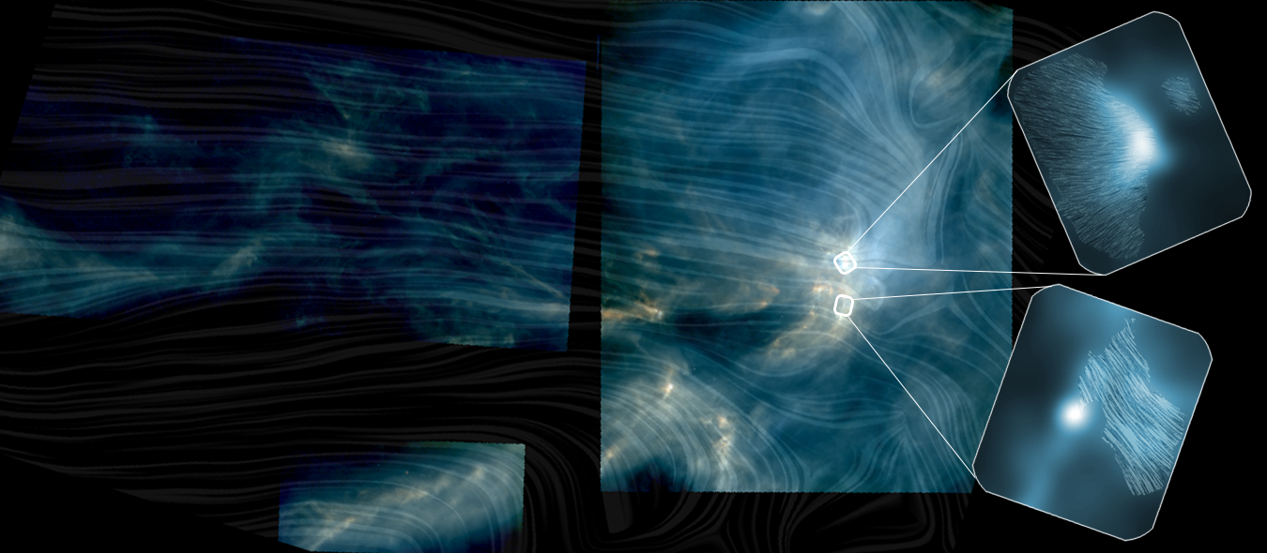


Constraining Magnetic and Gravitational Energies in Star-Forming Clouds
Planck and SOFIA/HAWC+ both observed L1688, part of the Rho Ophiuchus cloud complex, covering scales ranging from 3 pc (the size of L1688) down to 0.02 pc. Planck observations of the transition of magnetic fields, from preferentially parallel to the orientation of elongated structures at lower column densities to preferentially perpendicular at higher column densities, were near its angular resolution limit. SOFIA/HAWC+ provided a much higher resolution while still incorporating sufficient information at larger spatial scales to overlap with Planck. The combination allows the transition to be more fully characterized.
While the Planck data for Ophiuchus are highly suggestive of a transition in this region, the addition of the higher-resolution HAWC+ data at the high column densities provides confirmation of a transition. Therefore, the large-scale magnetic field in L1688 has an energy density comparable to or greater than that of turbulent gas motions. Researchers estimated the threshold volume density where the outward magnetic force balances the inward gravitational force. The value found for L1688 was approximately 10⁴ molecules per cm^{3.}
Image credit: ESA/Herschel/Planck; J. D. Soler, MPIA; Lee et al. 2021
Paper: “HAWC+/SOFIA Polarimetry in L1688: Relative Orientation of Magnetic Field and Elongated Cloud Structure”
Lee, Dennis, et al., 2021/09, ApJ, 918, 39.
Notes:
Paper DOI: http://doi.org/10.3847/1538-4357/ac0cf2
High-res image link: https://www.sofia.usra.edu/sites/default/files/2022-05/SCI2022_0007.png
Science Spotlight: https://www.sofia.usra.edu/publications/science-results-archive/constraining-magnetic-and-gravitational-energies-star-forming

