Slide 1
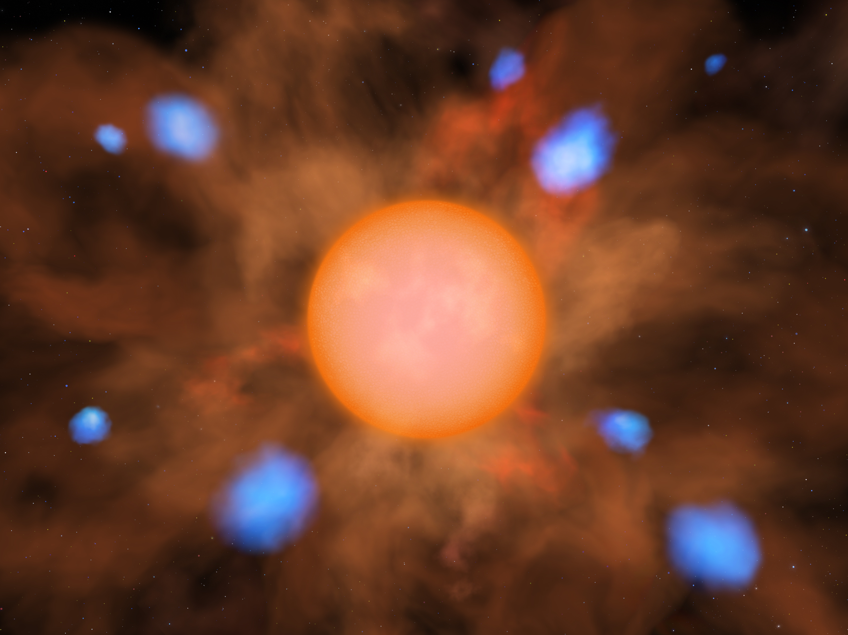


New Observations of Terahertz Water Masers with SOFIA
SOFIA/GREAT detected the 1.296 THz water maser transition in the outflowing circumstellar envelopes of two stars: Mira, a pulsating asymptotic giant branch star, and R Crateris, a semi-regular variable star. This data was supplemented with observations from two ground-based telescopes, the Effelsberg radio telescope in Germany and the Atacama Pathfinder Experiment, or APEX, telescope in Chile. Together, the three instruments allowed the authors to observe water maser transitions over a large span of wavelengths, from about 0.0002 meters to about 0.0136 meters.
The researchers combined these multiwavelength data and interpreted them using an excitation model. For the five circumstellar outflows with terahertz-frequency maser detections, the implied water abundances fall in a range of 1.4-2.5 × 10^{–4} water molecules per hydrogen molecule. These values are broadly consistent with the expectation that water vapor and carbon monoxide will be the primary reservoirs of oxygen within such outflows.
Image credit: Lynette Cook
Paper: “Terahertz Water Masers. II. Further SOFIA/GREAT Detections Toward Circumstellar Outflows, and a Multitransition Analysis”
Neufeld, David A., et al., 2021/01, ApJ, 907, 42.
Notes:
Paper DOI: http://doi.org/10.3847/1538-4357/abc628
High-res image link: https://www.sofia.usra.edu/sites/default/files/Public/SCI2021_019.jpg
Science Spotlight: https://www.sofia.usra.edu/publications/science-results-archive/new-observations-terahertz-water-masers-sofia

Slide 2
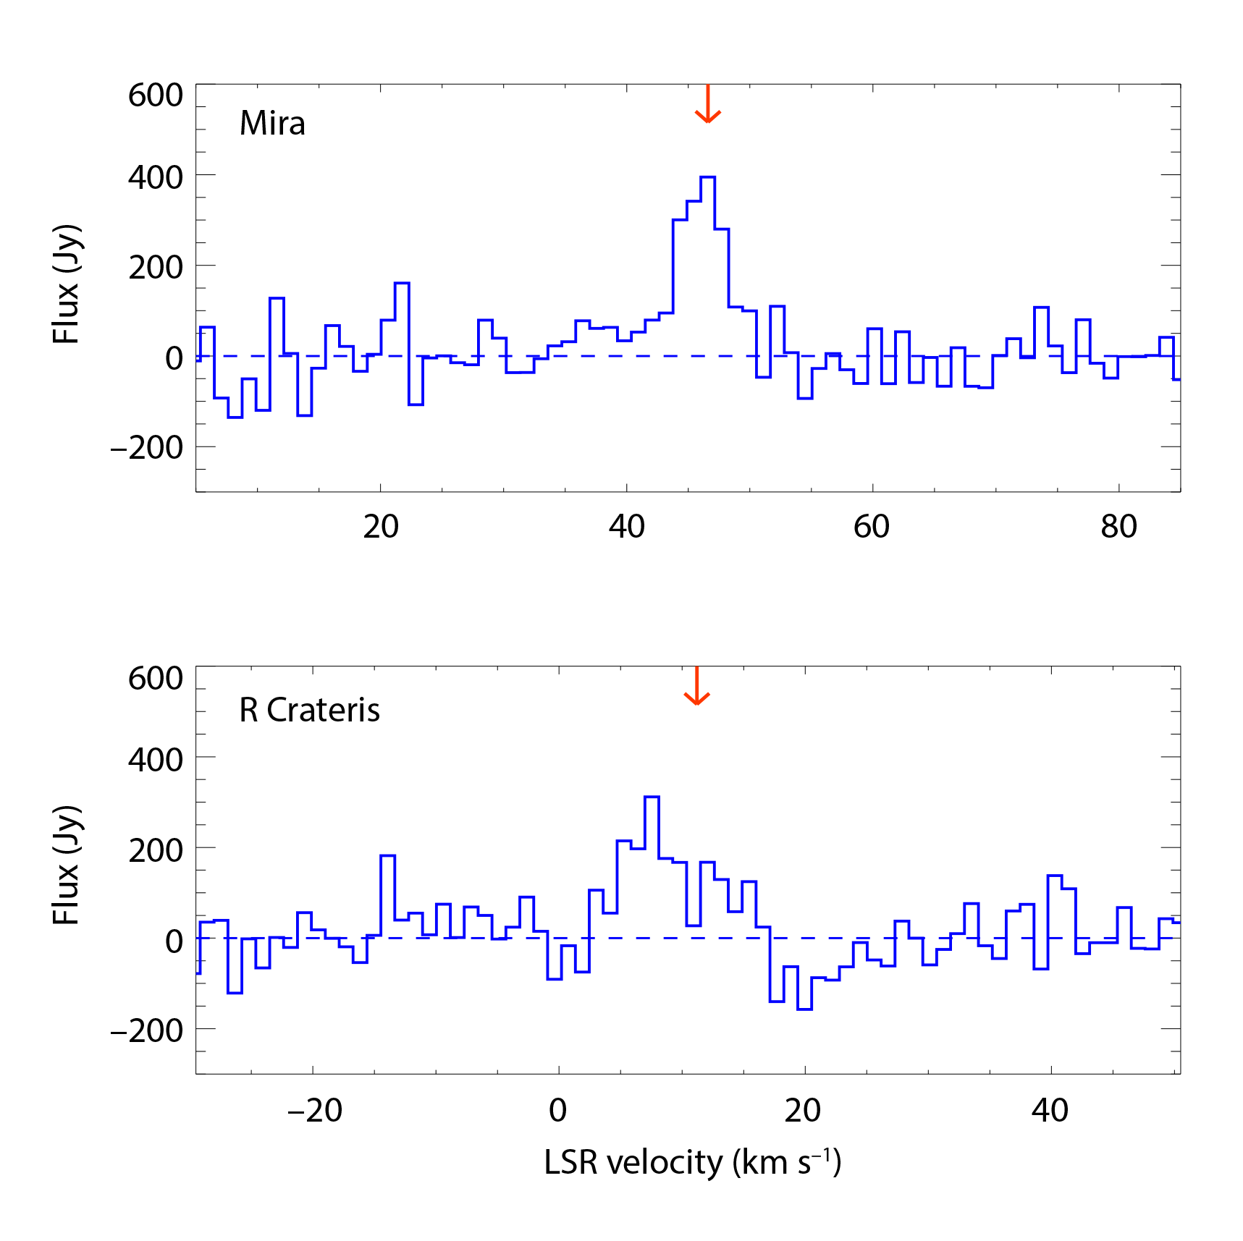
New Observations of Terahertz Water Masers with SOFIA
Spectra of the 1.296 THz maser transition of water observed by the GREAT instrument on SOFIA toward the outflowing circumstellar envelopes of Mira and R Crateris. Red arrows indicate the systemic velocity of each star. Dashed lines indicate the baseline for each transition.
Image credit: Neufeld et al. 2021
Notes:
High-res image link: https://www.sofia.usra.edu/sites/default/files/Public/SCI2021_018.png

