Slide 1
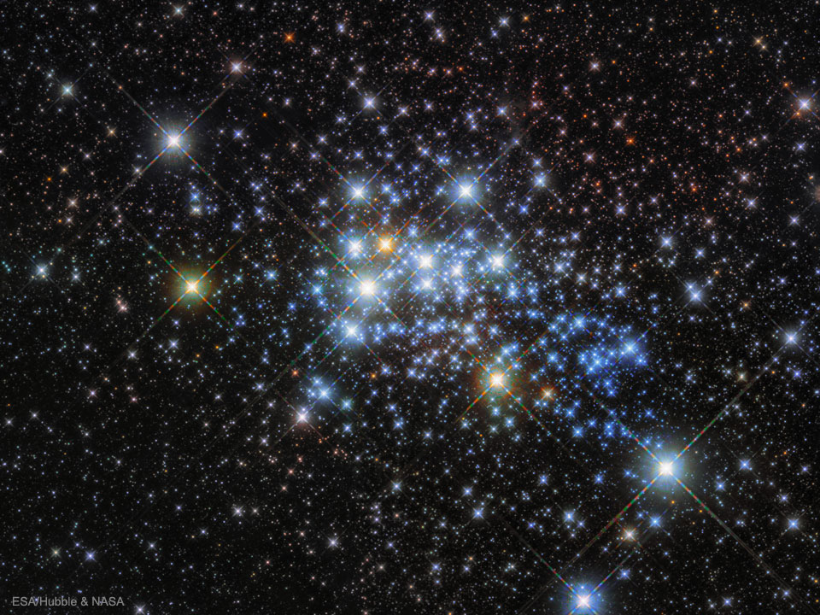


The Age of Westerlund 1 Revisited
Westerlund 1 is a nearby Milky Way cluster, the only known analogue to the bright clusters seen in metal rich starburst galaxies where all of the individual stars can be resolved. Provided an age can be determined, this makes Westerlund 1 an ideal benchmark system for studies of more distant, high-redshift starburst galaxies.
While the age of Westerlund 1 has been determined to be 5 Myr from the Wolf-Rayet and pre-main sequence stars, there have been no direct measurements of the luminosities of the cool supergiants. Optical as well as near-, mid-, and far-IR photometry is needed to determine the most accurate luminosities, but previous attempts have been hampered by saturated measurements from space-based observatories.
SOFIA FORCAST imaged Westerlund 1 in the wavelength range of 5.6 - 31.5 microns, covering a crucial portion of the spectral energy distribution where a large proportion of flux is emitted. The results imply that the age of Westerlund 1 is 10 Myr.
Image credit: ESA/Hubble & NASA
Paper: “The Age of Westerlund 1 Revisited”
Beasor, Emma R., et al., 2021/05, ApJ, 912, 16.
Notes:
Paper DOI: http://doi.org/10.3847/1538-4357/abec44
High-res image link: https://www.sofia.usra.edu/sites/default/files/Public/SCI2021_017.jpg
Science Spotlight: https://www.sofia.usra.edu/publications/science-results-archive/age-westerlund-1-revisited

Slide 2
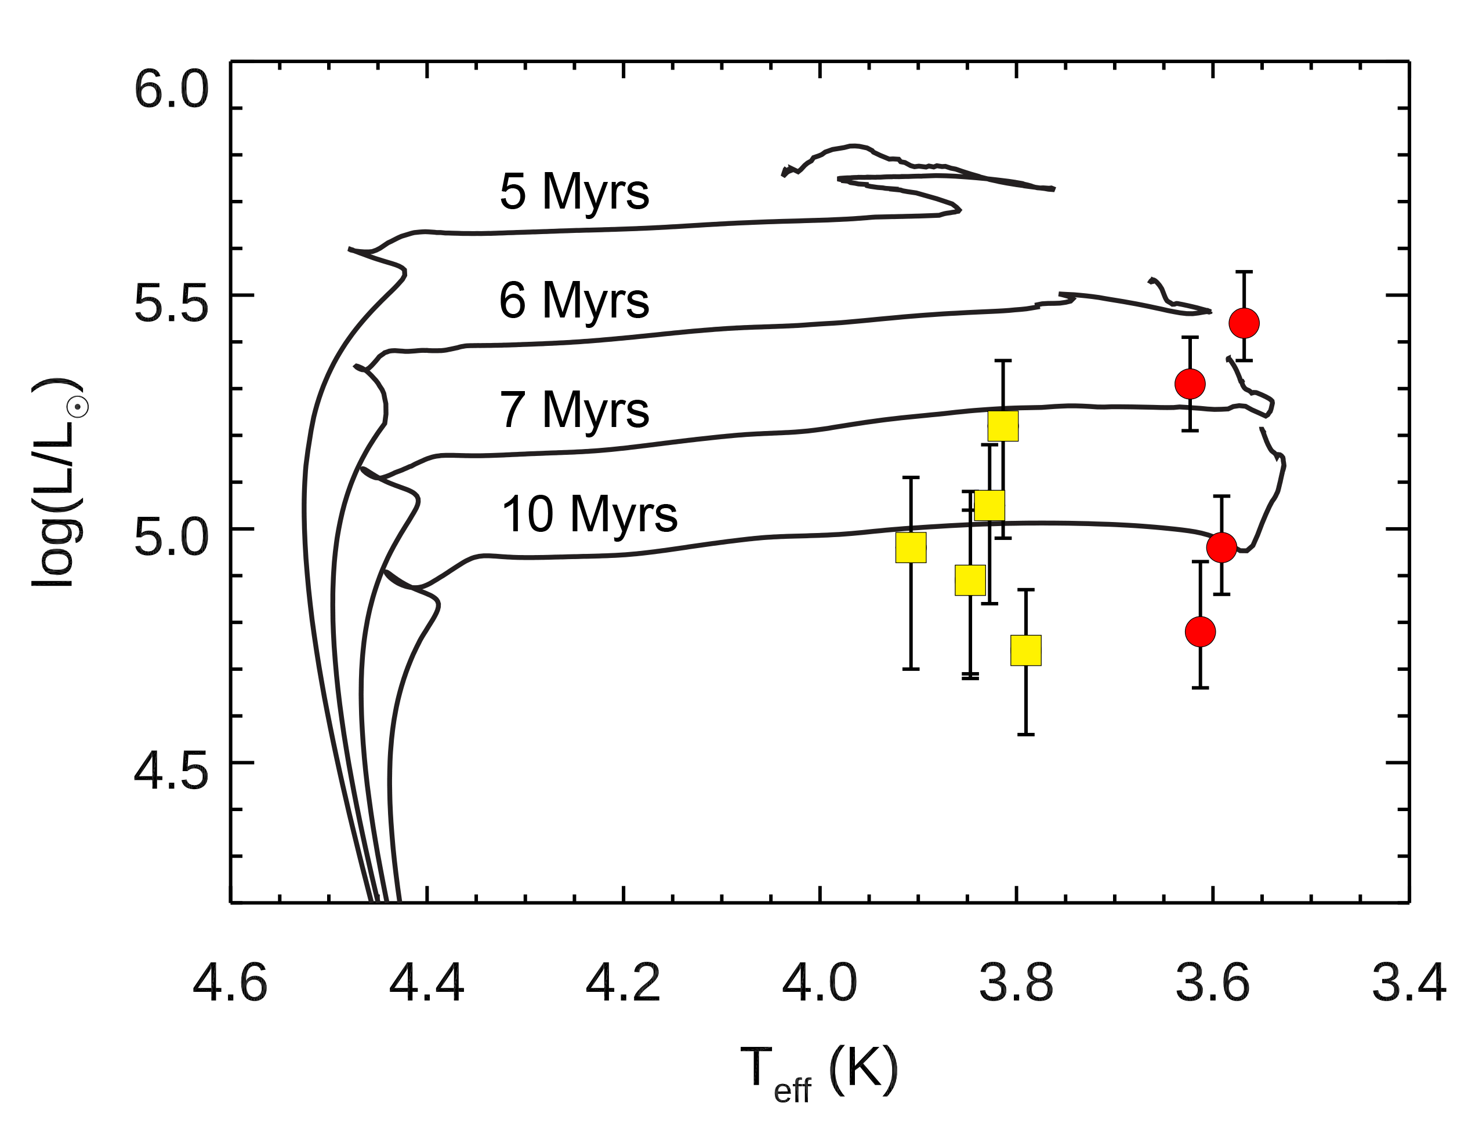
The Age of Westerlund 1 Revisited
Hertzsprung-Russel diagram for the cool supergiants in Westerlund 1. The red supergiants (red circles) and yellow supergiants (yellow boxes) are plotted along with stellar isochrones (black curves). The supergiant luminosities are clearly inconsistent with the previous age estimate of 5 Myr. Instead, they appear to be an older population consistent with an age of 10 Myr.
Image credit: Beasor et al. 2021
Notes:
High-res image link: https://www.sofia.usra.edu/sites/default/files/Public/SCI2021_016.png

