Slide 1
GREAT Early Results
Göran Sandell, on behalf of the GREAT Consortium

Slide 2
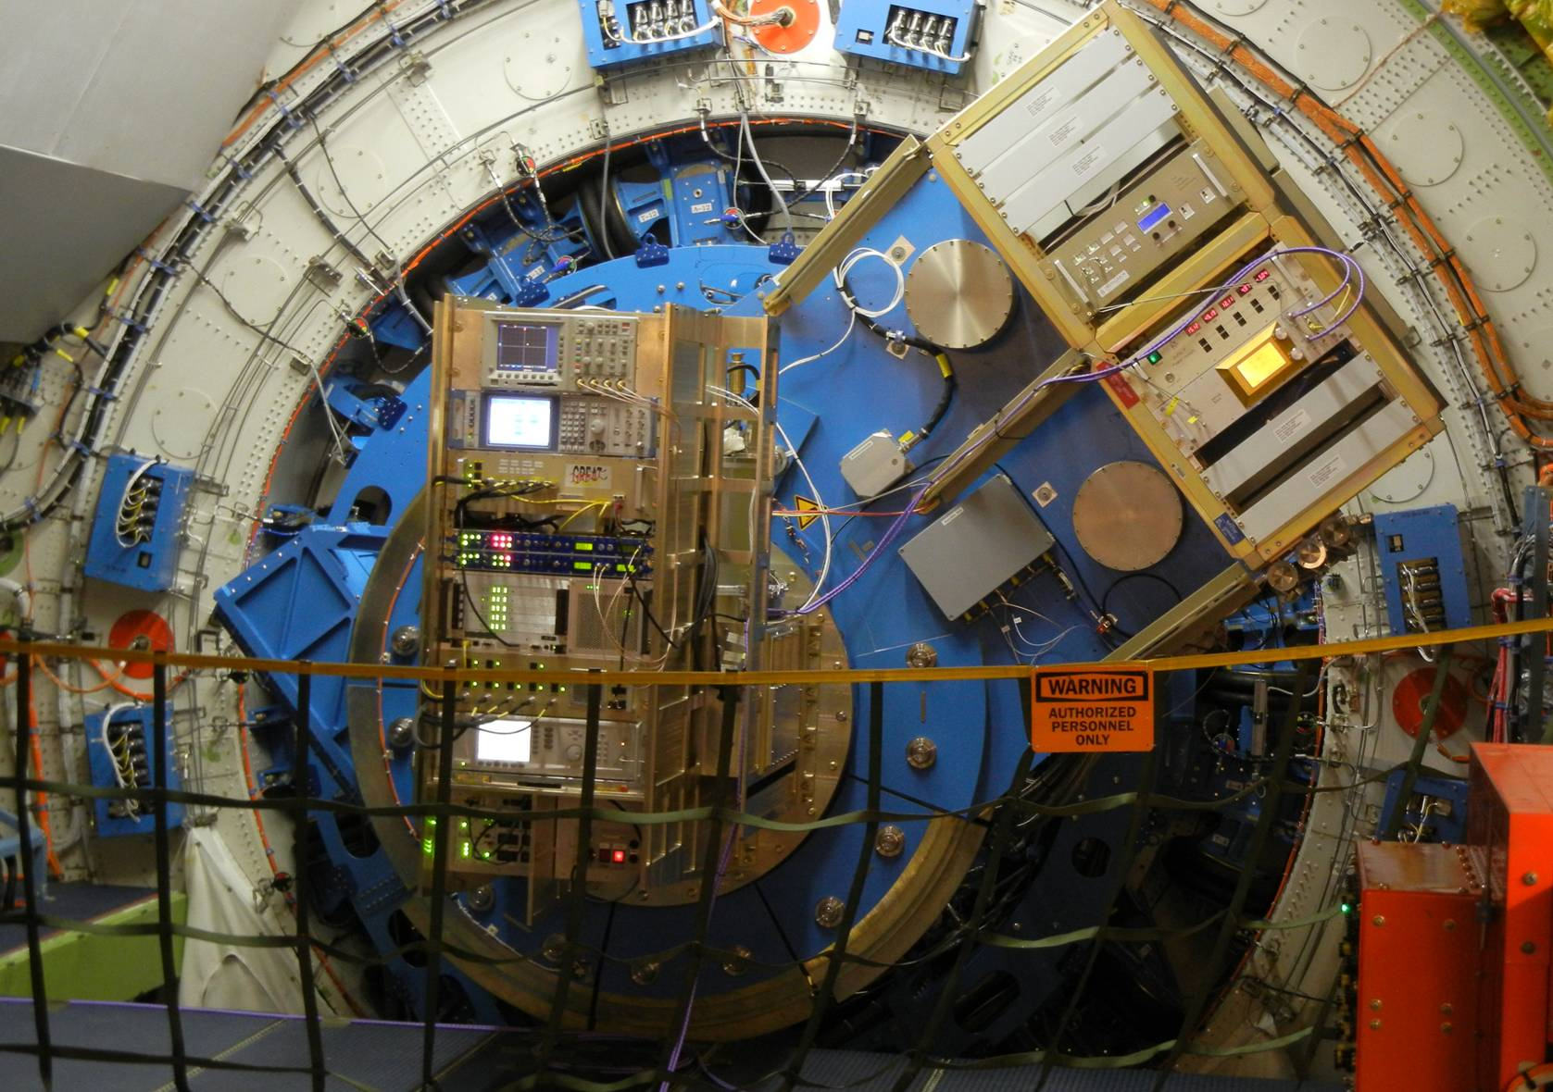
GREAT installed on SOFIA

Slide 3
SHORT SCIENCE 2 (SS2)
3 flights in early April + one setup flight (OCF4)
GREAT SS2 configuration:
  L#1 1.27 – 1.39 THz (a), 1.43 – 1.52 THz (b)
  L#2 1.82 – 1.92 THz
Improved Bandwidth – now 1.5 GHz
Better noise temperature

Slide 4
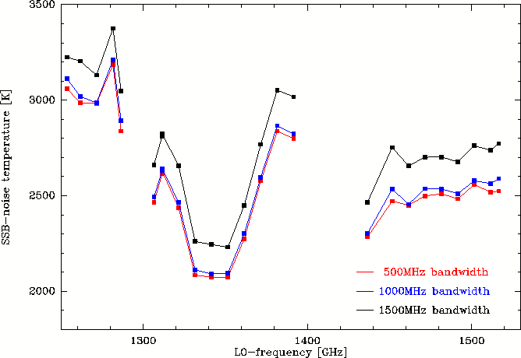
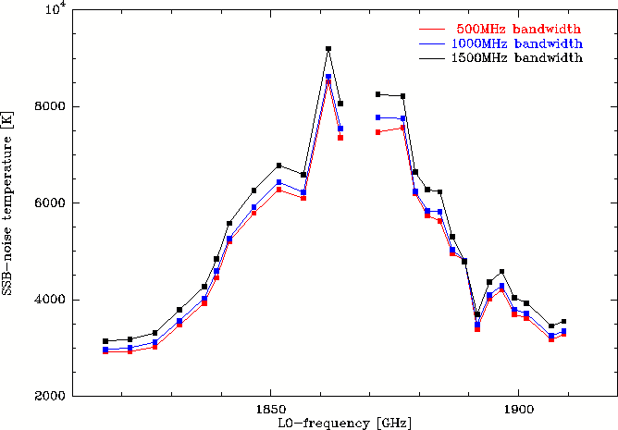
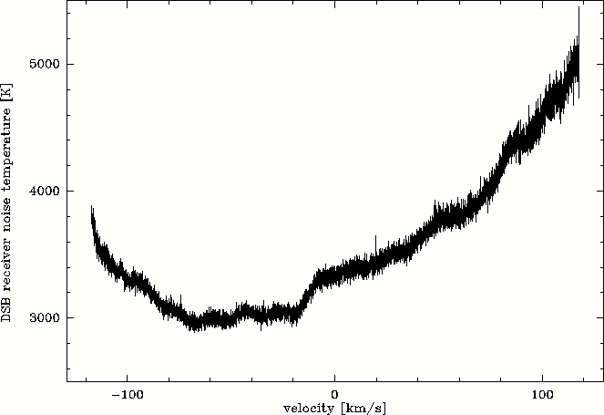
Noise performance & bandwidth
SSB-noise performance vs. LO frequency
  gaps are due to LO power limitations
  lower performance between 1840 and 1885 GHz is due to LO noise contributions
  clean overall band-pass (right hand side)
    usable bandwidth up to 1.5GHz

Slide 5
Performance Summary
Channel Topic | L #1a | L #1b | L #2
RF-Range [THz] | 1.25 – 1.39 | 1.43 – 1.52 | 1.81 – 1.90
IF-Bandwidth [GHz] | 1.5 |  | 1.5
IF-Center [GHz] | 1.6 – 2.3 (variable)
SSB-Noise-temp. [K] | 2000K – 3500K |  | 2500K – 8000K
Beam-size [arcsec] | ~22 |  | ~16
Allen time [s] | spectroscopic: > 100, total-pow. > 15

Slide 6
GREAT Short Science
one observatory characterization flight
hardware & procedures (prepared during line ops & in HIL/SIL) worked fine, but operation troubled by serious software issues
finally, on Saturn & galactic PDRs, we determined & verified:
  boresight offsets GREAT to FPI
  Z-focus offset GREAT to FPI
  GREAT observing modes
    pointed, raster, on-the-fly, in total power and chopped observing modes
    in both, continuum and spectrospopy modes
message: a single commissioning flight for an instrument with the complexity of GREAT (blind from ground) is sub-critical.
three short science flights

Slide 7
GREAT Short Science
science demonstration was amazingly successful
during our three SS2 flights
  7-8 science projects completed (to the extent possible)
  2-3 projects do need more integration time, will be re-scheduled in July
science will be published in A&A special volume in autumn,
with technical contributions desribing GREAT
status of data processing
  calibration pipeline (atmospheric models) more demanding than expected
  [lack of calibrated water readings from onboard monitor painful]
  improving on shortcomings (header information, timing)

Slide 8
