Slide 1
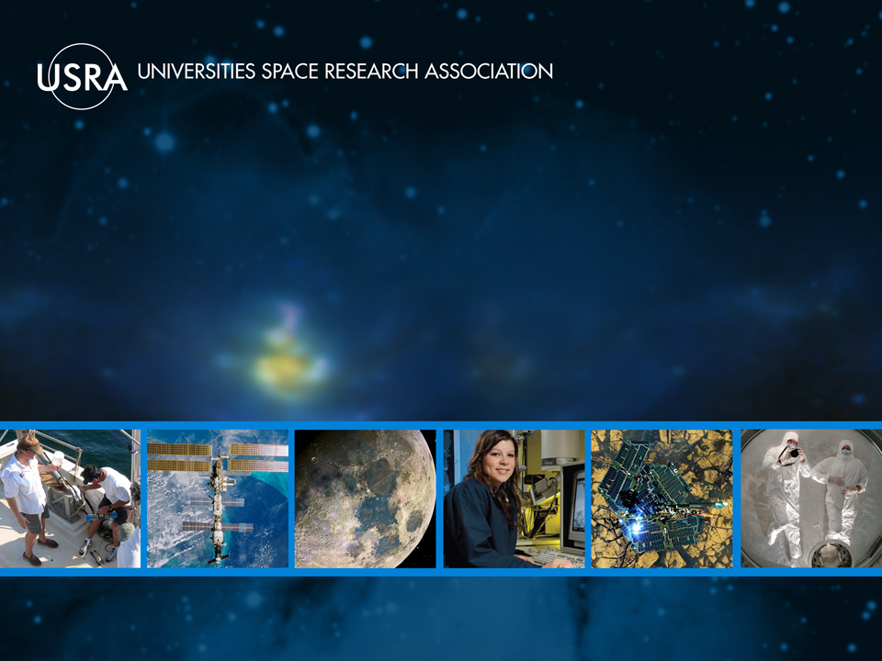
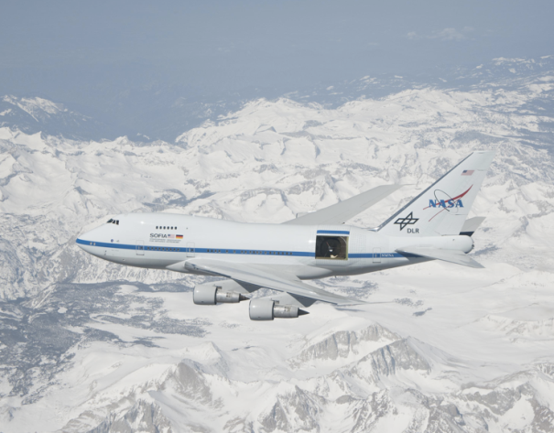
Stratospheric Observatory for Infrared Astronomy (SOFIA)
Helen J. Hall
September 13, 2012
Advanced Maui Optical and Space Surveillance Technologies
Conference (AMOS) 2012

Slide 2
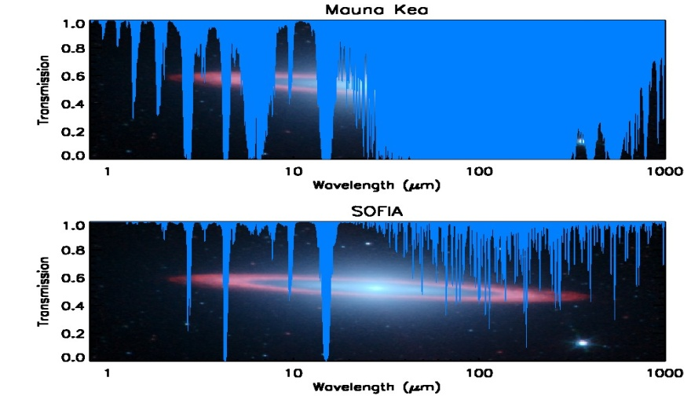
What is SOFIA?
A 2.5 m telescope in a modified B747SP aircraft
  - Optical-mm performance
  - The obscured Infrared (IR) (30-300 um) is most important
Joint Program between the US (NASA - 80%) and Germany ( DLR- 20%)
- USRA and the Deutsches SOFIA Institute (DSI,
University of Stuttgart) are the science
mission contractors
Built for 20 year lifetime
- Operates at 39,000 to 45,000 feet.
- Above > 99% of obscuring water vapor .
- Wide instrument range. Future Instrumentalists.
World Wide Deployments, will ramp up to ~1000 science hours per year
  - Science flights to originate from NASA Dryden Flight Research Center (DFRC).
  - Science Center is located at NASA Ames Research Center.

Slide 3
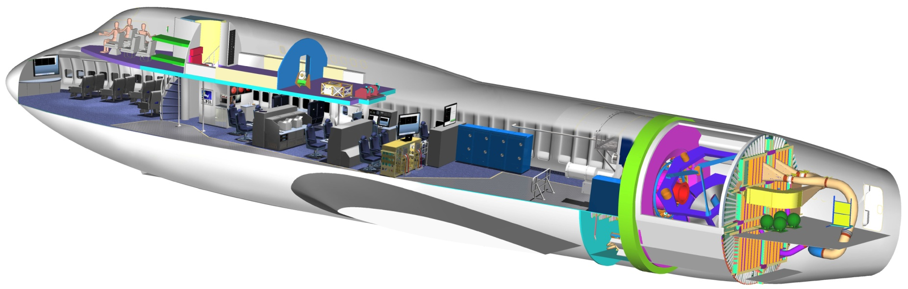
SOFIA — The Observatory
open cavity
(door not shown)
Educators work station
pressure bulkhead
scientist stations, telescope and instrument control, etc.
TELESCOPE
scientific instrument (1 of 7)

Slide 4
Basic Roles & Responsibilities
  Dryden Flight Research Center (DFRC)
  - Overall Program Management (may be transferred to Ames at full operations).
  - Aircraft development, testing, operations and maintenance.
  - Palmdale Regional Airport Operating Location
  Ames Research Center (ARC)
  - “Science Project” management
  USRA and DSI
  - Science Mission Contractors – Instruments, Observing Time, etc.
  - Together form a roughly 77 person Science Center at Full Operational Capability
  - 32 Personnel at Palmdale
  - 45 Personnel at ARC
  - DSI is an associate contractor to USRA
  - USRA relations with DSI are very strong.
Notes:
At the top level Dryden is currently responsible for overall program management.
That should transfer back to Ames at full operations. Dryden will remain in charge of
the “platform” project which includes…..
Ames has the “science project”
USRA and DSI are the science mission contractors, and perform the same basic functions
of an astronomy science center – however unlike Spitzer, Chandra or Hubble centers, we
also build the instruments and operate them in flight. At the peak this center will have
about ___ people, ____from USRA and ___ from DSI. ____ of them will be
permanently assigned to Palmdale, the rest at Ames. DSI is not the USRA
subcontractor. It contracts directly with the DLR and is an associate contractor to
USRA. A bright spot in SOFIA is that the USRA – German relations are very strong.

Slide 5
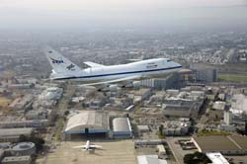
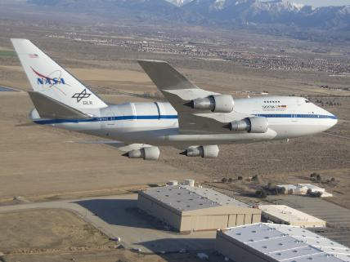
The Science Mission Operations has Split Geographic Locations:
SOFIA Science Center at NASA
Ames Research Center
Science Mission Operations Director
& Deputy in place
Science Staff**
Science Data Network (SOFIA
Data Cycle System & Archive)
Mission Planning
Systems Integration Laboratory
Science Instrument
Laboratories
Education & Public Outreach
SOFIA Operations Center at NASA Dryden
Aircraft Operations Facility in Palmdale
Telescope Assembly & Science Instrument
Integration Team
Operations Staff
Early Science Instrument Laboratories
Systems Integration Laboratory
Mirror Coating Facility
Mission Systems Development
(Flight Data & Observatory Data
Cache)
**PhD Internships being sponsored between University of Stuttgart and USRA.

Slide 6
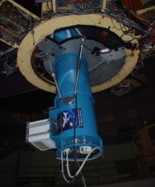
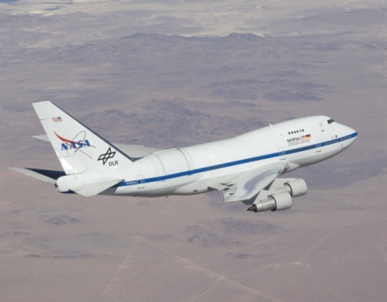
Data Cycle System Tools for Annual Lifecycle
Archive
Raw Data, House Keeping Data
Science Instrument Reduced Data
Investigator
Archive &
Reduce Data
SOFIA Science Center Staff
Query &
Retrieve Data
Science Instrument
Integration
Science Integration
Lab
Airborne System
Science
Data Products
New Science
Instruments
Raw Data, House Keeping Data
Data Manifests
Mission
Datasets
Investigator
Joint Observatory
Operations
Execute
Observations
Analysis &
Prop Support
Observatory
Maintenance
& Operations
Observatory
Proposal
Process
Mission Plans
Detail
Observing
Plan
Develop
Flight Plan
Annual Operating
Plan
Observing Plans
Planning
Database

Slide 7
SOFIA Light Path
Incoming Infrared Light
        Observers in pressurized cabin have ready access to the focal plane
Secondary Mirror
Pressure bulkhead
Spherical Hydraulic Bearing
Light Tube
Infrared Instrument
Infrared Light Mirror
Visible Light Mirror
Primary Mirror
Visible Light Camera

Slide 8
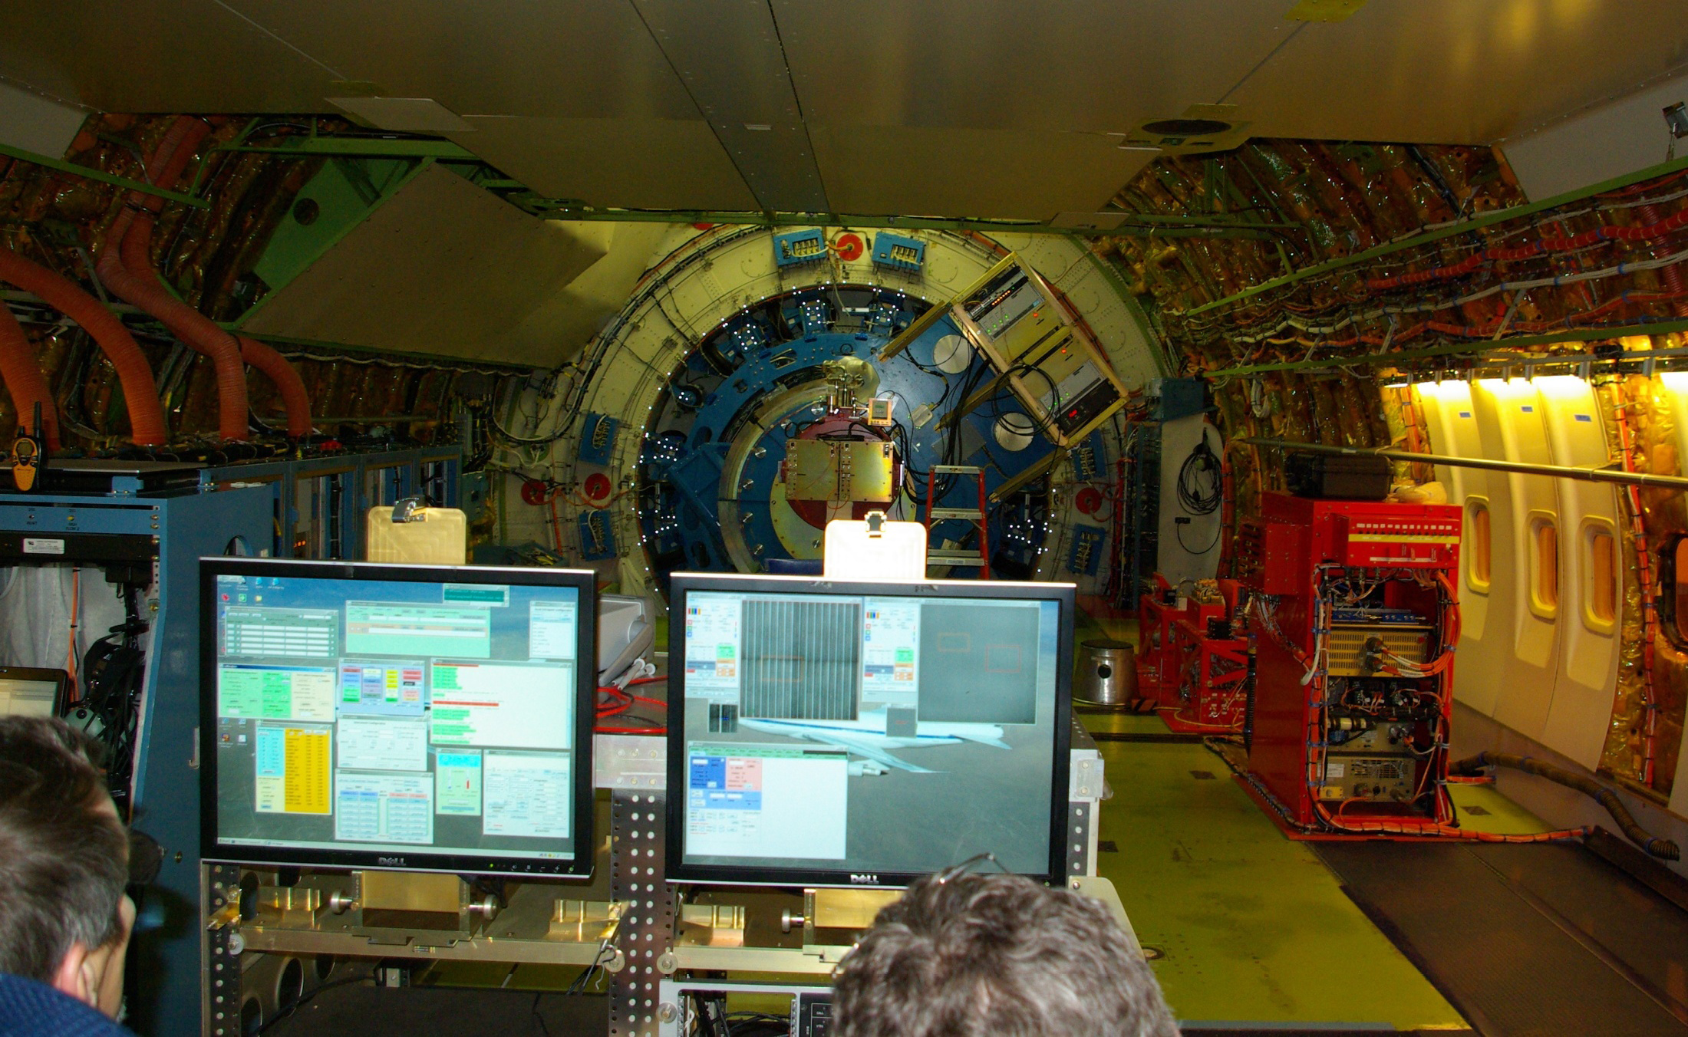
Onboard SOFIA –FORCAST mid-IR camera installed

Slide 9
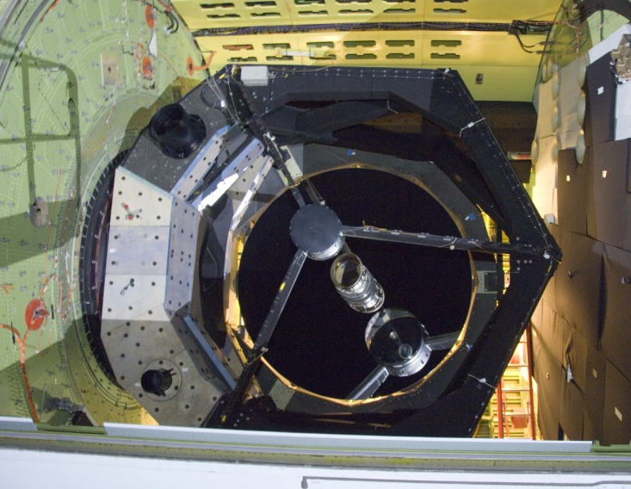
Coated Mirror on SOFIA

Slide 10
Schedule Overview
(Tracking Schedule)
We are here!
Instrument Commissioning
Inst 1
Inst 2
Backup & Heavy Maint.
First In-Flight
Light
Inst 3
Inst 4
Inst 5
Arrival at Dryden
First Door
Closed Flight
Door open
Flight
Inst 6
HIPO Line Ops
Basic Science
TA V&V
SS
German FL
CY07
CY08
CY09
CY10
CY11
CY12
CY13
CY14
CY15
0
1
2
3
Operations
ISF
ISF
FOC
FOC
Avionics Upgrade
(Part 2)
Cavity Insulation
Segment 3
Downtime
Elements
Cavity Envir
Control Syst
ISF = Initiation of Science Flights
FOC = Full Operational Capability
SS = Short Science
Mission Comm
Control Syst
Observatory Upgrades
Science Flight activity
Engineering flights
A/C Testing/Work

Slide 11
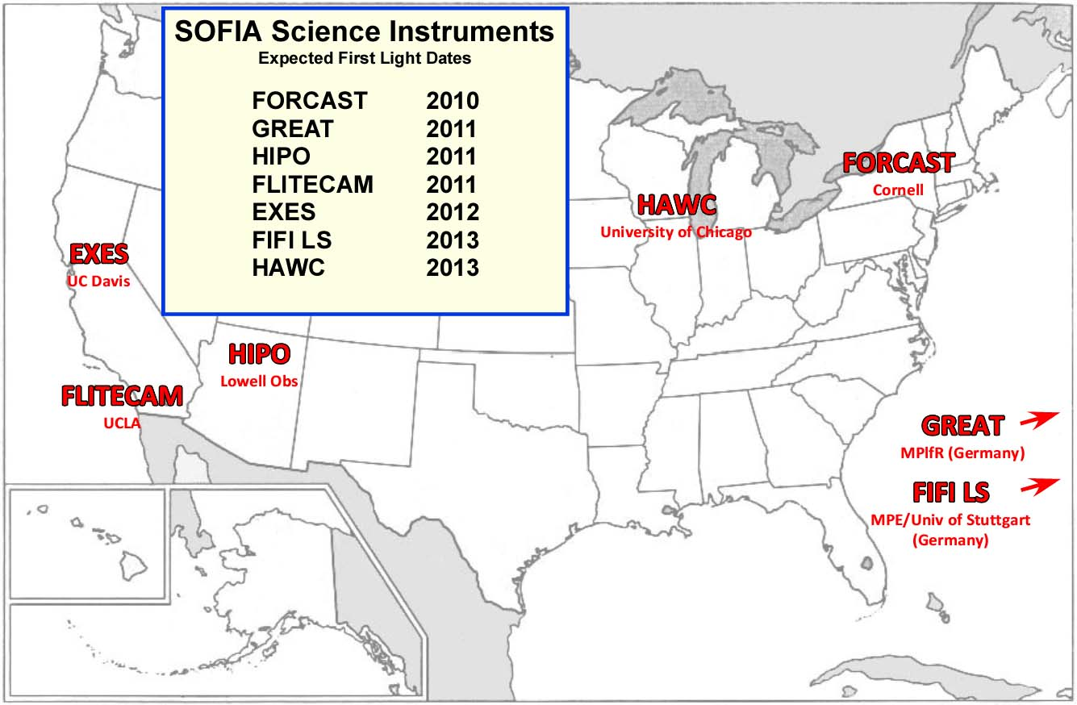
Geographic Distribution of SOFIA Instruments
2013
2010
2011
2011
2011
2014
2015
2015
Notes:
On to the fun stuff. USRA is really proud of the way it is involving the university community in SOFIA. Instruments come from CalTech, UCLA, Lowell Observatory, Chicago, Cornell and Goddard.
11

Slide 12
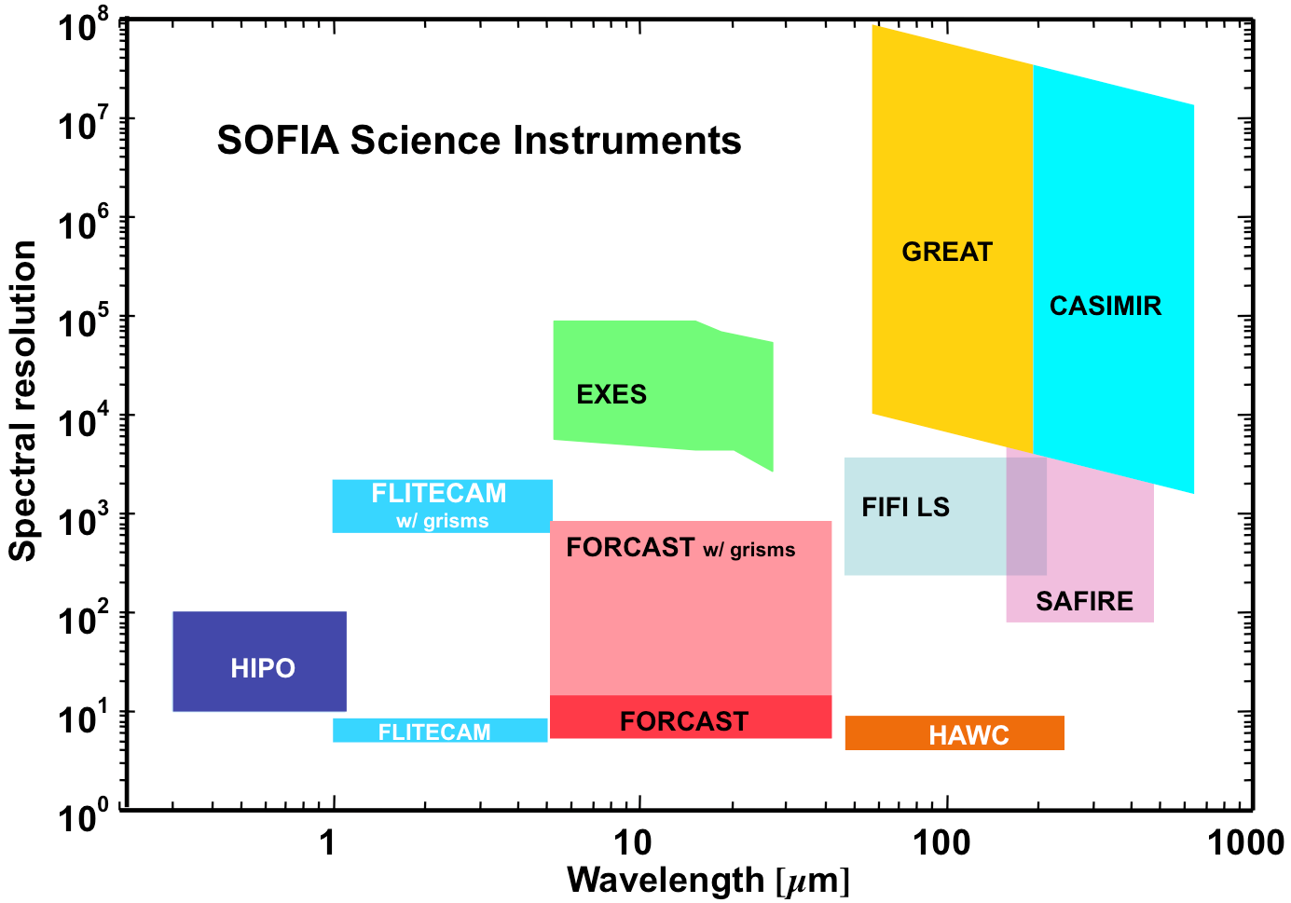
Instrument R/λ graph
SOFIA 1st Generation Science Instruments
FIFI LS
12

Slide 13
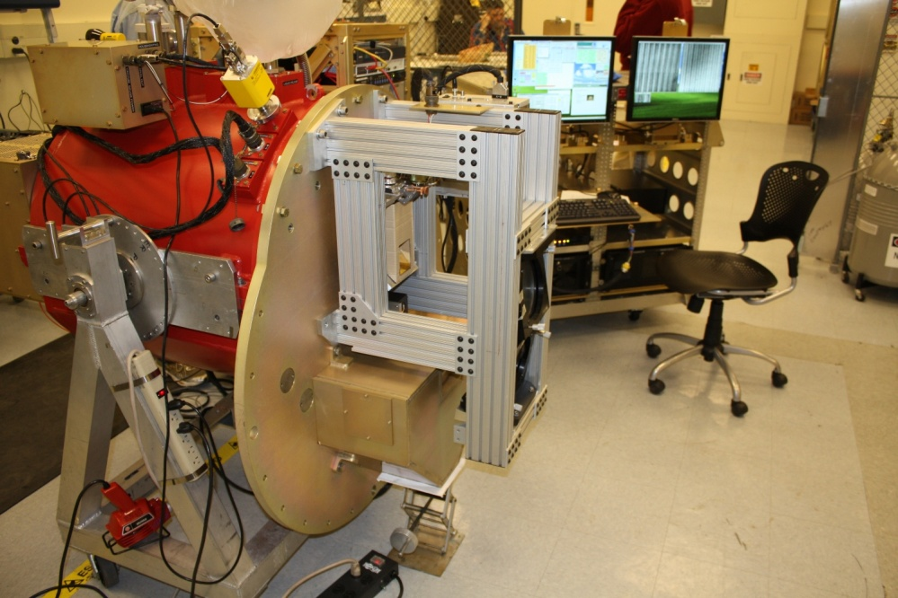
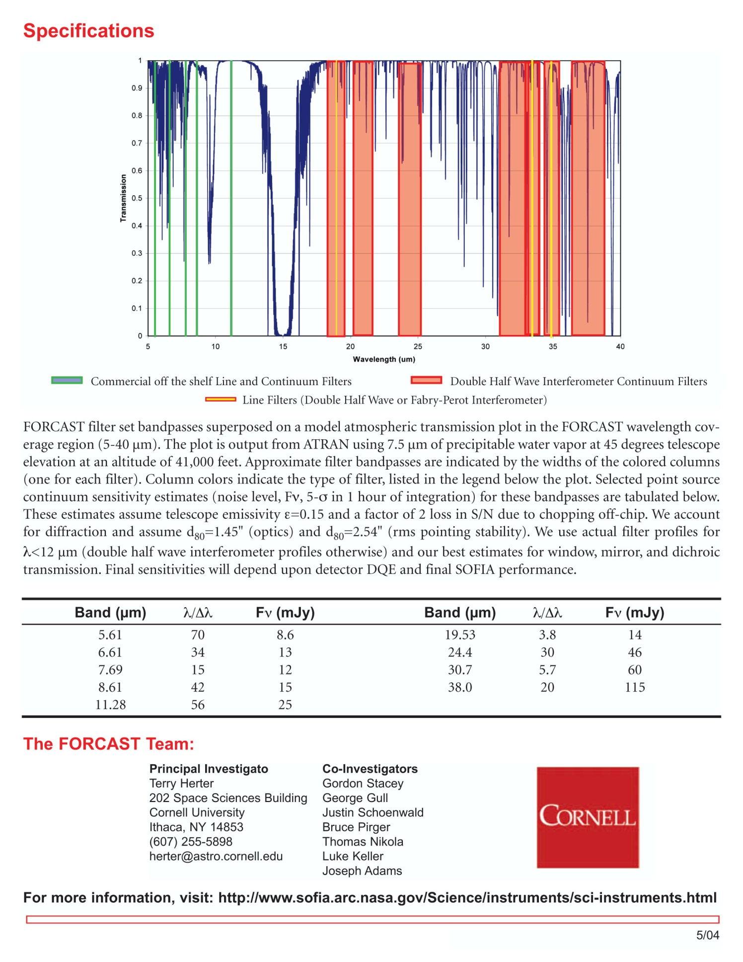
FORCAST – Faint Object infraRed CAmera for SOFIA
Facility Instrument
- λ = 5 – 25 µm; 25 – 40 µm [MIR]
- FOV: 3.2‘ x 3.2‘
0.75“ per pixel
- 9 narrow and band filters
Spectral resolution: 5.7 - 250
Maximum frame rate: 4 per s for full frame
Highest time resolution: 1.6 mm
Detector: 256x256 Si:As ; Si:Sb blocked
Transmission
1
FORCAST in the lab at Palmdale, CA
Simultaneous continuum imaging
in two MIR bands &
Low resolution spectroscopy
Principal Investigator:
Dr. Terry Herter,, Cornell University , Ithaca, New York
0
5
15
λ
25
35

Slide 14
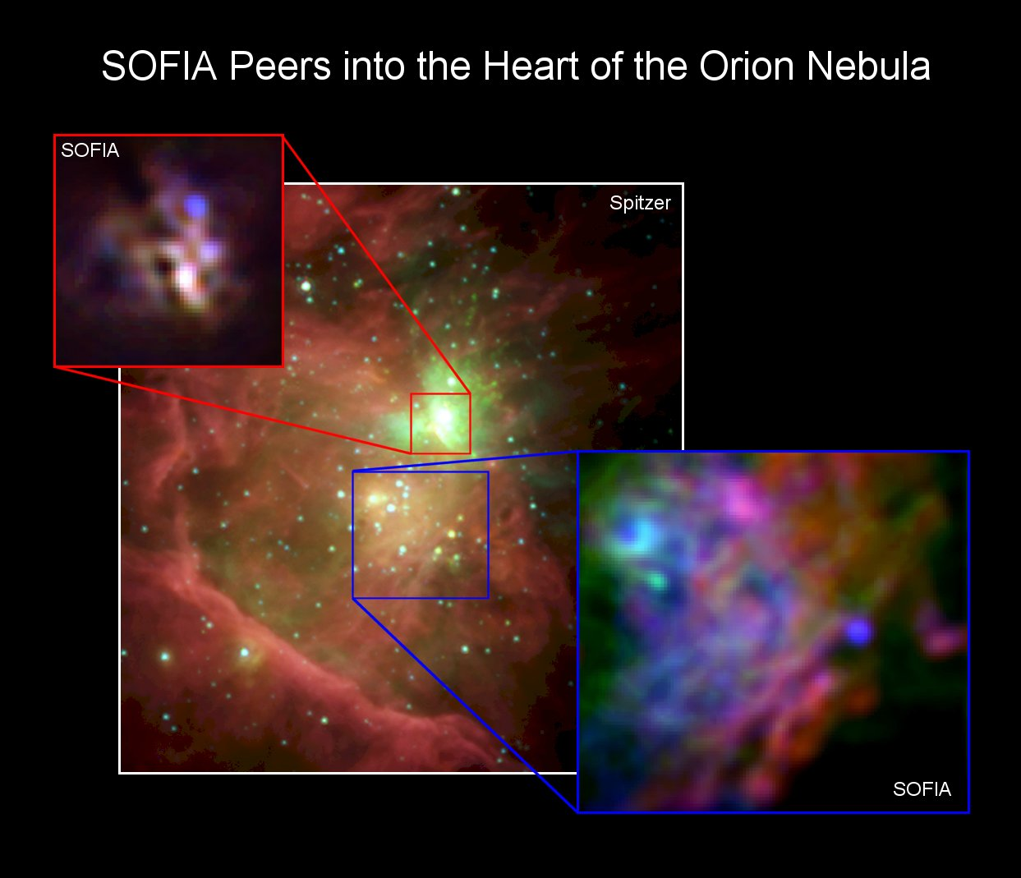
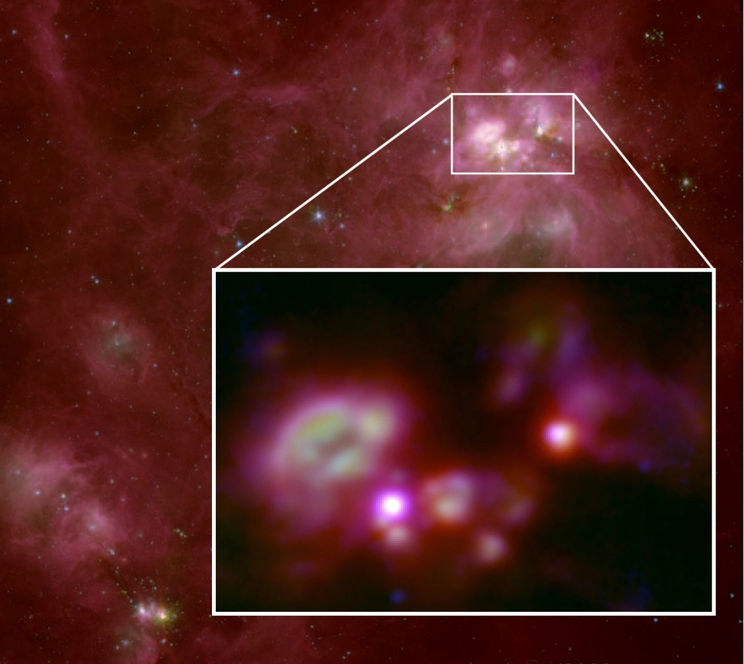
Image Releases
See:
Jim DeBuizer
Poster this
Conference for
More detailed
Science Results
This image was taken with FORCAST and show two regions with the Orion Nebula over a composite photo from Spitzer. The area shown by the red box is known as the Becklin-Neugebauer/Kleinman-Low (BNKL) region of Orion. This region is so bright that it is saturated in the Spitzer image and details cannot be seen. However, in the SOFIA image the region is seen to be composed of many individual young forming stars and knots of dust and gas. (Jim De Buizer)
Mid-infrared image of the W3 star forming region from SOFIA/FORCAST, inset on a near-infrared image from Spitzer. The SOFIA image dimensions are 150 x 100 arcseconds, corresponding to 15 x 10 light years at a distance of 6400 light years. Arrow indicates a bubble cleared in the nebula by wind and radiation from the most massive newborn star in the cluster. (SOFIA image, inset: Red, Green, Blue = 37, 20, 7.7 μm; NASA / DLR / USRA / DSI / FORCAST team / F. Salgado, A. Tielens, J. De Buizer) (Spitzer image, background: Red, Green, Blue = 7.9, 4.5, 3.6 μm; NASA / Caltech - JPL).

Slide 15
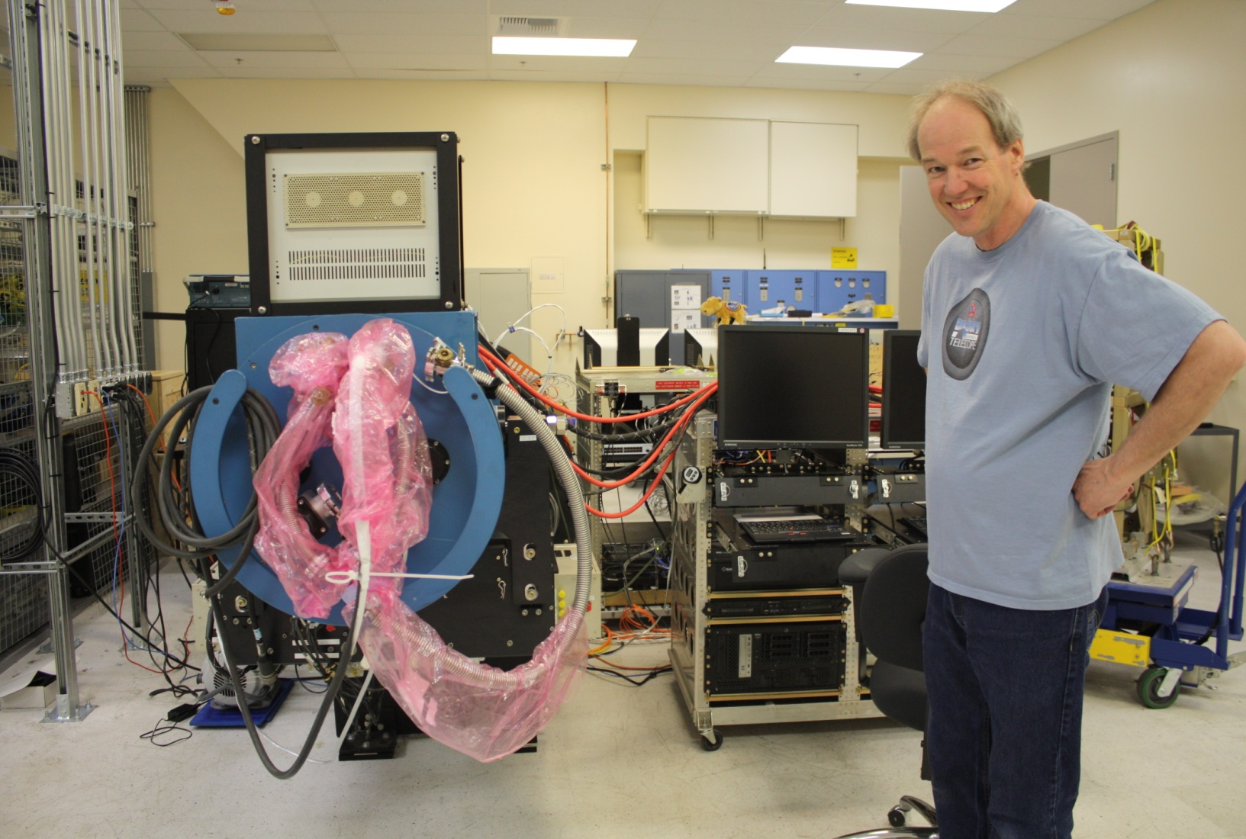
HIPO – High Speed Imaging Photometer for Occultations
Special Purpose Instrument
- λ = 0.3-0.6 µm, 0.4 – 1.1 µm [optical/NIR]
- FOV: 5.6‘ x 5.6‘
0.33“/0.055“ per pixel
Maximum frame rate: 10/20 ms for three
80x80 pixel sub-frames
Through put of HIPOs optic: ≥70 % from
0.4 – 0.9 µm
Detector: e2vCCD47-20 frame transfer
silicon CCD
Read out noise: ≤ 6/3 electrons
Quantum Efficiency: 40 – 80 %
HIPO in the lab at Palmdale
Simultaneous high-speed time resolved imaging photometry at two optical/[NIR] wavelength (& FLITECAM >> + NIR)
Principal Investigator:
Dr. Edward W. Dunham; Lowell Observatory, Flagstaff , Arizona

Slide 16
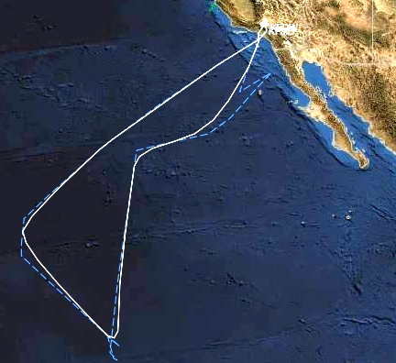
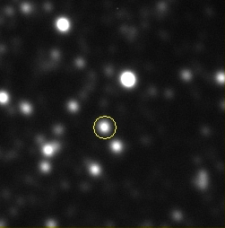
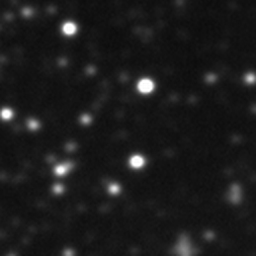
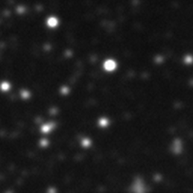

Occultation by Pluto 2011 June 23
Dwarf planet Pluto occulted a star
SOFIA met the shadow of Pluto in the mid-Pacific
HIPO and the Fast Diagnostic Camera (FDC) observed the occultation simultaneously
Image sequence from the FDC
Pluto (circled) is 13 arcsec from the star 200 minutes before the occultation
Just before occultation: Pluto and star merged, combined light
During occultation: Pluto and star merged, only Pluto light seen
After occultation: Pluto and star merged, combined light

Slide 17
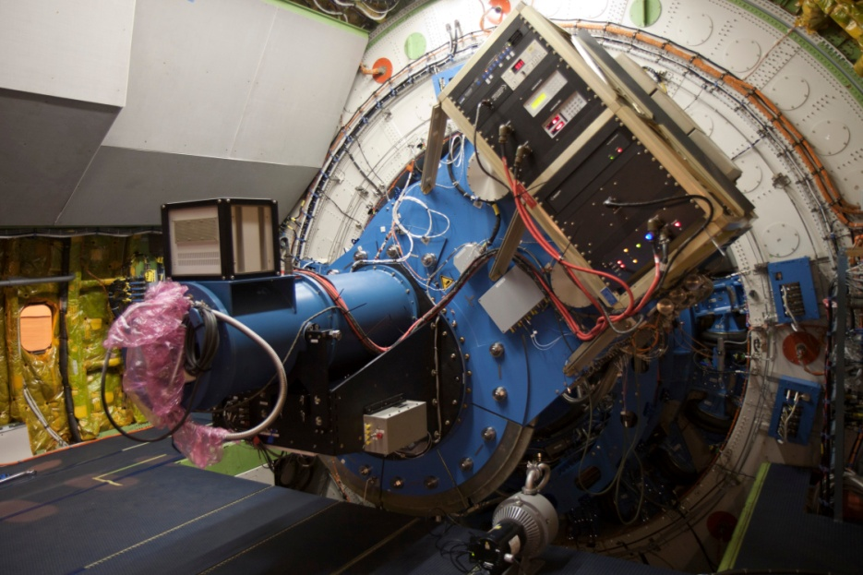
FLITECAM – First Light Infrared Test Experiment CAMera
Facility Instrument
- λ = 1- 5.5 µm [NIR]
- FOV: Ø 8‘
0.46“ per pixel
- Filter: J, H, K, L, L`, M & various narrow
band filters
Spectral resolution: 1000- 2000
Maximum frame rate: 4 per s for full frame
Detector: Raytheon ALADIN II 1024 x 1024
Read out noise: ≤ 40 electrons
Quantum Efficiency: ~ 80 %
cooled by double liquid helium and nitrogen
cyrostat
HIPO and FLITECAM co-mounted in the Telescope
- Test camera for image quality
- Simultanoulsy mounted with HIPO (see above)
Principal Investigator:
Ian S. McLean, UCLA Div. Astronomy, Los Angeles, California

Slide 18
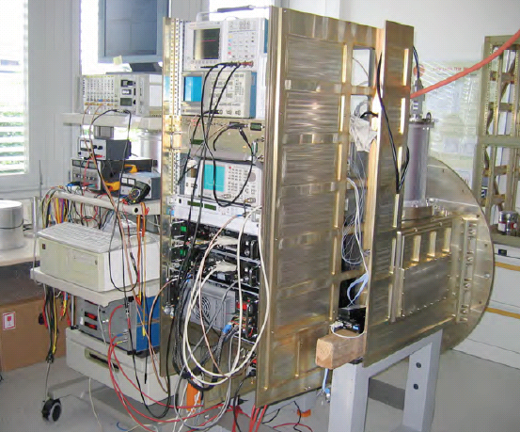
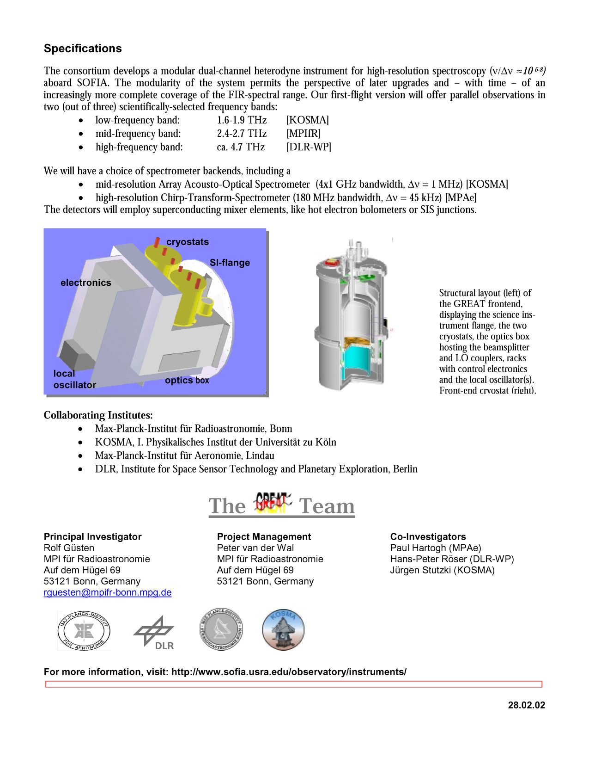
GREAT – German REceiver for Astronomy at THz Frequencies
- λ = 1.6 – 1.9 THz, 2.4 – 2.7 THz~ 4.7 THz
[63 – 187 µm] [FIR]
- velocity resolution: ~100 m/s
Channels Astronomical lines
1.25-1.50 THz [NII], CO, (13)CO, HCN, H2D+
1.82-1.92 THz [CII], CO
2.4-2.7 THz HD, OH(2P3/2), CO, (13)CO
4.7 THz [OI]
- Heterodyne
Principal Investigator:
Dr. Rolf Güsten, MPI für Radioastronomie, Bonn

Slide 19
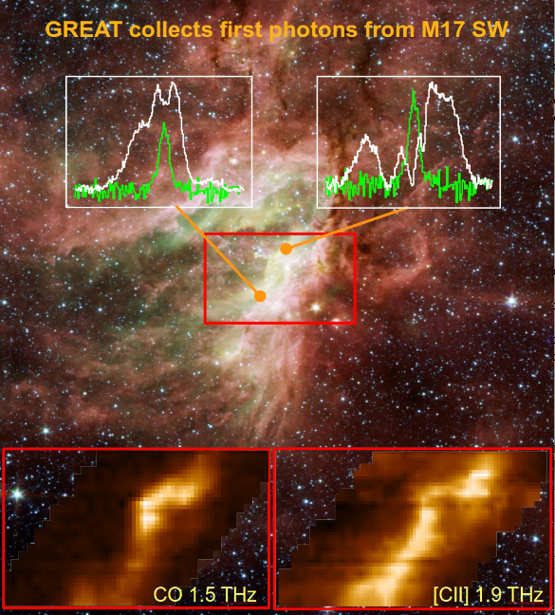
First Science with GREAT (White CII, Green CO)

Slide 20
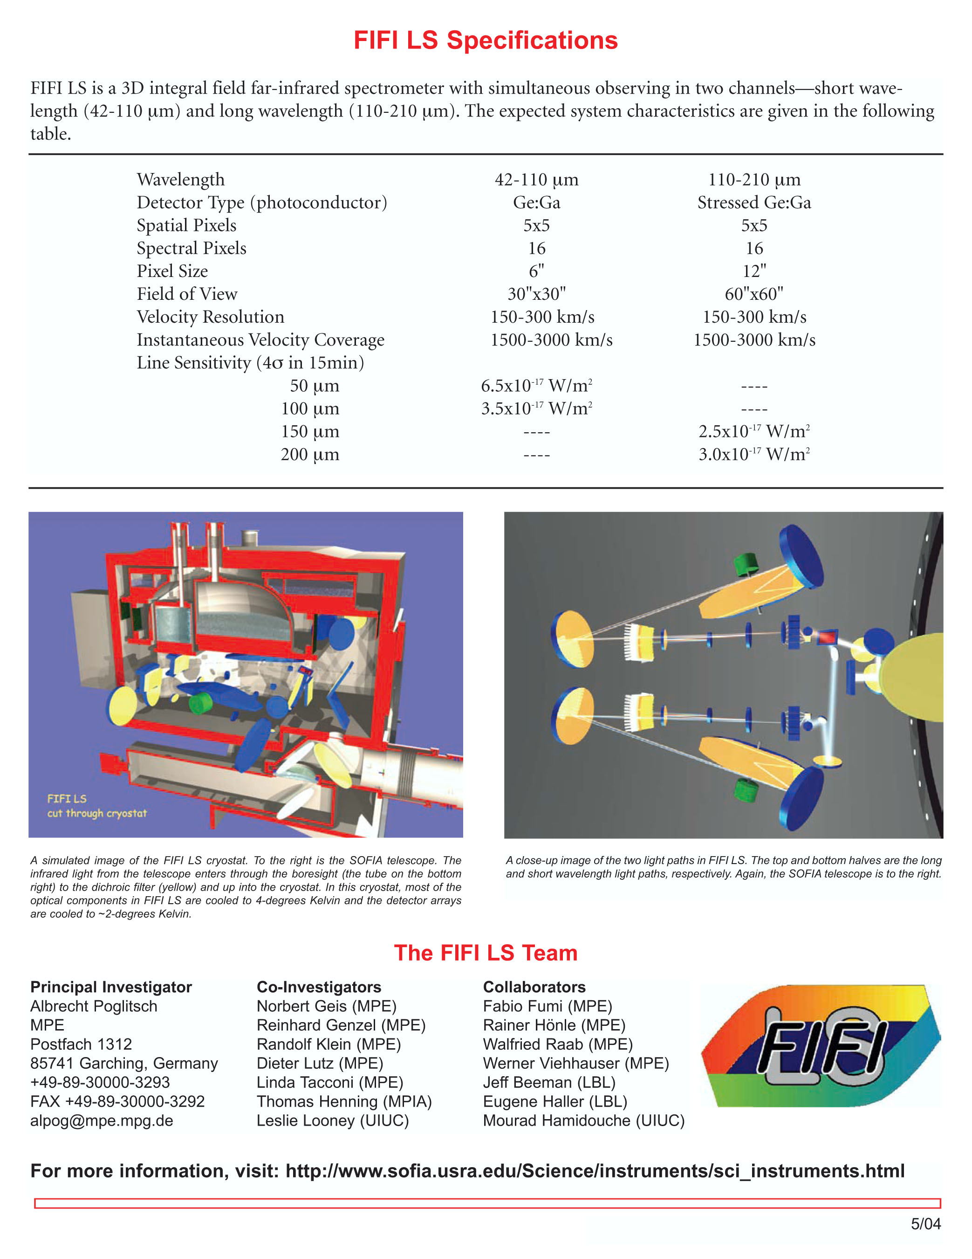
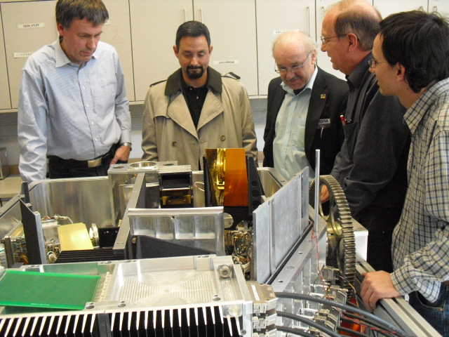
FIFI-LS – Far Infrared Field Imaging Line Spectrometer
- λ = 42 – 110 µm, 110 – 210 µm [FIR]
- FOV: 30“ x 30“; 60“ x 60“
6“/12“ per pixel
velocity resolution: 150 – 300 km/s
velocity range 1500 – 3000 km/s
Detector: Ge:Ga
Read out noise: ≤ 40 electrons
Quantum Efficiency: ~ 80 %
optical system cooled to 4 K; detector cooled to 2 K
Principal Investigator:
Prof. Dr. Alfred Krabbe,
Universität Stuttgart

Slide 21
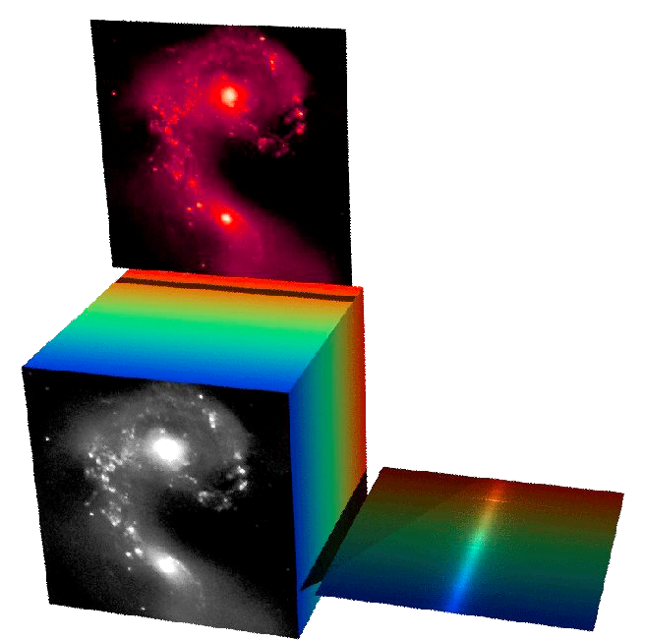
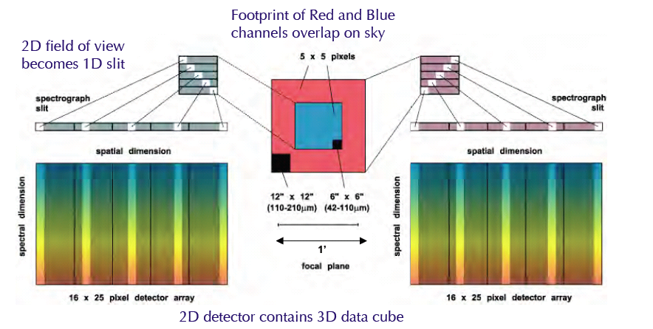
3D imaging:2D spatially and 1D spectrally
Optical slicer places the 2D sky on the 1D spectroscopy slit, so each observation creates an image cube with spatial and spectral dimensions.

Slide 22
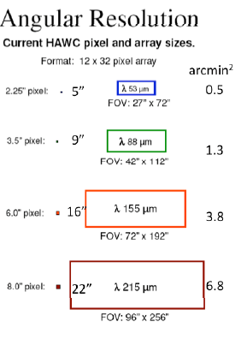
HAWC: High-resolution Airborne Wideband Camera
λ = 40- 300 µm [FIR/Submm]
- Four Filters at 53, 88, 155 and 215 µm
- Bolometer Detector: Goddard Silicon Pop-up Detector (SPUD), 12 x 32 array
Will be upgraded to perform Far Infrared Polarimetry
Far Infrared Bolometer Camera
Principal Investigator:
Dr. Al Harper
University of Chicago, Yerkes Observatory,
Williams Bay, Wisconsin

Slide 23
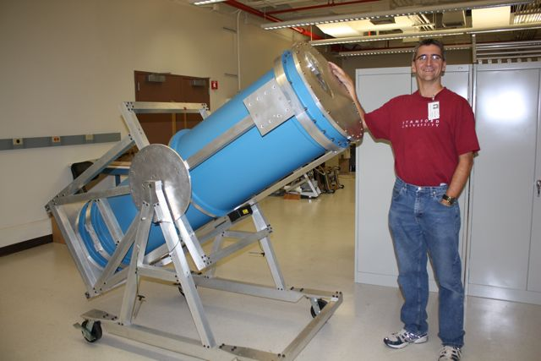
EXES: Echelon – Cross – Echelle Spectrograph
λ = 5-28.5 µm [Mid-IR]
Three Modes at 105, 104, and 3000
Detector: Si:As Blocked Impurity Band (BIB)
Al 6061 (Hyperfine diamond machined)
4“ x 4“ square, 40“ long grating
Three Spectral Modes:
-R = 50-100,000 cross-dispersed
-R = 15,000 long-slit
-R = 4,000 long-slit
plus source acquisition and pupil imaging camera
Science Drivers:
Proto-planetary disks
H2, H2O, CH4 in emission and absorption
line shapes give spatial distribution in Keplerian disks
Gas in star-formation regions
H2O, CH4, C2H2, HCN, CH3, NH3, HNCO, Fe, Fe+, O+3, Ne+, Ne+4, S, S+2, S+3, Ar+, Ar+2, Ar+4
Atmospheres of Planets and Satellites
High Resolution Echelon Spectrometer
Principal Investigator:
Dr. Matt Richter, University of California Davis, being built at NASA Ames Research Center

Slide 24
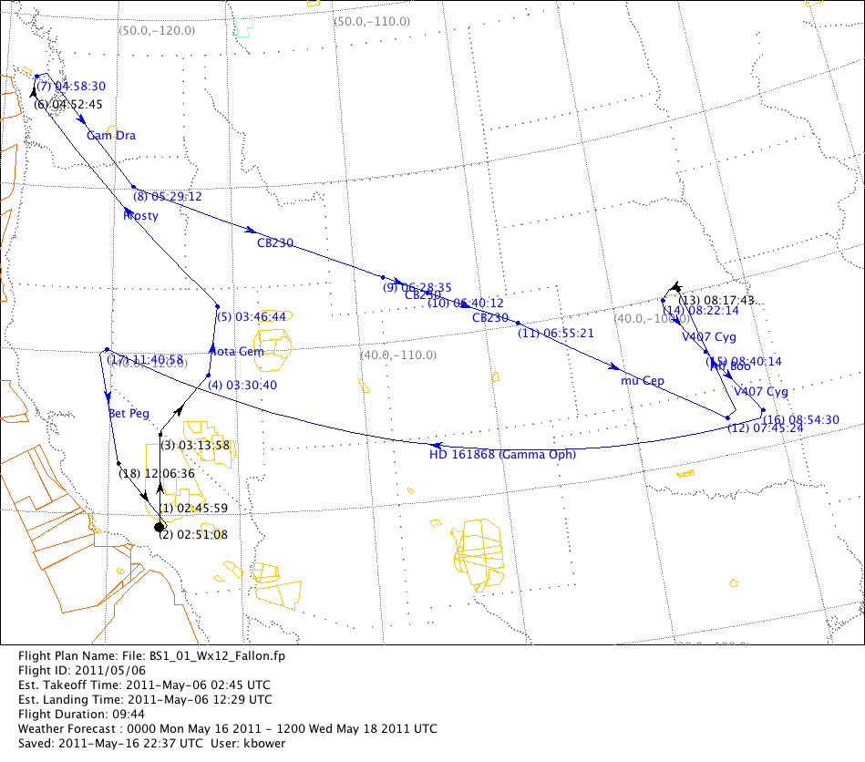
Basic Science Flight Plan
Leg | OBJECT | DUR Min
1 | DEAD LEG - turn | 6
2 | DEAD LEG - climb | 12
3 | DEAD LEG - climb | 7
4 | IOTA GEM | 15
5 | FROSTY LEO | 63
6 | DEAD LEG | 6
7 | GAMMA DRA | 30
8 | CB 230 | 62
9 | CB 230 | 10
10 | CB 230 | 20
11 | MU CEP | 47
12 | ALF BOO | 30
13 | DEAD LEG | 14
14 | V407 CYG | 13
15 | V407 CYG | 17
16 | GAMMA OPH | 148
17 | DEAD LEG | 1
18 | BET PEG | 25
19 | DEAD LEG - Descend | 23

Slide 25
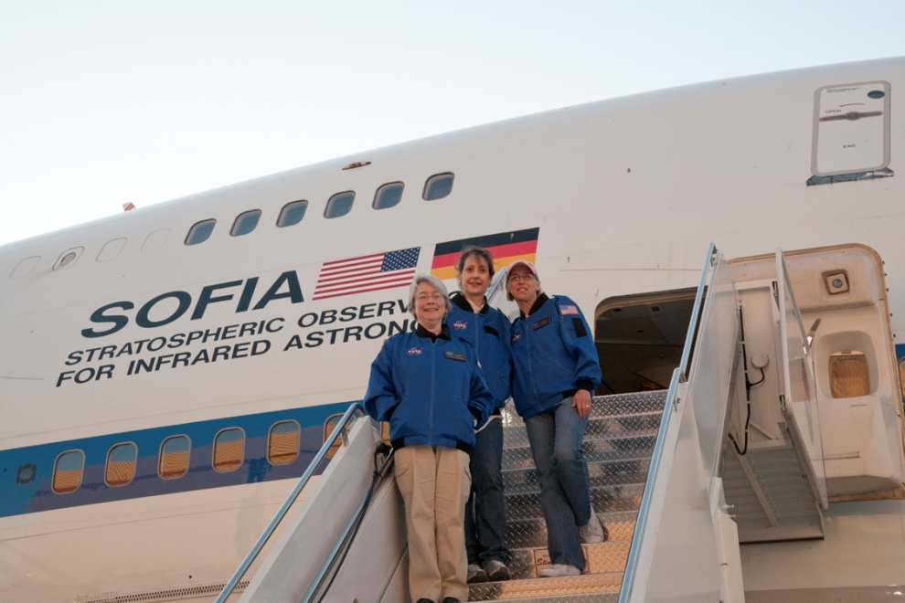
SOFIA EP/O
Airborne Astronomy Ambassadors (AAA) Program Launched
  All 6 US educators in the first AAA class flew on Basic Science 1 flights
  Parallel German AAA program flew their first educators during Basic Science 2
Educators from the first Airborne Astronomy Ambassadors flight. (l-r) Margaret Piper, Lincoln Way High School, Frankfort, Ill.; Theresa Paulsen, Mellen School District, Mellen, Wis.; and Kathleen Joanne Fredette, Desert Willow Intermediate School, Palmdale, Calif.

Slide 26
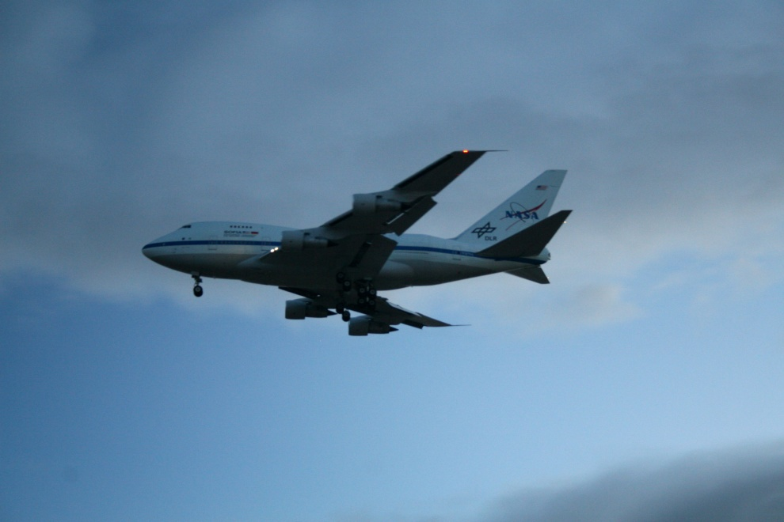
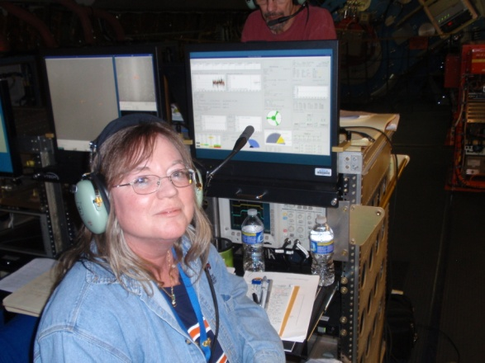
Program making progress!
  Early Science with FORCAST and GTREAT was a great success. (31 refereed papers published)
  Aircraft upgrades in the works
  Next General Observing Cycle starts November 2012
SOFIA will be one of the primary facilities for far-IR and sub-millimeter astronomy for many years
Notes:
2009 is going to be a very important year for us. We have a full schedule of hardware
and flight milestones. (some description of them).

Slide 27
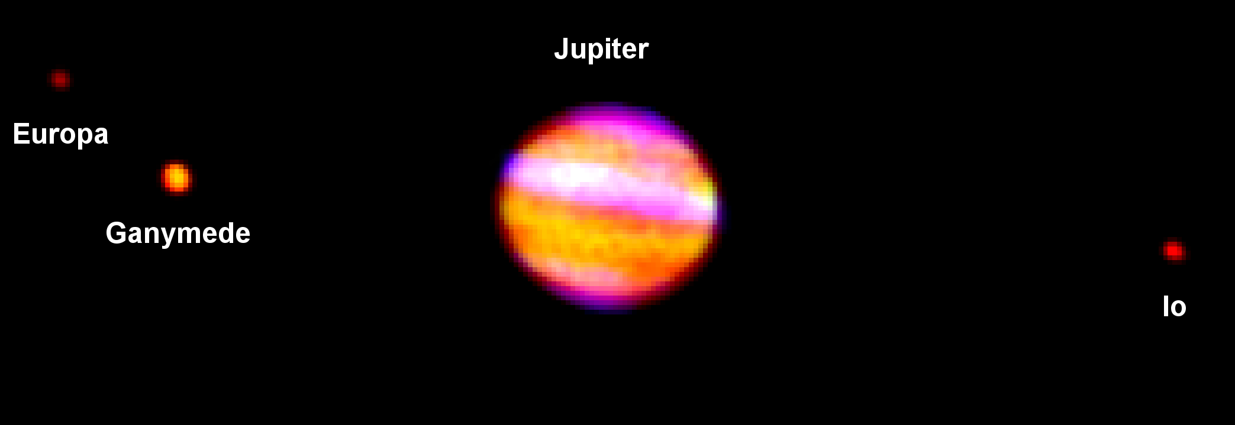
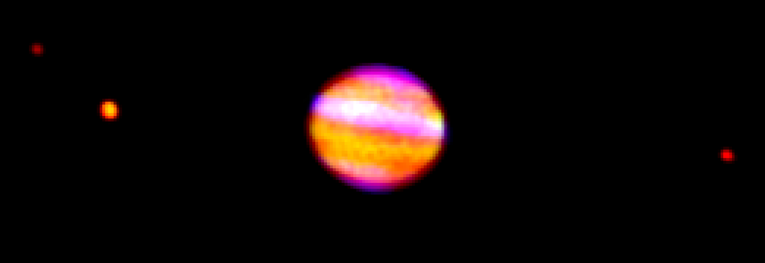
SOFIA First Light Image, May 25, 2010
Red = 37.1um, Green = 24.2um, Blue = 5.4um

