Slide 1
FIFI-LS Highlights
Robert Minchin

Slide 2
FIFI-LS Highlights
Nice face-on galaxies where [CII] traces star formation

Slide 3
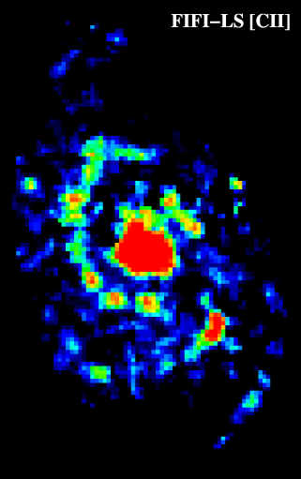
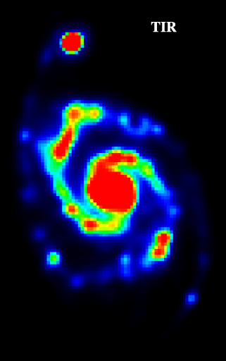
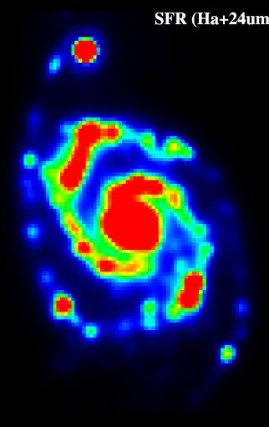
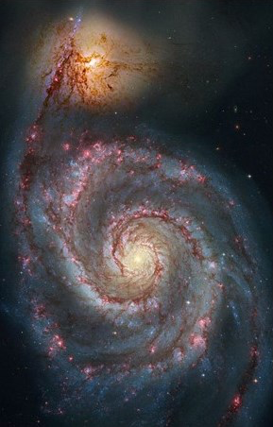
[CII] traces star formation in M51
Pineda et al. 2018
Notes:
M51b – deficient in [CII] compared to TIR continuum (Herschel + Spitzer) and SFR calculated from Halpha & 24um. Interpreted by Pineda et al. as being due to suppressed SF, while IR continuum is powered by other mechanisms. Similar (though a lot less pronounced) [CII] deficit/continuum excess in central region.

Slide 4
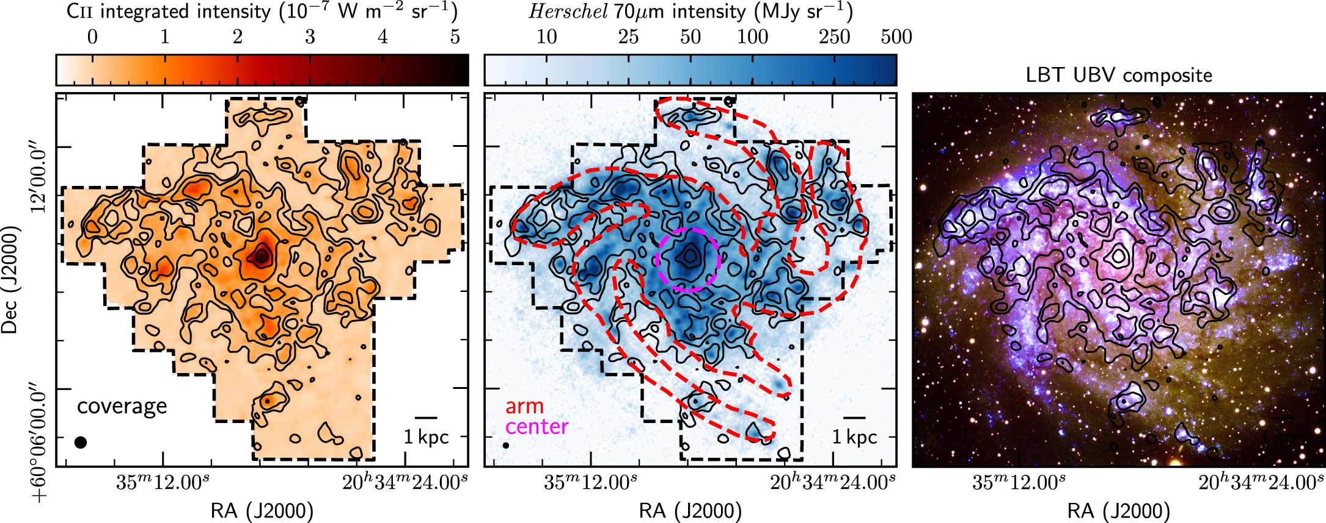
[CII] in NGC 6946
Bigiel et al. 2020
[CII] particularly important as H₂ & SFR tracer in inter-arm regions

Slide 5
FIFI-LS Highlights
Nice face-on galaxies where [CII] traces star formation
Galaxies where [CII] doesn’t trace star formation

Slide 6
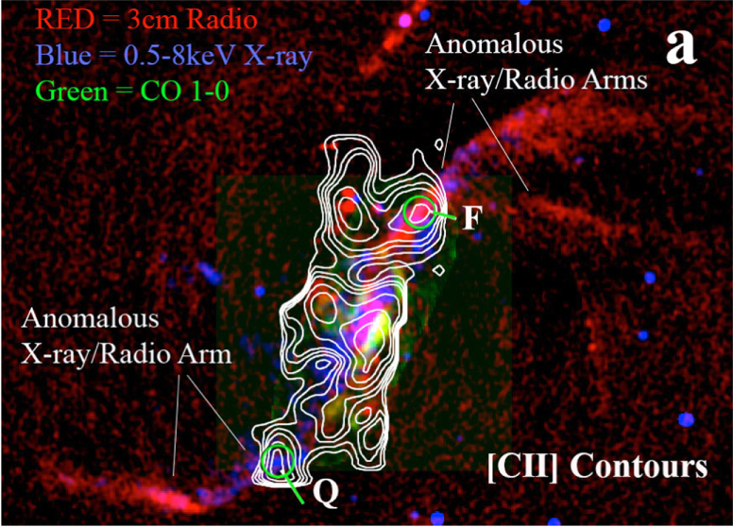
[CII] from shocks & turbulence in NGC 4258
[CII] seen along X-ray/radio ‘arms’ of NGC 4258, associated with past or present jet activity
[CII] excited by shocks and turbulence associated with the jet impacting the disk
NOT star formation
Appleton et al. 2018
Notes:
Describe where [CII] is seen

Slide 7
Excess [CII] in HE 1353-1917
HE 1353-1917 has a large excess in L_{[CII]}/L_{FIR}
AGN ionization cone intercepts the cold galactic disk
Smirnova-Pinchukova et al. 2019
Notes:
Trend. Outlier is the interesting one.

Slide 8
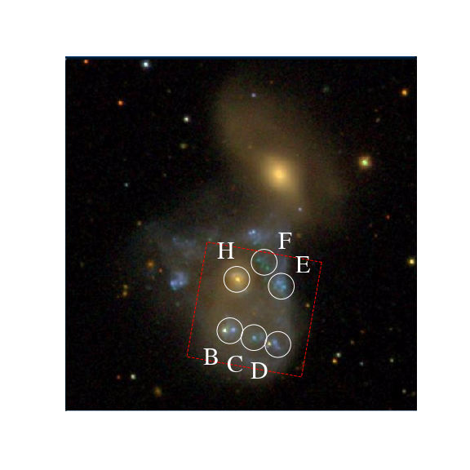
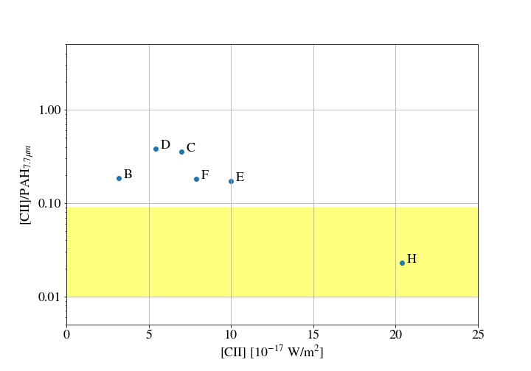
Shock-excited [CII] in NGC 2445
[CII] in the ring of NGC 2445 is enhanced compared to PAHs, showing a shock excitement origin rather than star formation
Fadda & Appleton, 2020, AAS Meeting 235

Slide 9
FIFI-LS Highlights
Nice face-on galaxies where [CII] traces star formation
Galaxies where [CII] doesn’t trace star formation
Galaxies with gas away from the plane

Slide 10
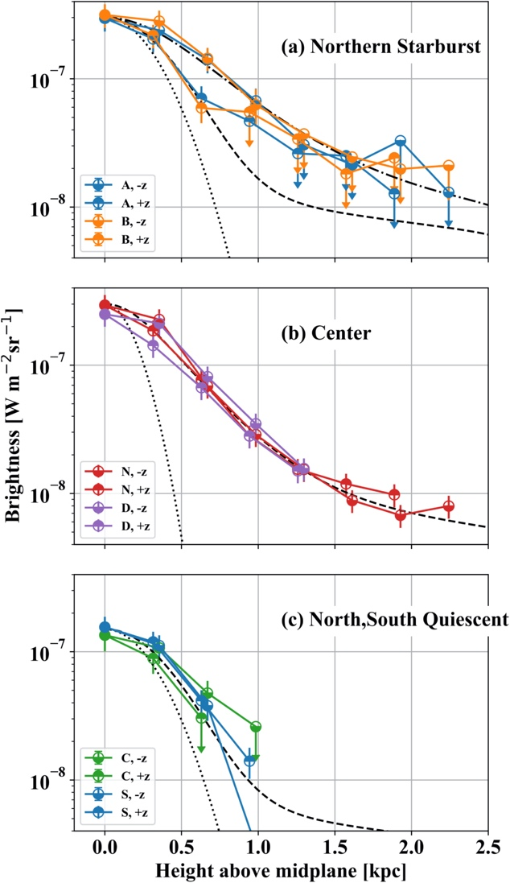
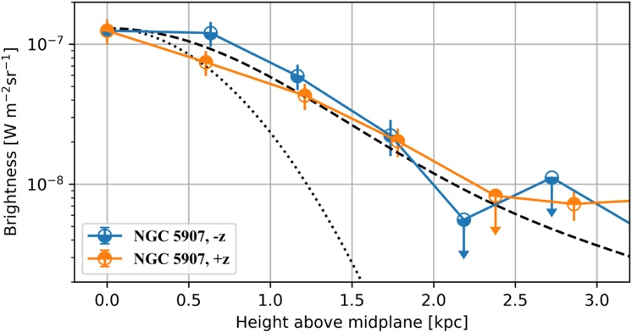
Extraplanar [CII] in edge-on galaxies
Edge-on galaxies NGC 891 & NGC 5907 observed by Reach et al. (2020)
Figures show [CII] off the plane of the galaxy in NGC 891 (left) and NGC 5907 (below right)
[CII] much more extended than MIR emission, which traces current massive star-formation
May arise in walls of ‘chimneys’
where winds and SNe from
SF regions carry material up
into the halo

Slide 11
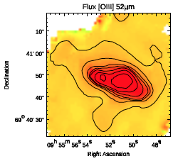
Outflows in M82
Observations of M82 by Latzko et al. detect both [CII] and [OIII] 52 µm in the outflow
Velocity field confirms that seen by PACS (central region only) for [CII]; [OIII] differs from
[CII] (but has lower SNR)
Also observed at 57 µm
by Spilker et al.
[OIII] 52 µm
(same scale)
Latzko et al. 2018, KMOS@5 meeting

Slide 12
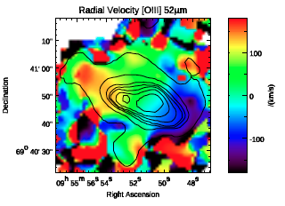
Outflows in M82
Observations of M82 by Latzko et al. detect both [CII] and [OIII] 52 µm in the outflow
Velocity field confirms that seen by PACS (central region only) for [CII]; [OIII] differs from
[CII] (but has lower SNR)
Also observed at 57 µm
by Spilker et al.
[OIII] 52 µm
(same scale)
Latzko et al. 2018, KMOS@5 meeting

Slide 13
FIFI-LS Highlights
Nice face-on galaxies where [CII] traces star formation
Galaxies where [CII] doesn’t trace star formation
Galaxies with gas away from the plane
Metallicity measurements

Slide 14
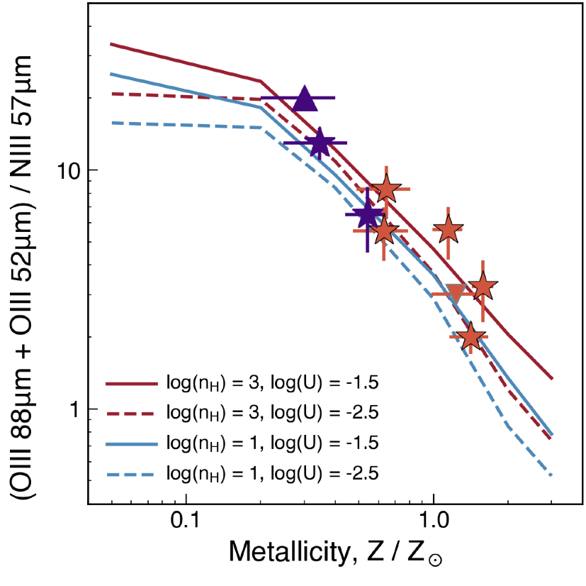
Extinction-free FIR metallicities
Possible to calculate metallicity using [OIII] at 52 & 88 µm and [NIII] at 57 µm
Many projects underway using this on various galaxies
Plot shows preliminary results from new SOFIA measurements by Spilker et al. (purple) and existing ISO + Herschel + SOFIA data (red)
Spilker 2020, SOFIA Instrument Roadmap Workshop I

Slide 15
FIFI-LS Highlights
Nice face-on galaxies where [CII] traces star formation
Galaxies where [CII] doesn’t trace star formation
Galaxies with gas away from the plane
Metallicity measurements
Our Galactic Center

Slide 16
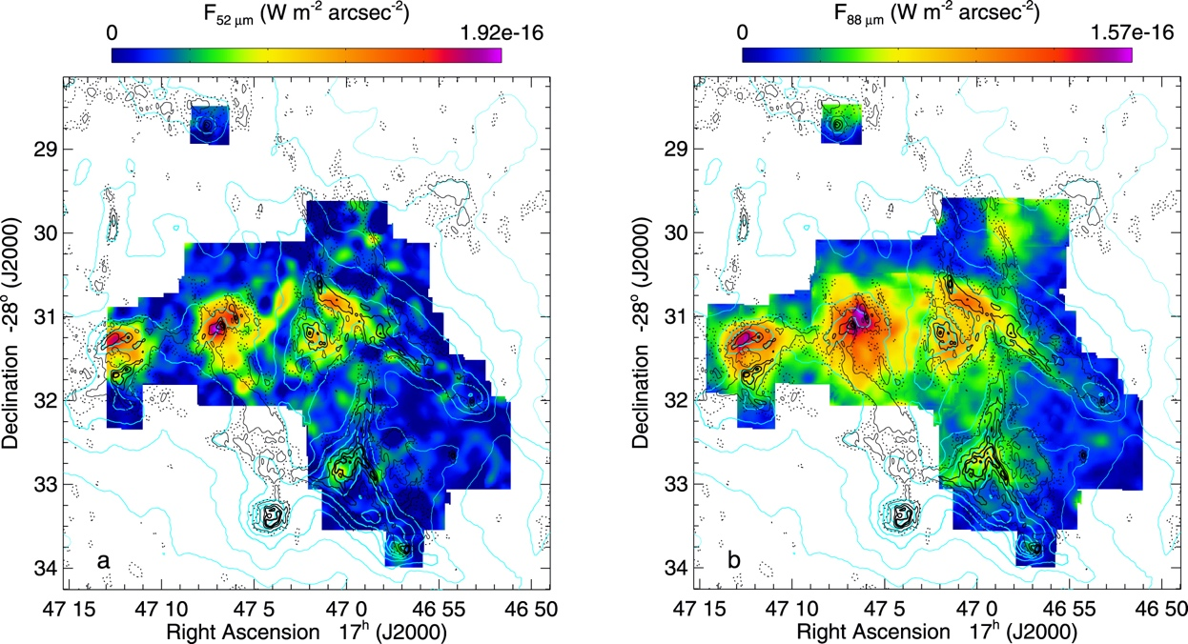
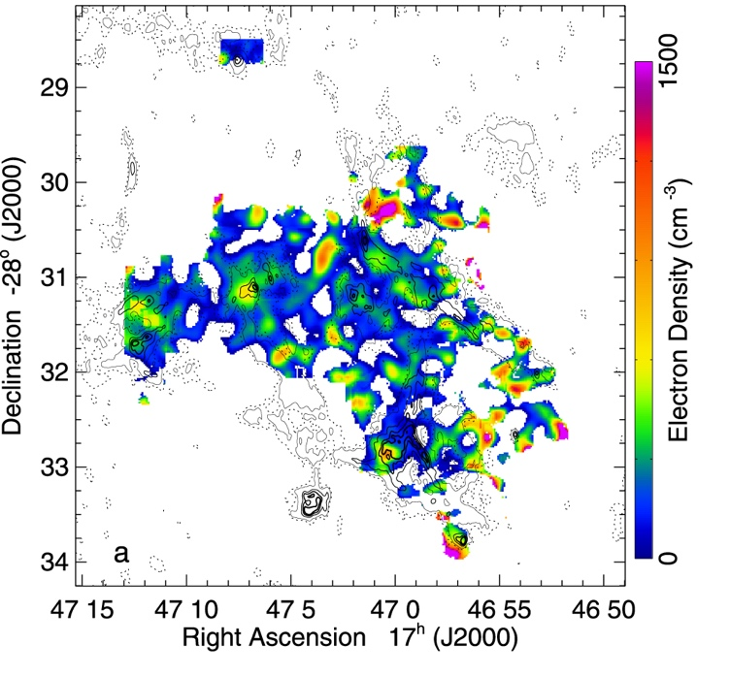
Sgr B1 – ionization structure & sources of excitation
[OIII] 52 and 88 µm maps (left) give the electron density (right)
Combination with Spitzer data gives O⁺⁺/S⁺⁺ and Ne⁺⁺/O⁺⁺
Maps show at least eight scattered regions of high ionization, surrounded by areas of low ionization
Likely that ionizing star cluster is at least a few Myr old and that the stars did not form in situ but are from a previous era of star formation
Simpson et al. 2018

Slide 17
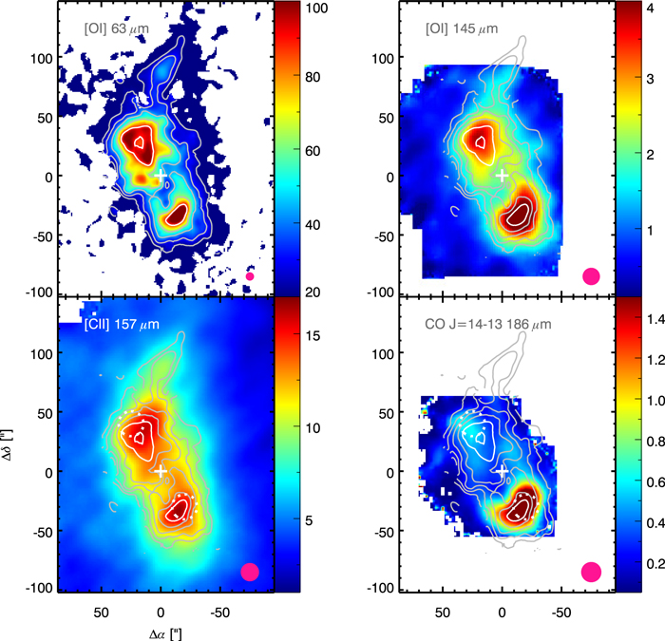
The Circumnuclear Ring
Probe dense photodissociation region using [CII], [OI] (63 and 145 µm), and CO J=14-13 (186 µm)
Also FORCAST images & PACS continuum
Compare with PDR models
Found consistent picture of CNR being a transient toroidal structure powered by cluster of O/B/WR stars orbiting Sgr A*
Iserlohe et al. 2019

Slide 18
FIFI-LS Highlights
Nice face-on galaxies where [CII] traces star formation
Galaxies where [CII] doesn’t trace star formation
Galaxies with gas away from the plane
Metallicity measurements
Our Galactic Center
CO-dark molecular gas

Slide 19
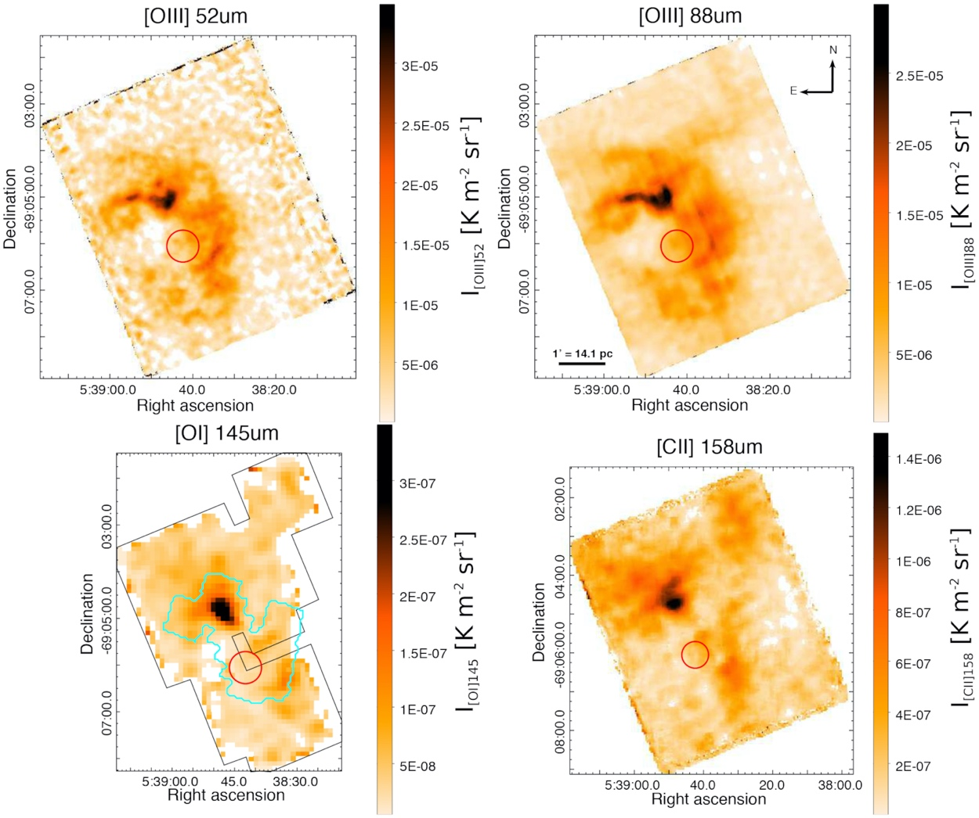
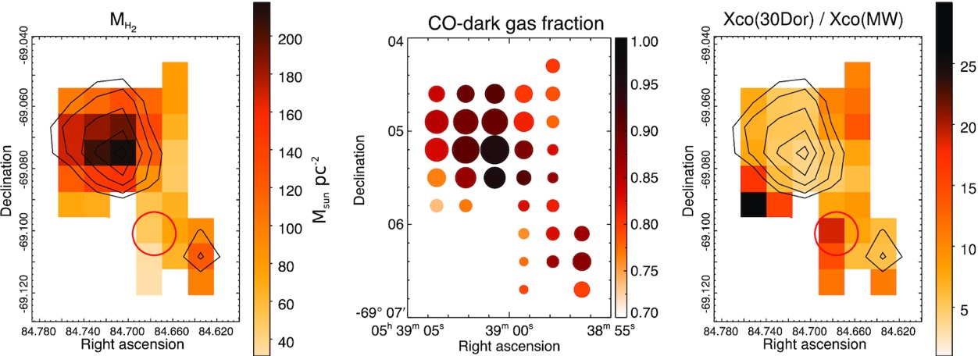
30 Doradus
Observations of [OIII] at 52 and 88 µm combined with [OI] at 145 µm and [CII] & archival data
PDR modelling used to find H₂ mass & CO-dark mol gas fraction
≳75% of H₂ would be missed using standard X_{CO} factor
Chevance et al. 2020

Slide 20
FIFI-LS Highlights
Nice face-on galaxies where [CII] traces star formation
Galaxies where [CII] doesn’t trace star formation
Galaxies with gas away from the plane
Metallicity measurements
Our Galactic Center
CO-dark molecular gas
Accretion bursts in HMYSOs

Slide 21
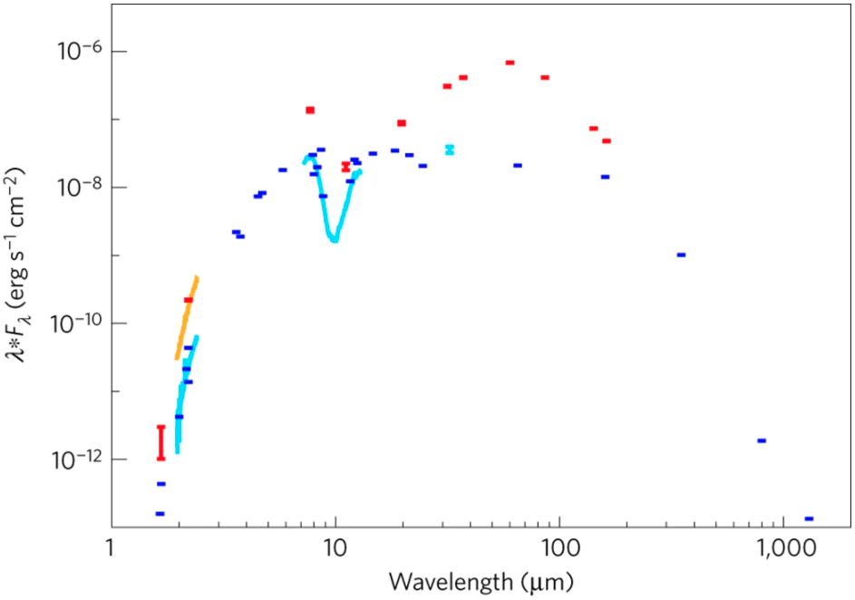
S255IR NIRS 3
FIR (including peak) from FIFI-LS; MIR from FORCAST
Increase in accretion luminosity (ΔL_{acc}) of (1.3 ± _{0.3}^{0.4}) × 10⁵ L⊙ and an energy release of (1.2 ± 0.4) × 10³⁹ J over nine months from start of burst
Confirmed that HMYSOs form via disk accretion, not stellar mergers
Caratti o Garatti, 2017

Slide 22
FIFI-LS Highlights
Nice face-on galaxies where [CII] traces star formation
Galaxies where [CII] doesn’t trace star formation
Galaxies with gas away from the plane
Metallicity measurements
Our Galactic Center
CO-dark molecular gas
Accretion bursts in HMYSOs
Proto-stars and star forming regions

Slide 23
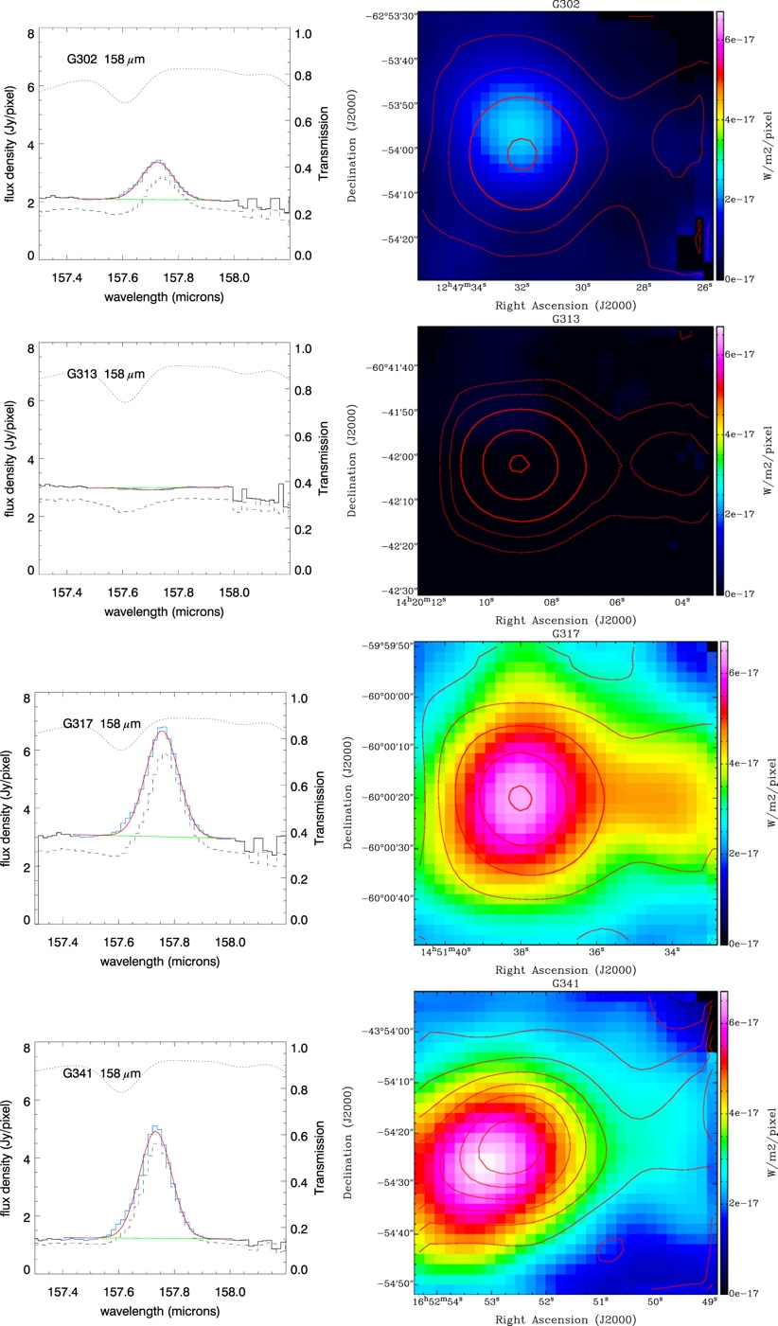
Star forming clumps in [CII]
Does galactic [CII] emission arise from an ensemble of star-forming molecular clumps? Is [CII] a robust tracer of global star formation?
Three of four clumps detected in [CII]
Undetected clump factor > 100 below empirical correlation curve between [CII] and FIR found for galaxies
Possibly early evolutionary stage w/o sufficient UV or dust attenuation of UV
Jackson, 2020

Slide 24
FIFI-LS Highlights
Nice face-on galaxies where [CII] traces star formation
Galaxies where [CII] doesn’t trace star formation
Galaxies with gas away from the plane
Metallicity measurements
Our Galactic Center
CO-dark molecular gas
Accretion bursts in HMYSOs
Proto-stars and star forming regions
…

