Slide 1
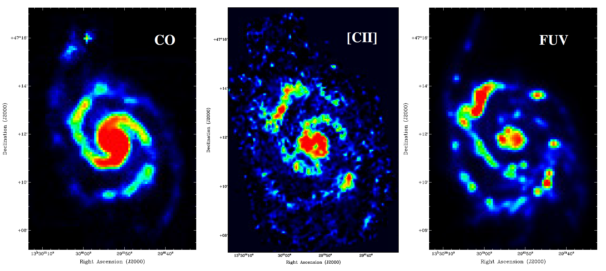
Summer 2020 GREAT Update
Simon Coudé, Kyle Kaplan, & Randolf Klein

Slide 2
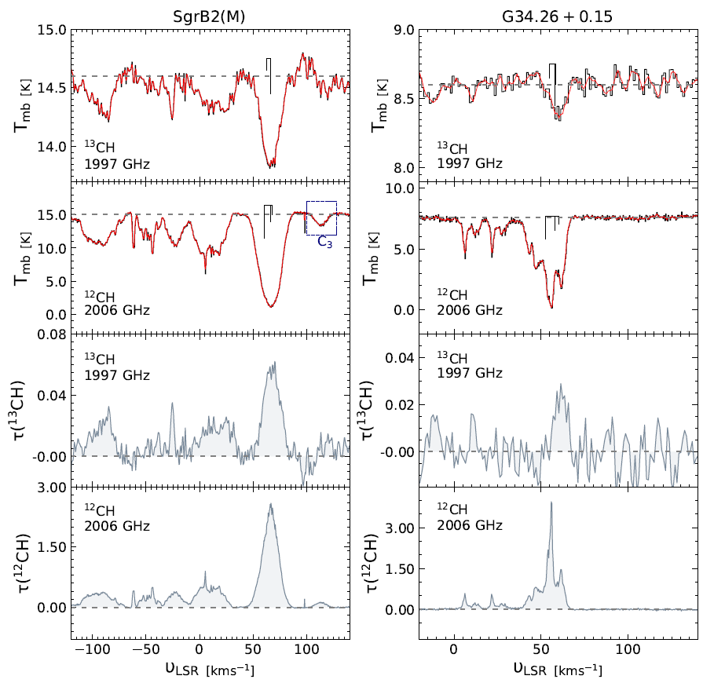
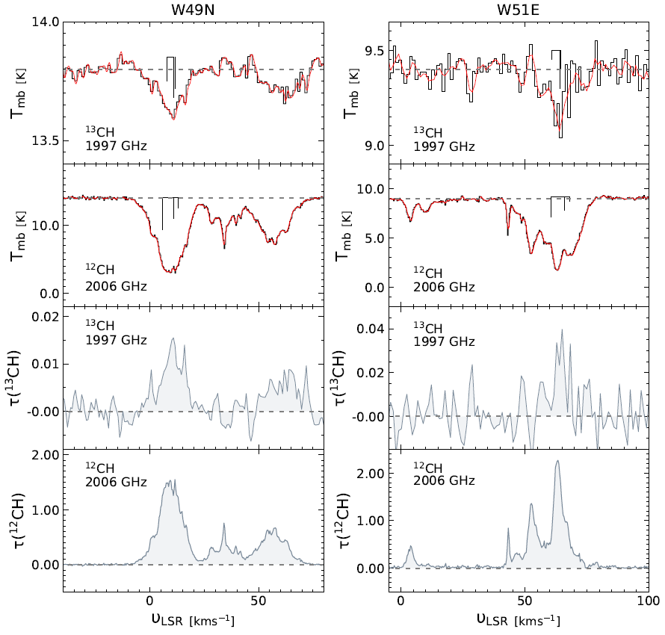
First detection of ¹³CH in the interstellar medium – Jacob et al.
Jacob et al., 2019, A&A, 632A, A60

Slide 3
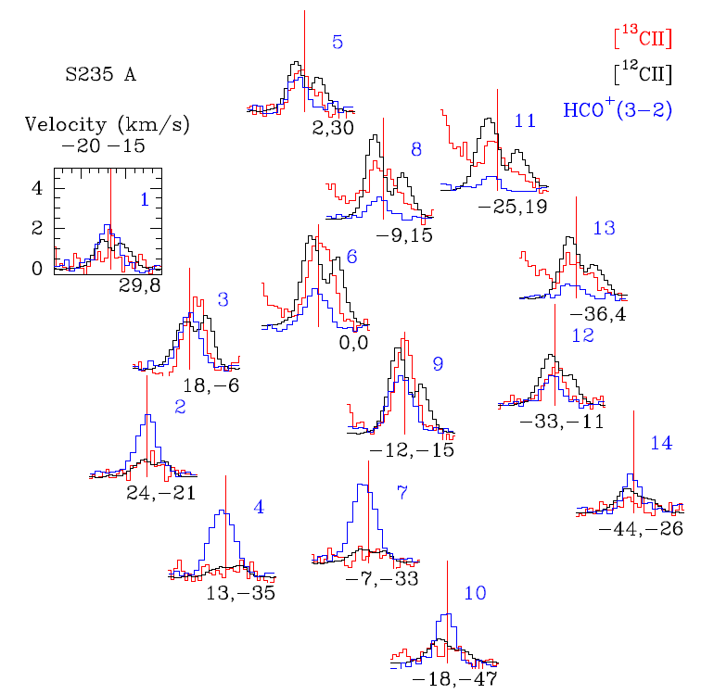
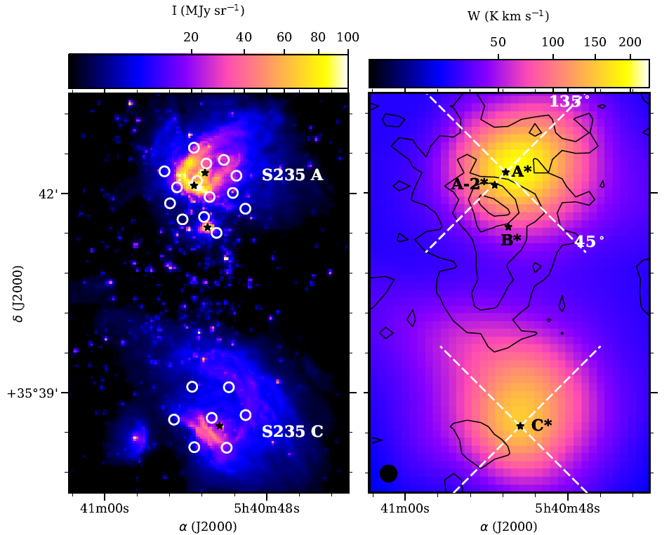
The PDR structure and kinematics around the compact HII regions S235 A and S235 C … – Kirsanova et al.
Kirsanova 2020, MNRAS, 497, 2651

Slide 4
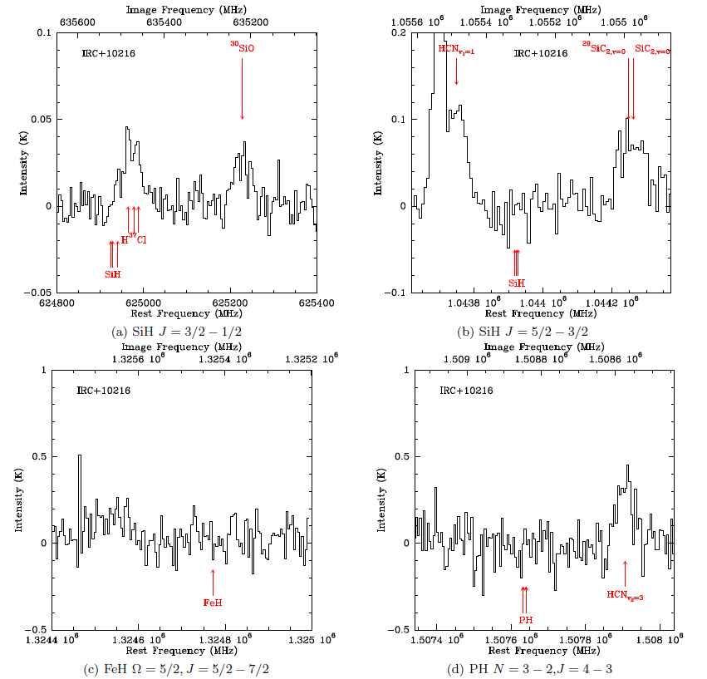
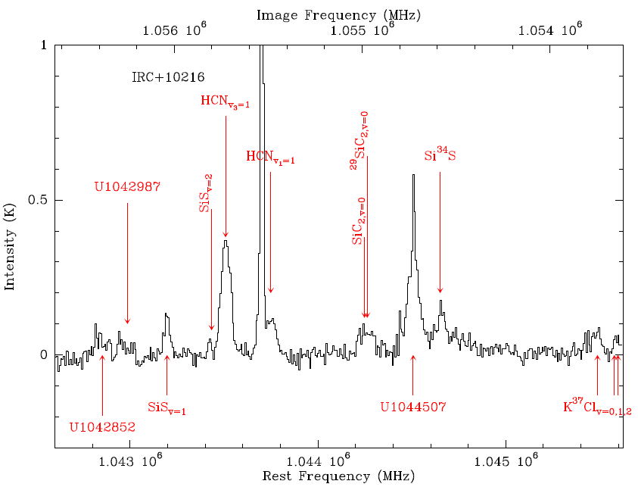
A Search for Light Hydrides in the Envelopes of
Evolved Stars – Siebert et al.
Siebert et al., 2020, ApJ, 901, 22

Slide 5
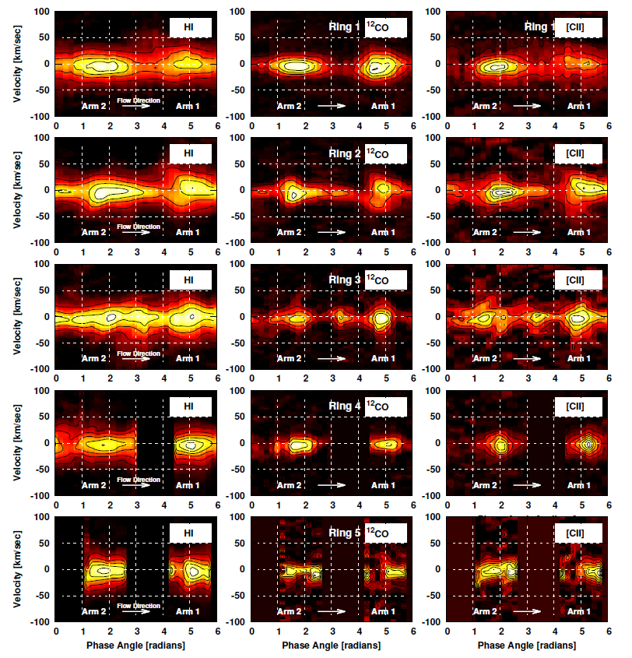
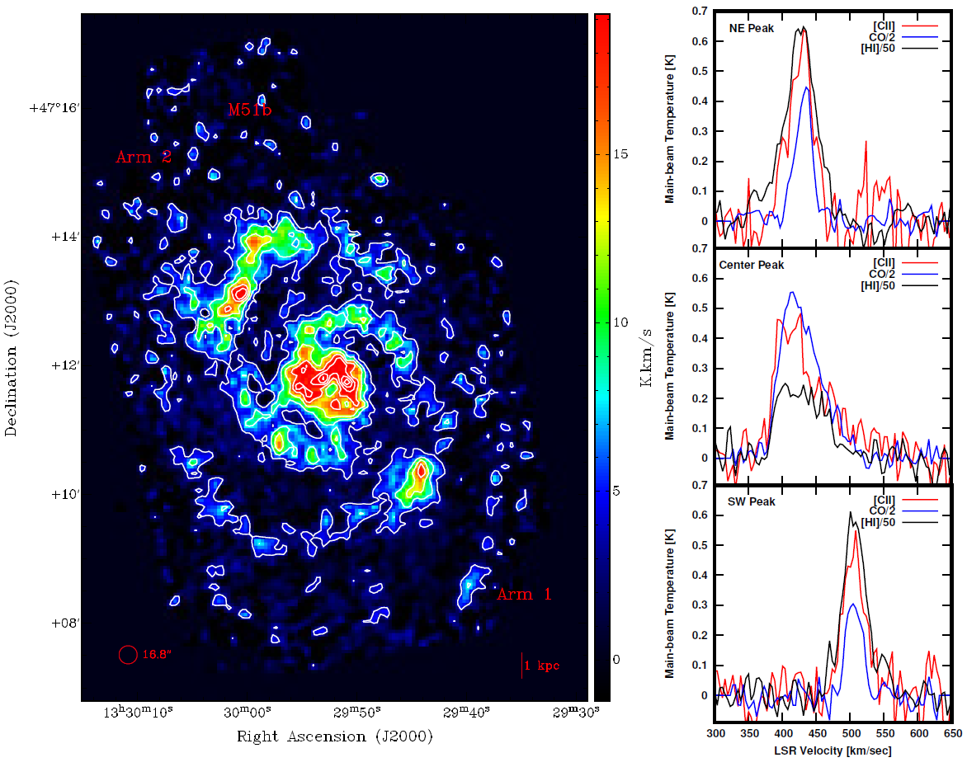
A SOFIA Survey of [C II] in the Galaxy M51 II. [C II] and CO Kinematics Across Spiral Arms – Pineda et al.
Pineda et al., 2020, ApJ, 900, 132

Slide 6
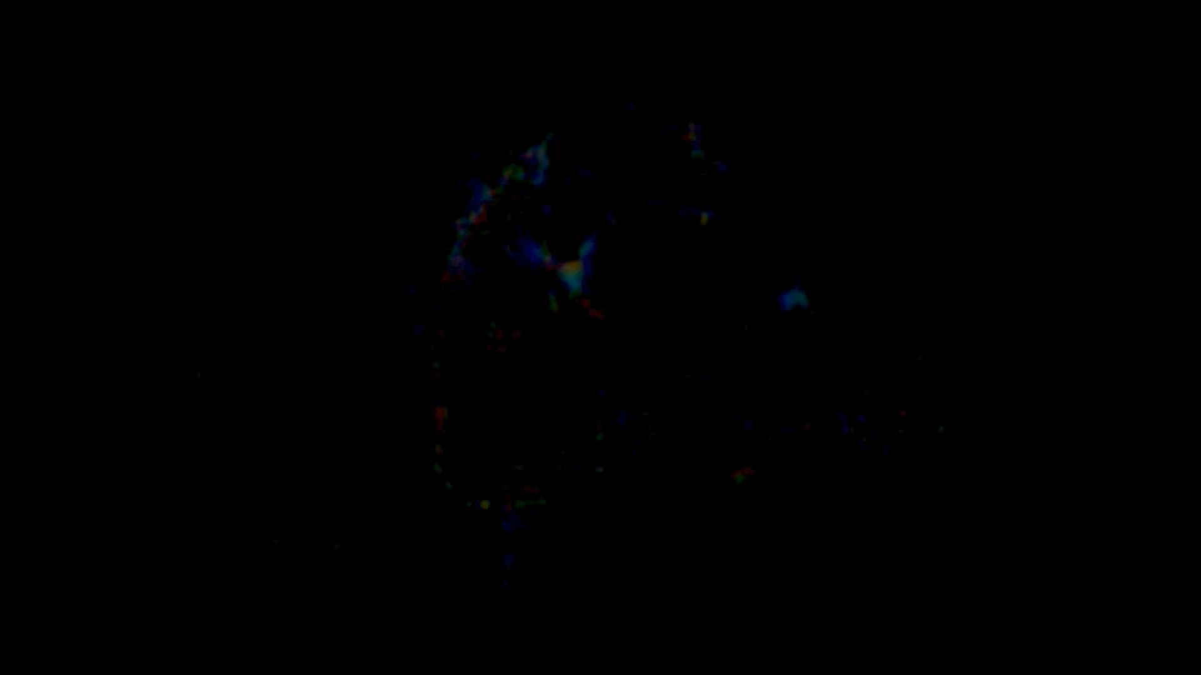
Legacy Program: FEEDBACK
Radiative and mechanical feedback in regions of massive star formation (FEEDBACK)
PIs: Tielens and Schneider (07_0077)
[CII] (and [OI]) data cubes of
11 prominent Galactic sources
6000 arcmin²
96 hours awarded, 33 observed
Allows to study mechanical and radiative feedback of massive stars
Similar data set to Orion [CII] map shows as video here
Pabst et al. 2019, Nature, doi:10.1038/s41586-018-0844-1

Slide 7
Upcoming Legacy Program: HyGal
HyGAL: Characterizing the Galactic Interstellar Medium with Hydrides
PIs: Neufeld and Schilke (08_0038)
Absorption-line spectroscopy
22 sight lines in the Galactic plane
Column densities of OH+, H2O+, ArH+, SH, OH and CH C+ and O
82 hours awarded
Distribution for the H₂ fraction
Cosmic-ray ionization
Characterization of ISM turbulence
SH in absorption with
SOFIA (Neufeld et al., 2012, A&A, 542)

