Slide 1
SOFIA Observatory Overview and Specifications
Last Updated – 2012-09-14

Slide 2
SOFIA Overview
2.5-m telescope in a modified Boeing 747SP aircraft
  Imaging and spectroscopy from 0.3 μm to 1.6 mm
  Emphasizes the obscured IR (30-300 μm)
Operational Altitude
  39,000 to 45,000 feet (12 to 14 km)
  Above > 99.8% of obscuring water vapor
Joint Program between the US (80%) and Germany (20%)
  First Light images were obtained on May 26, 2010
  20 year design lifetime – can respond to changing technology
  Science Ops at NASA-Ames; Flight Ops at Dryden FRC (Palmdale- Site 9)
  Deployments to the Southern Hemisphere and elsewhere
  Goal is >120 8-10 hour flights per year

Slide 3
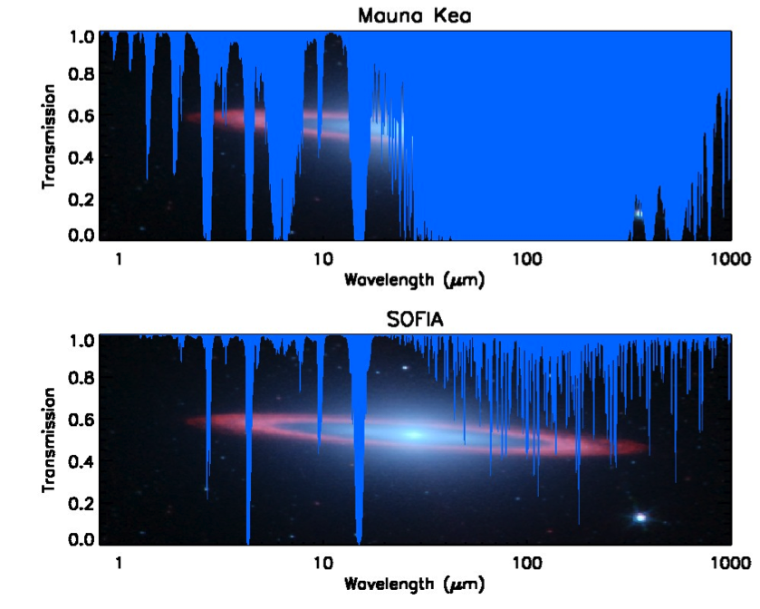
The SOFIA Observing Environment
Above 99.8% of the water vapor
Transmission at 14 km >80% from 1 to 800 µm
Emphasis is on the obscured IR regions from 30 to 300 µm

Slide 4
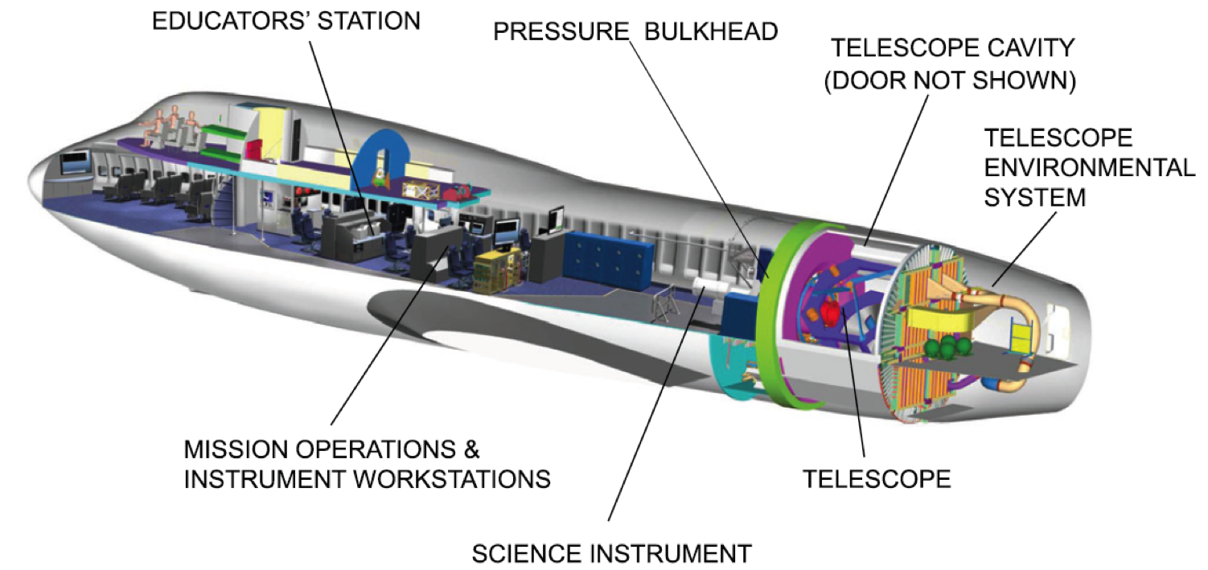
The SOFIA Observatory
E.T Young et al. 2012, ApJ, 749, L17

Slide 5
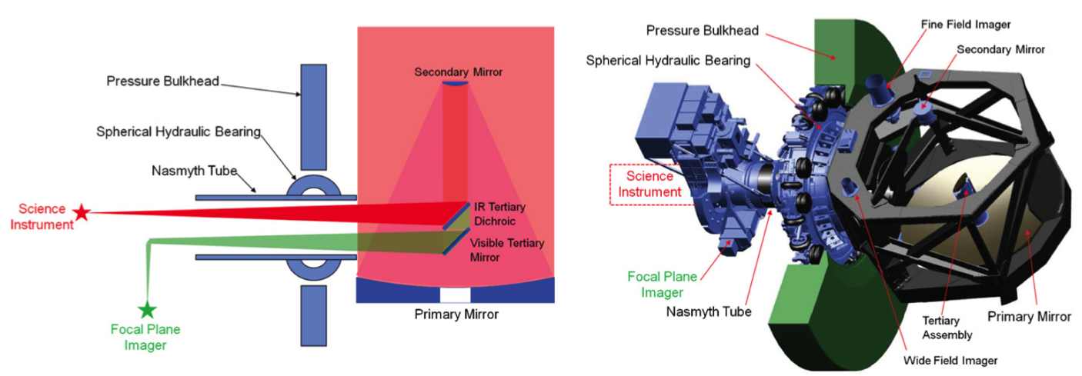
Telescope and Optical Layout
E.T Young et al. 2012, ApJ, 749, L17

Slide 6
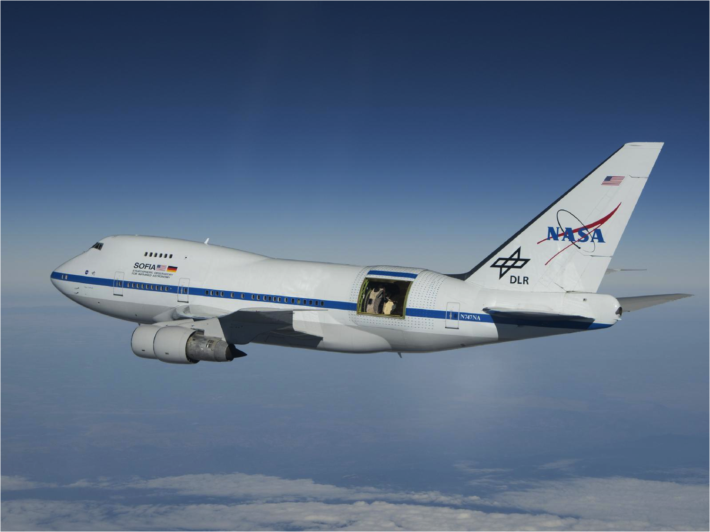
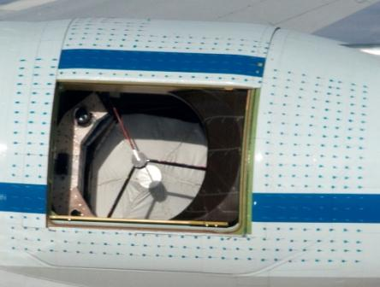
SOFIA Airborne on July 13, 2010

Slide 7
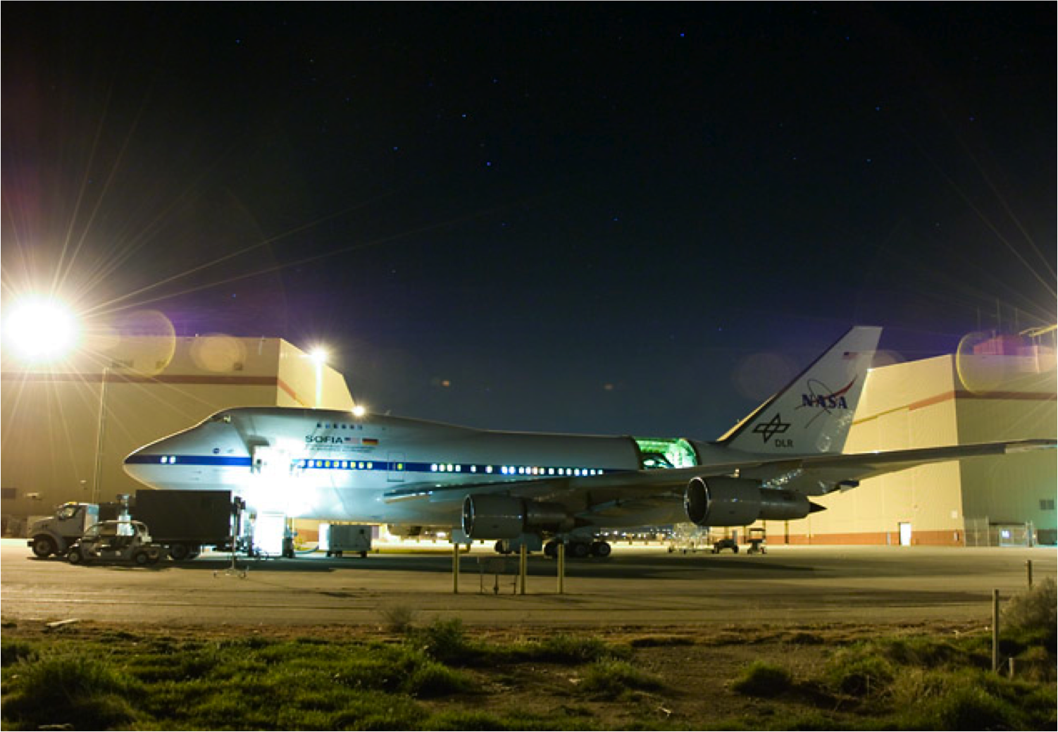
SOFIA at DAOF during Line Ops – Spring 2011

Slide 8
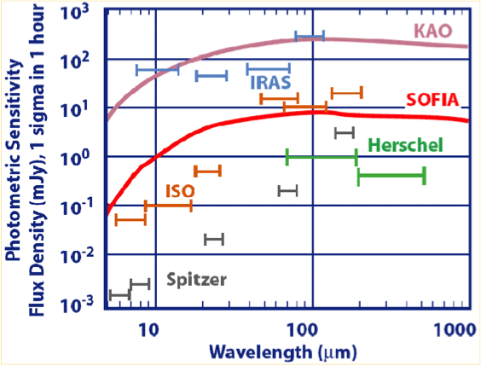
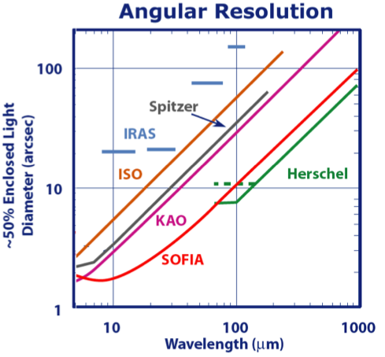
Photometric Sensitivity and Angular resolution
  SOFIA is diffraction limited beyond 25 µm (θmin ~ λ/10 in arcseconds) and can produce images three times sharper than those made by Spitzer
SOFIA is as
sensitive as ISO

