Slide 1
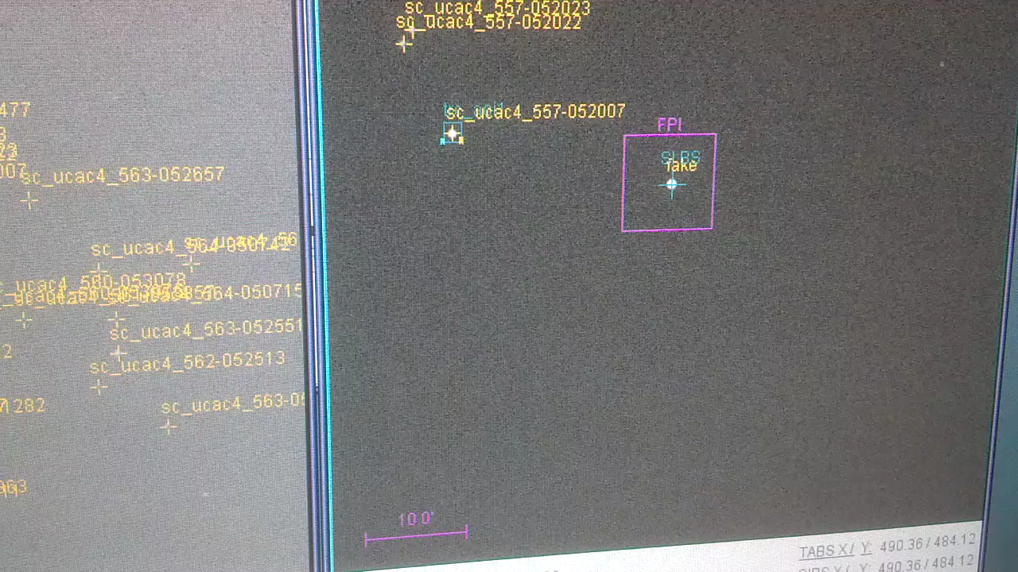
Integration Lab Results
Guiding on a star in FFI while observing a ~15”/sec object

