Slide 1
User Tools for Cycle 1
Phase I: Proposal Preparation and Submission
R. Y. Shuping
DCS Development Lead
W. Vacca
DCS Senior Scientist

Slide 2
Phase I: Proposal Preparation and Submission
During Phase I, GI prepares proposal and submits electronically to SSMOC for review.
Proposal Contents:
  Cover Info: Investigators, abstract, timing constraints
  List of Proposed Observations: Position, instrument/config, filters/gratings, total integration time, etc…
  Scientific/Technical Justification: attached PDF file

Slide 3
Phase I Tools
SOFIA Instruments Time Estimator (SITE): web-based tool that provides sensitivity estimates (S/N, integration times for given source flux).
  https://dcs.sofia.usra.edu/proposalDevelopment/SITE/index.jsp
SOFIA Proposal Tool (SPT): stand-alone JAVA application for preparing and submitting all proposal materials.
  https://dcs.sofia.usra.edu/proposalDevelopment/installSPT/index.jsp
Visibility Tool (VT): web-based tool that plots visibility/heading plots given source position, aircraft location, and date/time.
  Informational only – output from VT not required as part of proposal submission. But useful in determining schedule constraints.
  https://dcs.sofia.usra.edu/observationPlanning/visibilityTool.jsp

Slide 4
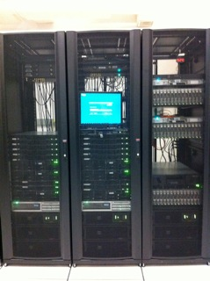
Data Cycle System Planning Database
All proposals submitted to the SSMOC are parsed and stored in the DCS Observation Planning database.
Planning database can be accessed (by SMO staff) via web pages which provide:
  Access controls
  Duplicate checking (between planning DB and archive)
  Review tracking (e.g. time awarded, TAC grade, notes, etc…)

Slide 5
Development Overview
Development for SPT/SITE/VT and proposal submission system is basically complete (all requirements met).
  Upgrades still required for new SIs/modes or updates to existing SIs/modes.
  Exception: spectroscopy support for SITE (see below)
Issues filed as Software Problem Reports (SPRs) and assigned to upcoming releases based on operational needs and resource constraints.
Personnel (FTE):
  Sean Colgan (NASA): SPT/VT/SITE (<1.0 on-going)
  Lan Lin (USRA), R. Krzazcek (RIT): Proposal submission system (~0.5 each, as needed)
  Li Sun (USRA): Planning database infrastructure/applications: (~1.0, as needed)

Slide 6
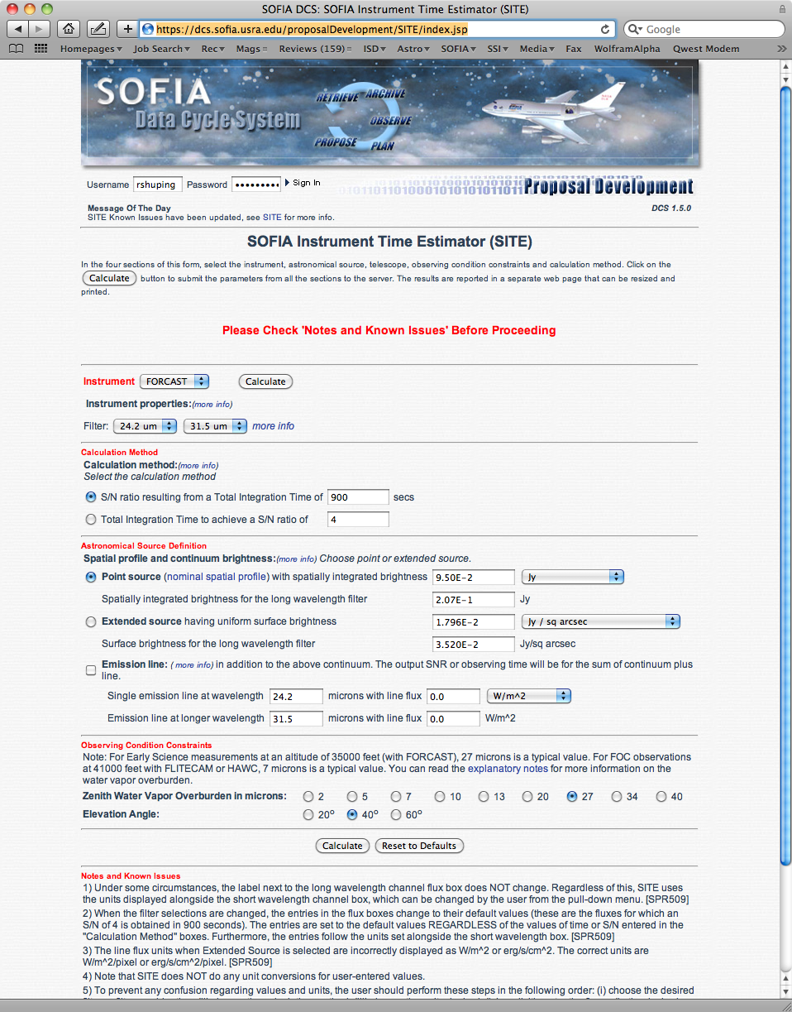
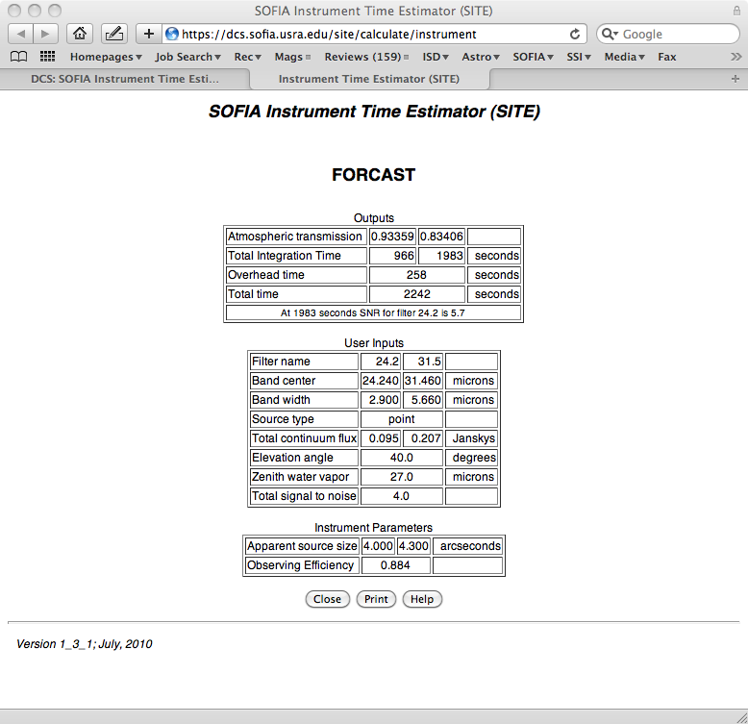

Slide 7
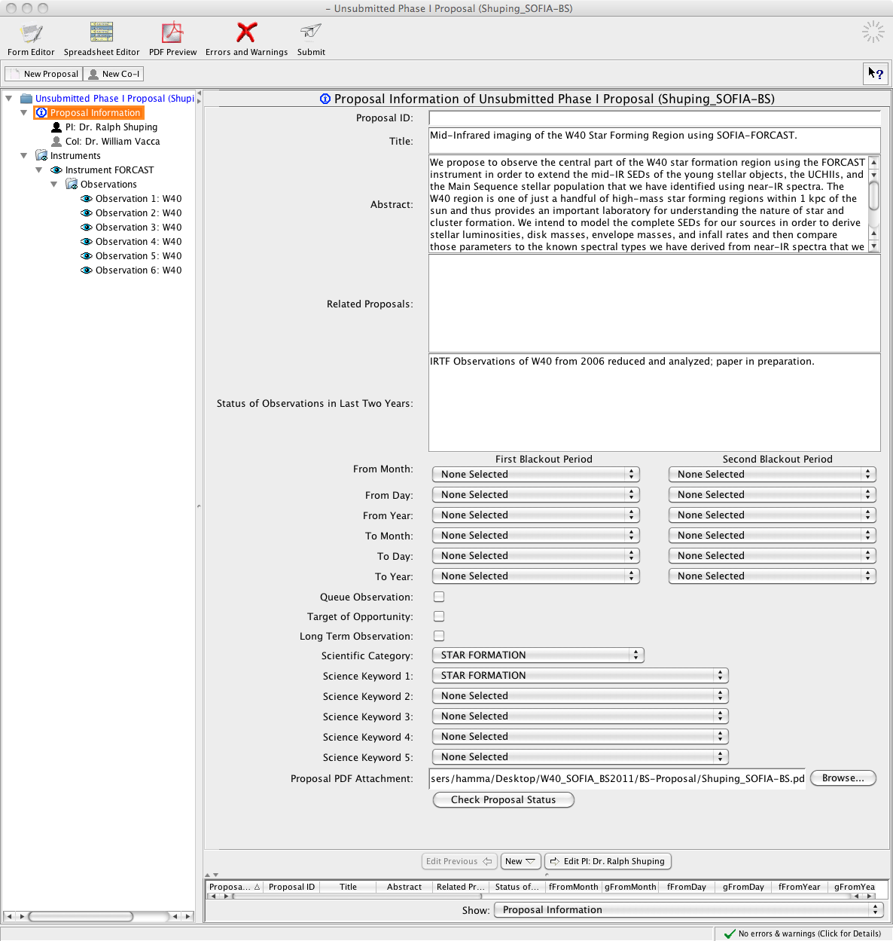
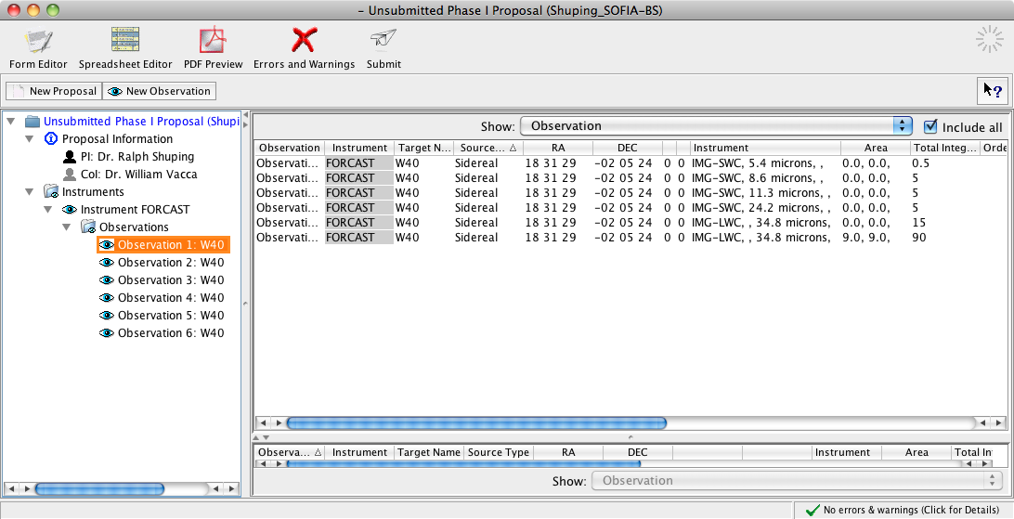
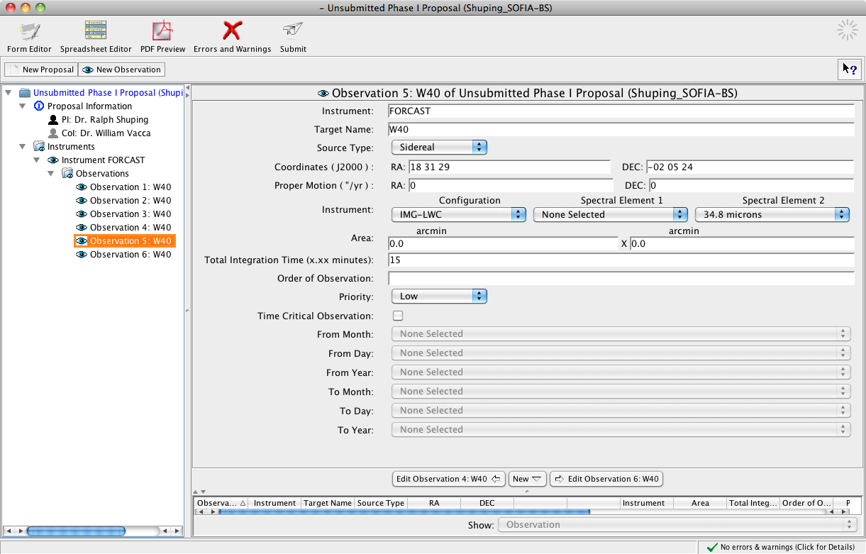

Slide 8
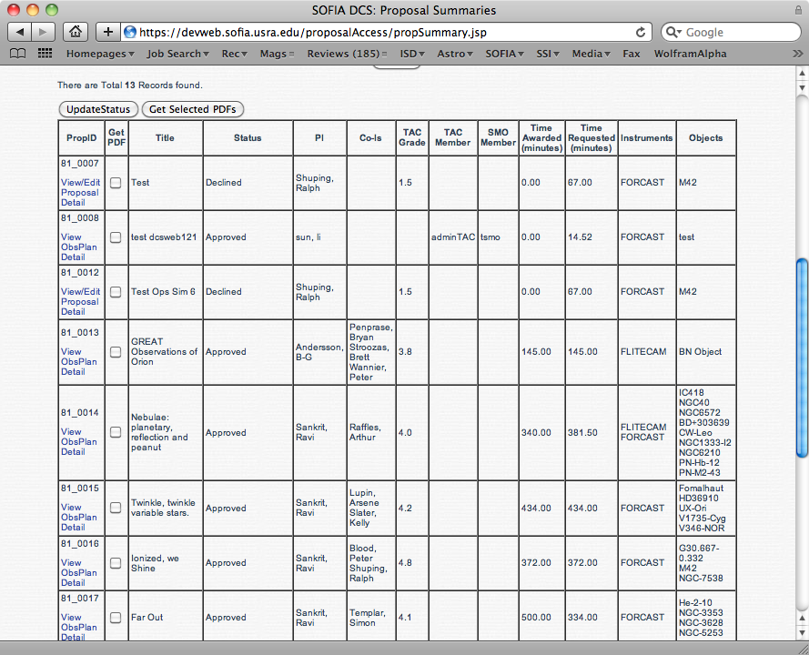
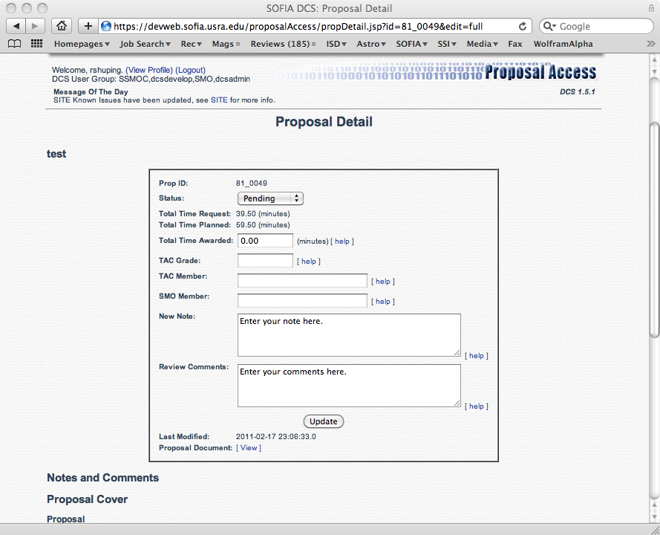

Slide 9
Basic Science Proposal Submission
First real-world use of SPT/SITE and proposal submission system:
  Overall, system worked as designed
  165 submission/resubmission transactions with 9 errors.
Total Proposals Received: 60
Submission loads were modest and well within our system stress test benchmarks:
  Last 24 hours: 90 proposals submitted.
    24 hour system stress test: >1000 proposals submitted.
  Peak submission rate: 1 proposal/min (not sustained)
    System stress test: 120 proposals in 2 minutes.
Issues and Lessons Learned:
  One lost proposal – situation understood, documented.
  22 Software Problem Reports (bugs) filed (SPT/SITE/VT).
  2 procedural issues identified.

Slide 10
Issues with SPT/SITE/VT
SITE Issues:
  Clean up input flux handling (SPR 509)
  Synchronize units in SITE and SPT (SPR 629)
VT Issues:
  Fix/update astronomical name resolution (SPRs 510, 721, 722)
  User interface clean-up (SPRs 217, 442)
SPT Issues:
  Improve error/status messages (SPRs 536, 633)
  Fix support for GREAT frequencies (SPR 549)
  Issues with cover info data (SPRs 380, 533)
  UI Issues (SPRs 520, 538, 551)
  Improve PDF handling (SPR 543, 592)
  Synchronize units with SITE (SPR 630)

Slide 11
SI Configurations to be offered for Cycle 1:
FORCAST Imaging (SUP)
FORCAST Grisms (Shared Risk)
GREAT Low (SUP)
GRAT Medium (Shared Risk)
FLITECAM Imaging (SUP)
FLITECAM Grisms (Shared Risk)
HIPO (SSI)

Slide 12
SPT/SITE Support for Cycle 1
Do we support all Cycle 1 SIs in SPT?
  Yes, not hard and streamlines proposal preparation/review.
  Only issue would be accuracy of overheads for Shared Risk SIs and HIPO.
Do we support all Cycle 1 SIs in SITE?
  Yes for SUP SIs
  Not clear that we will have good sensitivity numbers for Shared Risk SIs. Could provide expected sensitivities via static look-up-tables/plots on SOFIA website.
  What about HIPO?

Slide 13
Updates to SPT and Proposal Submission System
Need specification of SI configurations and modes to be offered (Documented in SI-DCS ICDs) from Cycle 1 SI teams ASAP:
  Filters/grisms available
  Overheads for each observing mode
Need to update SPT and proposal submission system to support new configurations and modes.

Slide 14
Updates to SITE/VT
SITE currently supports imaging modes only. Need to provide support for spectroscopic modes as well:
  Sensitivity as function of wavelength
  Update to atmospheric modeling (ATRAN)
  Slit-losses and other throughput considerations
Need current (best available) sensitivity estimates/algorithms for all SI configurations/modes (documented in SI-DCS ICDs) from Cycle 1 SI teams ASAP.
Need maximum integration time calculator for VT, based on mean time between LOS resets.

Slide 15
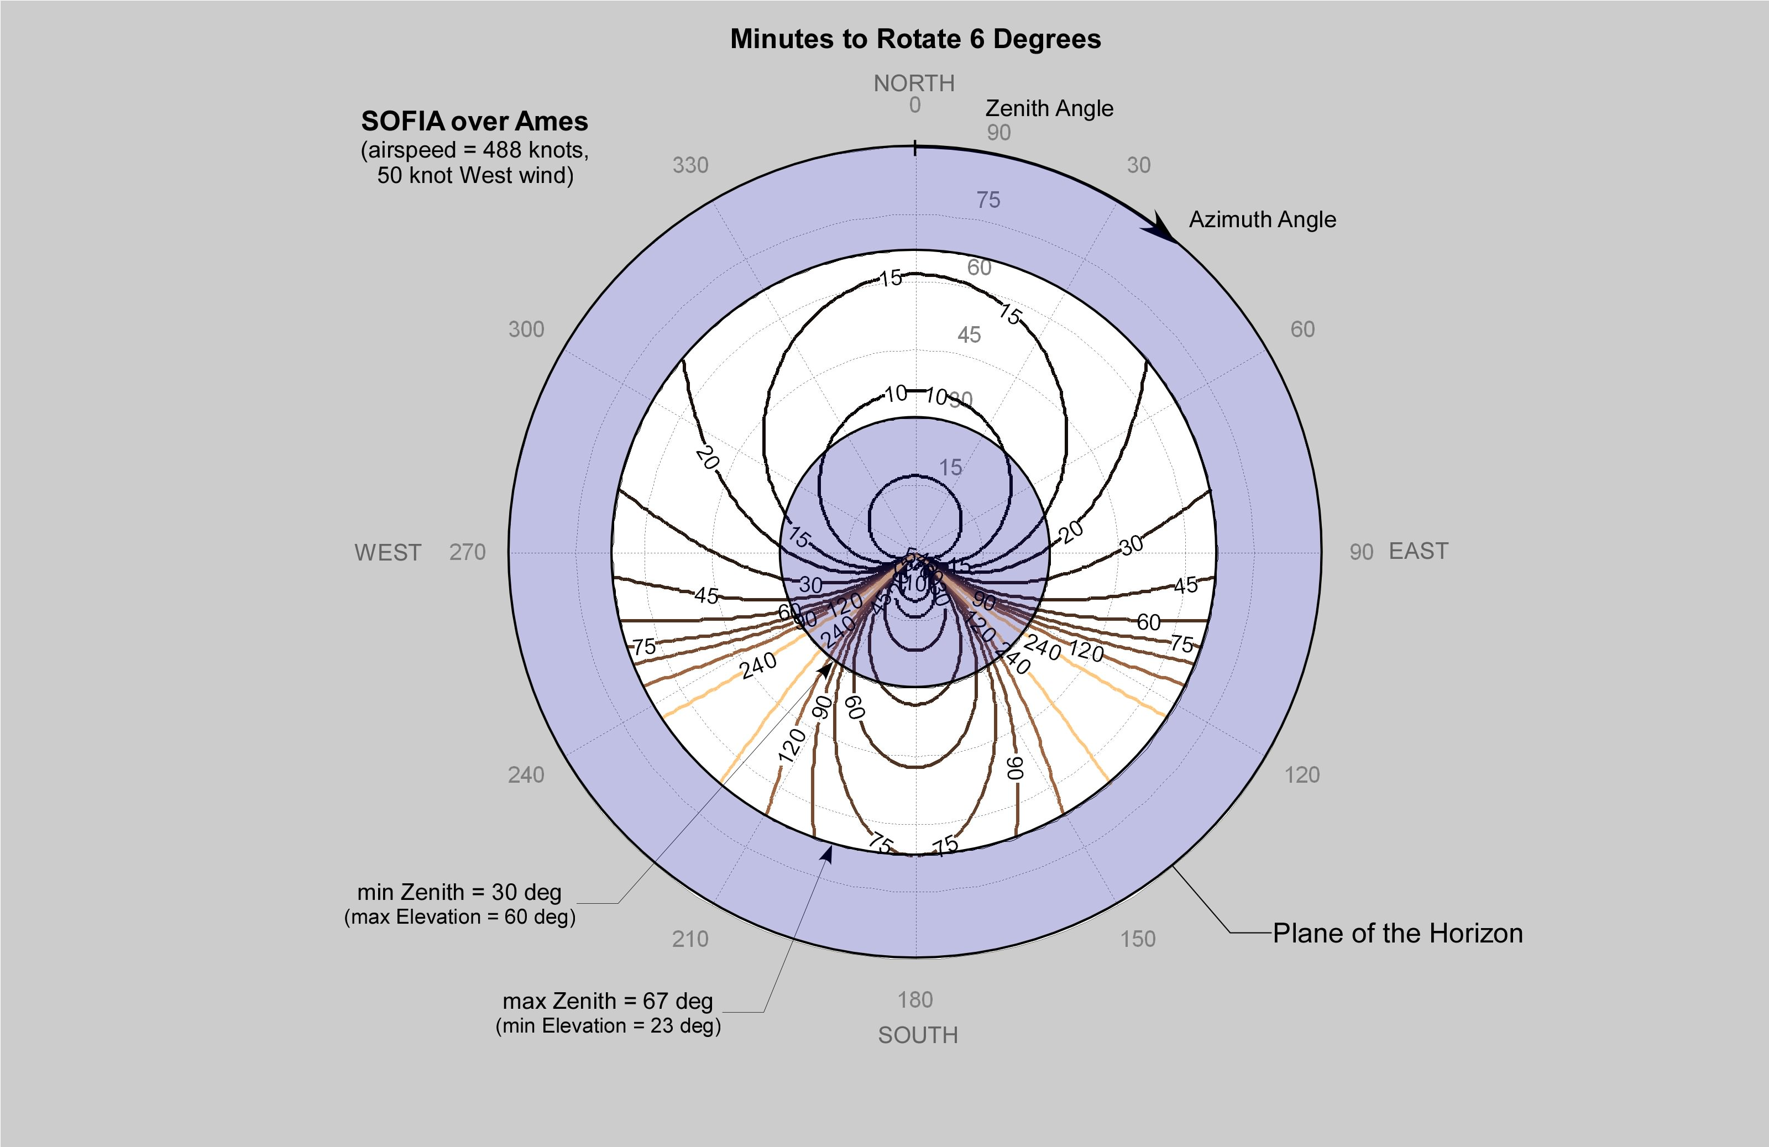
Updates to VT.
Should consider adding maximum integration time calculation to VT (or SITE?), based on mean time between LOS rewinds – very useful for GIs observing faint objects.

Slide 16
DCS v2.0 Development Schedule (SITE/SPT/VT)
July: Delta Design Review
July - Aug: Implementation and informal test
Sept: Test Readiness Review
Sept: Formal Testing
Sept. 30: Release of SITE/SPT/VT
Oct: Cycle 1 Call for Proposals

Slide 17
Proposed Prioritization
Updates to SPT and proposal submission system to support all instruments/configs/modes for Cycle 1.
  Needed to ensure efficient/effective proposal handling.
Update SITE with current sensitivities for all Cycle 1 SIs.
  Needed to ensure that GIs enter correct integration times into SPT.
High priority SPRs (SPT/SITE)
  Issues that affect usability or clarity
Add spectroscopic functionality to SITE for Grisms and GREAT.
  Spectroscopic sensitivities could be provided via static look-up-tables/plots on SOFIA website (Not Ideal).
Add maximum integration time calculator to VT.
Low priority SPRs (SPT/SITE/VT)

Slide 18
Schedule Issues
Currently not enough resources to complete all bug fixes and updates required in time for CfP.
  SPT/SITE development lead (Sean Colgan) is part-time and also working on KOSMA translator software.
Mitigation:
  Add resources: Not clear we can get someone up to speed fast enough to make these updates.
  Reduce Scope:
    SPT changes *must* be done to ensure that we can handle submitted proposals effectively and efficiently
    SITE changes could be scaled back, e.g. provide sensitivities only for fiducial wavelengths. May not provide enough schedule relief.
    Note that SITE updates are not *strictly* required from data handling perspective; time estimates for Grism modes could be provided by some other method.

