Slide 1
User Tools for Cycle 1
Phase II: SOFIA Spot
R. Y. Shuping
DCS Development Lead
L. Lin
DCS Engineer
J. Rho
Associate Scientist

Slide 2
Introduction
Observation planning for SOFIA is composed of two parts:
  Phase I: Proposal Preparation (SPT, SITE)
  Phase II: AOR creation/modification
Early decision was to not force GIs to create AORs as part of the proposal process.
Trade study of existing Obs Planning tools was conducted in 2001: included SPOT, SEA, OASIS, and the Gemini OT.
Trade study was reviewed in 2009 and decision was made by SMO director and ISD manager (Sept.) to go ahead with SPOT as the Phase II planning tool for SOFIA.

Slide 3
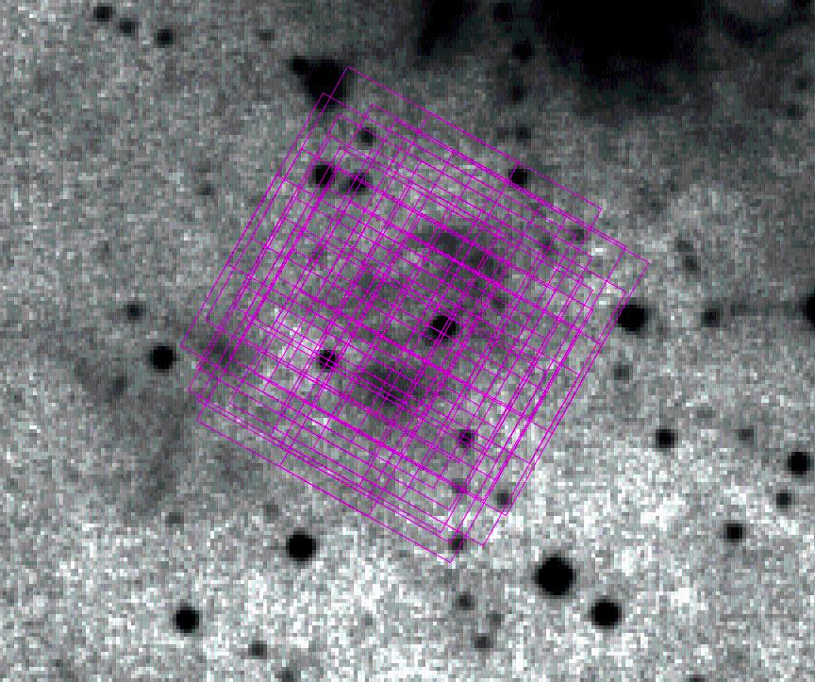
Intro to SPOT
Development Effort: 6-12 FTE, 2 years before and 4 years after the launch
Capabilities:
  Detailed observing strategy : detailed AORs including exact mapping strategy, chopping, nodding, slit selection etc.
  Excellent Visualization Tool
    Archival sky images (IRAS, MSX, 2MASS, etc) specified AOR
    Depth of planned observations
    Moving Target visualization with orbit parameters

Slide 4
Development Overview
SSPOT development composed of two parts:
  SSPOT application
  AOT development and integration
SSPOT application development is part of existing DCS 2.0 plan and schedule:
  Independent of SI team
  Support from IPAC SPOT team
  Subject to standard QA process (SCI-US-PLA-PM21-2011)
AOT development is parallel effort (until SSPOT app complete)
  Depends on SI specification and team

Slide 5
SSPOT Development Personnel
Lan Lin (< 1.0 FTE): SSPOT Development Lead
  Application Development
  AOT Integration
Li Sun (< 1.0 FTE): Database interface development
Jeonghee Rho (0.25 FTE): AOT specification and IPAC coordination
  With support from USRA Scientists
SSPOT Science Working Group:
  Charter:
    Evaluate/recommend changes to GUI layout/design/functionality
    Address science issues and provide algorithms (as needed)
    Feature prioritization
  Membership: Shuping (Chair), Rho, de Buizer, Vacca, Sandell, Andersson, Sankrit, Maureen, John V., L. Lin, Reach (visiting), Moore (visiting).

Slide 6
Adapting SPOT to SOFIA: Challenges
Separate Phase II Planning:
  Additional state management required
  Synchronization with the SOFIA DCS Obsplan DB
AOT specification is fluid:
  Software must handle frequent AOT updates, especially early on.
Details of focal plane overlays (e.g. PA) depend on exact time of observation; unknown at planning time.
SOFIA will have numerous AOTs over a long observatory lifetime:
  Requires robust AOT and AOR versioning approach/system so that users can always upgrade old AORs for use with most recent version of SSPOT.

Slide 7
Design Goals
User Experience
  Familiar, Intuitive Interface
  Feedback
    Status, Help, Knowing where you are
  Clarity
    Smart defaults
    Valid state
    Limits
  Network or Stand-alone
  Ease of Use
    Easy to learn
    Easy to install
    Easy to upgrade (both application and AORs)
Developer Experience
  Use of Objected Oriented principles and design patterns
  Easy to modify existing AOT
  Easy to add instrument
  Easy to add instrument mode

Slide 8
SSPOT Application Design/Implementation Activities
Develop ConOps and derived requirements (complete)
Develop Prototype (complete)
Develop/Update V&V Plan (in-work)
Develop/Update Architectural Design (in-work)
Develop Planning DB Interface (in-work)
Update visualization functionality (chopping/nodding)
Develop additional required functionality
Develop/update test procedures for V&V
Informal Testing

Slide 9
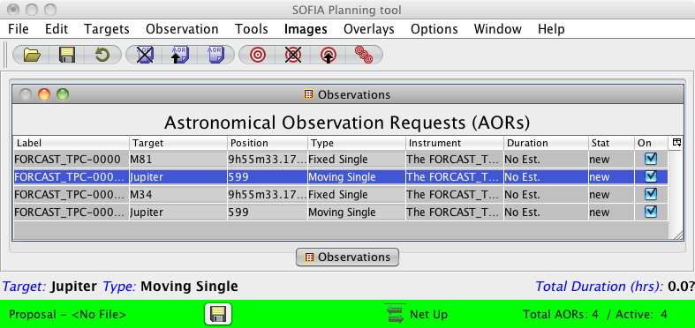
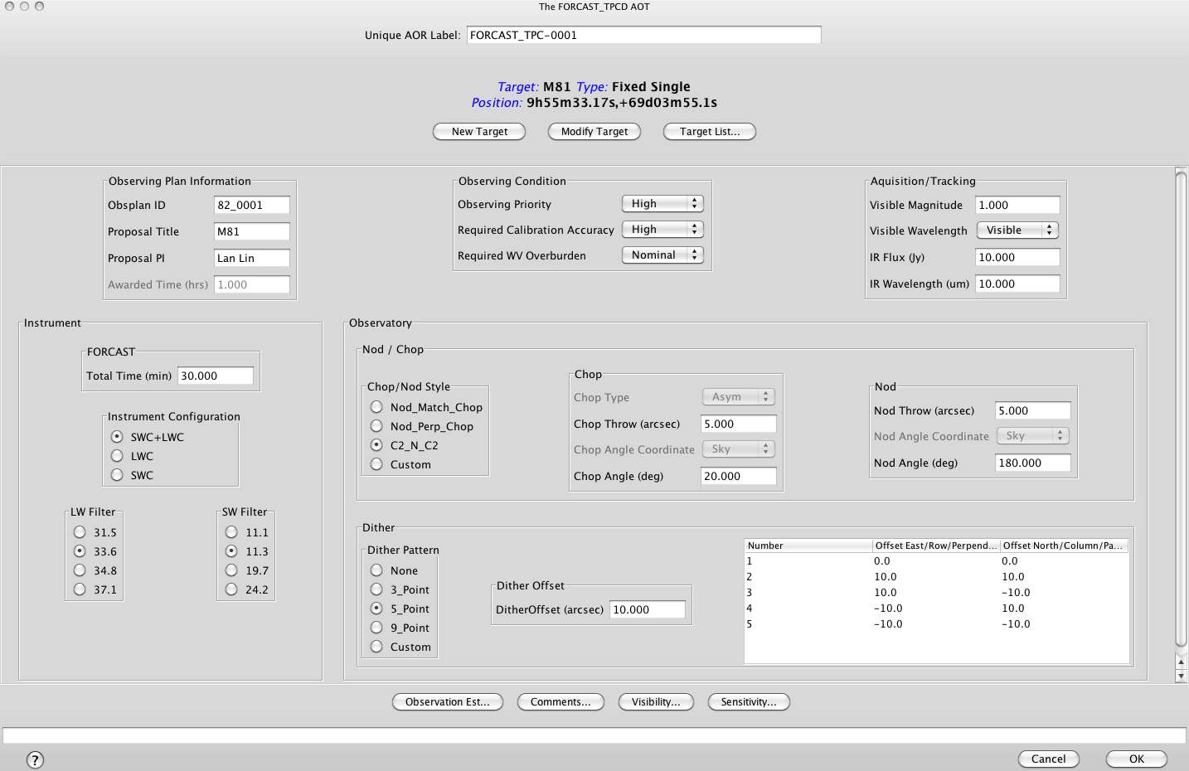

Slide 10
AOT Specification
AOT specification worked out with SI representatives for each mode, including:
  Options
  Constraints
  Parameters
  Value ranges and defaults
  Conceptual diagrams as needed
Spec then included in SI-DCS ICD and implemented as formal XML.
Kickoff meeting with SI teams?

Slide 11
AOT Prioritization for Cycle 1
FORCAST
  2 position chop/nod (dithering)
  Mapping
GREAT
  Pointed (Chopping)
  Mapping
FLITECAM Imaging
FORCAST Grism
FLITECAM Grism

Slide 12
V&V Overview
All DCS V&V activities to be documented in V&V Plan for Segment 3
  V&V guidelines documented in SCI-AR-PLA-PM92-2009.
Verification carried out to ensure software meets its formal requirements or fixes SPRs (bugs). Methods:
  Demonstration (functional, security, privacy requirements)
  Test (performance requirements)
  Inspection (mostly for SPRs)
  Analysis (rare)
Validation carried out to ensure that software meets the needs of users in the operational environment. Methods:
  Beta testing with representative users
  Simulations (e.g. SIM6 in 2009)
V&V Activities carried out in separate Test Environment independent of DCS Production Environment.
Result of V&V activities:
  Requirements status matrix updated
  Existing SPRs updated
  New SPRs generated (as needed)

Slide 13
DCS Verification Overview
All DCS software (including SSPOT) subject to SW QA Plan and V&V Guidelines.
Standard verification activities for every DCS release:
  V&V Plan updates (SV01, as needed)
    Covered in Design Review
  Test Procedure updates (SV02, as needed)
  Dry-Run Testing
  Establish SW baseline: CCB
  Test Readiness Review
  Witnessed Testing (USRA SW QA)
  Generate Test Records (SV04) and Test Report (SW05)
Once verification activities are complete, NASA conducts FCA/PCA and issues change request.
Once change request is approved, software can be deployed to production environment.

Slide 14
SSPOT Validation Planning
SSPOT Validation Plan to be included in General DCS V&V plan for Segment 3.
SSPOT Validation activities will involve Science and Mission Ops staff and should include:
  SMO User testing against the SSPOT ConOps.
  SMO exercises and simulations in preparation for Segment 3 phase II planning
  Beta testing with SI teams and other outside users (under controlled conditions)
Results to be documented in Validation Test Reports and SPRS (as needed).
Validation activities can be done anytime after formal baseline established (i.e. when the code is ready for formal test).
Informal validation will also occur as part of development (i.e. as soon as functionality and AOTs are available) as risk reduction – no formal documentation required:
  Demos with SPOT Science Working Group
  Informal testing with SI teams

Slide 15
SSPOT Development Schedule
June: Delta Design Review
June - Aug: Implementation and informal test
Sept: Formal Testing
Sept. 30: Release of SSPOT Beta (FORCAST TPCD)
  SSPOT ready for ops simulations and exercises
  SSPOT ready for integration with other AOTs

Slide 16
AOT Implementation Schedule
May – October: AOT Specification and ICD updates
June – October: AOT implementation (XML)
October – February (2012): AOT integration with SSPOT
  Assumes ~3 weeks per AOT
  Including informal test with science ops and SI teams
March 2012: Formal V&V
March 31, 2012: SSPOT released with full set of AOTs for Cycle 1 Planning
April 2012: Cycle 1 Phase II planning begins
Schedule is very tight: Very little margin for unexpected issues.

Slide 17
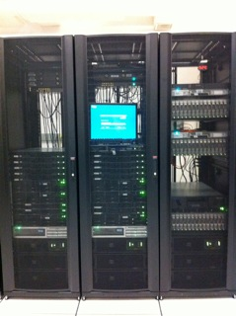
Appendix: DCS Archive Status
All data from Cycle 1 (both raw and pipelined) will be ingested into the DCS Archive and made accessible via DCS web pages.
Archive enforces proprietary periods and access controls.
Status:
  Database and storage systems complete
  Ingestion functions ready, in operations now for Basic Science
  Delivery functions complete, in operations now for Basic Science
  Web access complete, but a number of user interface issues identified, to be resolved in time for Cycle 1 observations

Slide 18
