Slide 1
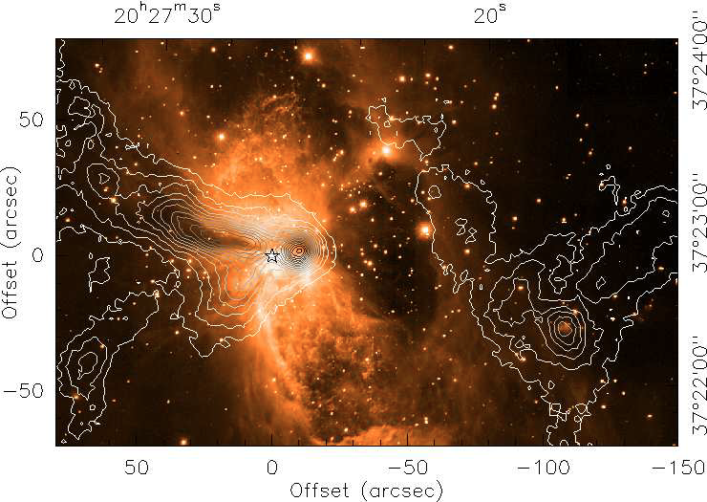
SOFIA/GREAT observations of S106
Dynamics of the warm gas
R. Simon at al. A&A 2012
S106 continuum:
NIR image & 350µm contours
What is the nature of the prominent dark lane?
Until now, it was an open question, whether the dark lane is due to the shadow cast by a small disk around the O-star or also due to extinction in foreground gas.
GREAT investigated the nature of the dark lane by disentangling the morphology and kinematics of warm neutral and ionized gas close to the star by observing velocity resolved spectral lines of [CII] and CO 11→10.
The hourglass-shaped HII region/PDR/molecular cloud complex S106 (d: 1.2-1.8kpc) is excited by a single late O-star (S106IR) denoted by the star symbol.

Slide 2
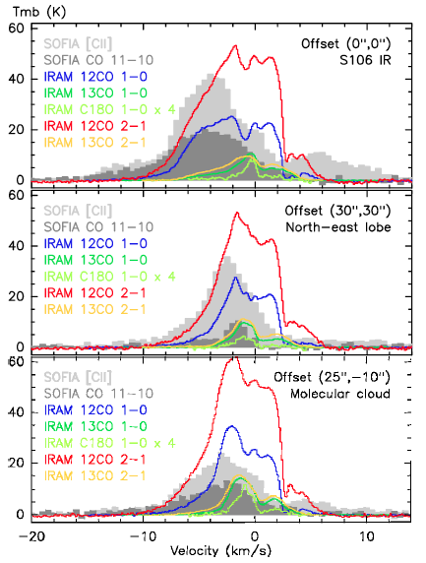
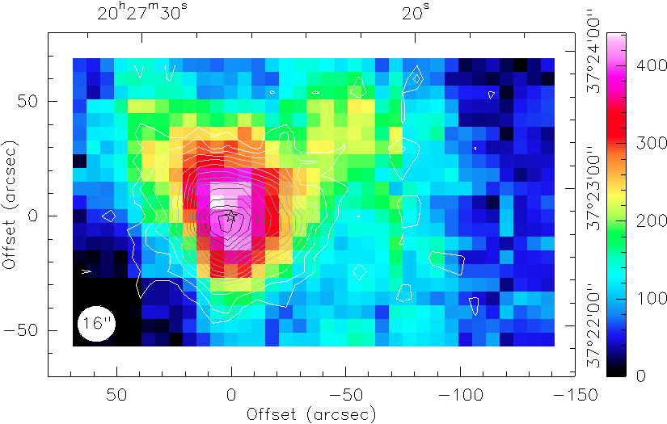
S106: GREAT observations and results
[CII] map and CO 11-10 contours
Spectra: GREAT/SOFIA
and IRAM 30m
[CII] emission is double peaked coming in part from the HII region but also extends into the outflow lobes. CO is centrally peaked and more confined.
These observations reveal that the dark lane and cone are not just a shadow of the small disk around S106 IR, but indeed high column density, warm gas at the edge of the molecular cloud located
in front of the HII region.
At the position of S106IR (top) [CII] and CO 11-10 peak blue-shifted from the low-J CO lines showing very broad wings especially in [CII].
At the other positions, CO 11-10 is much fainter as the transition is not excited so much in the quiescent gas.
Notes:
Maps on this and previous slide are blinkable.

