Slide 1
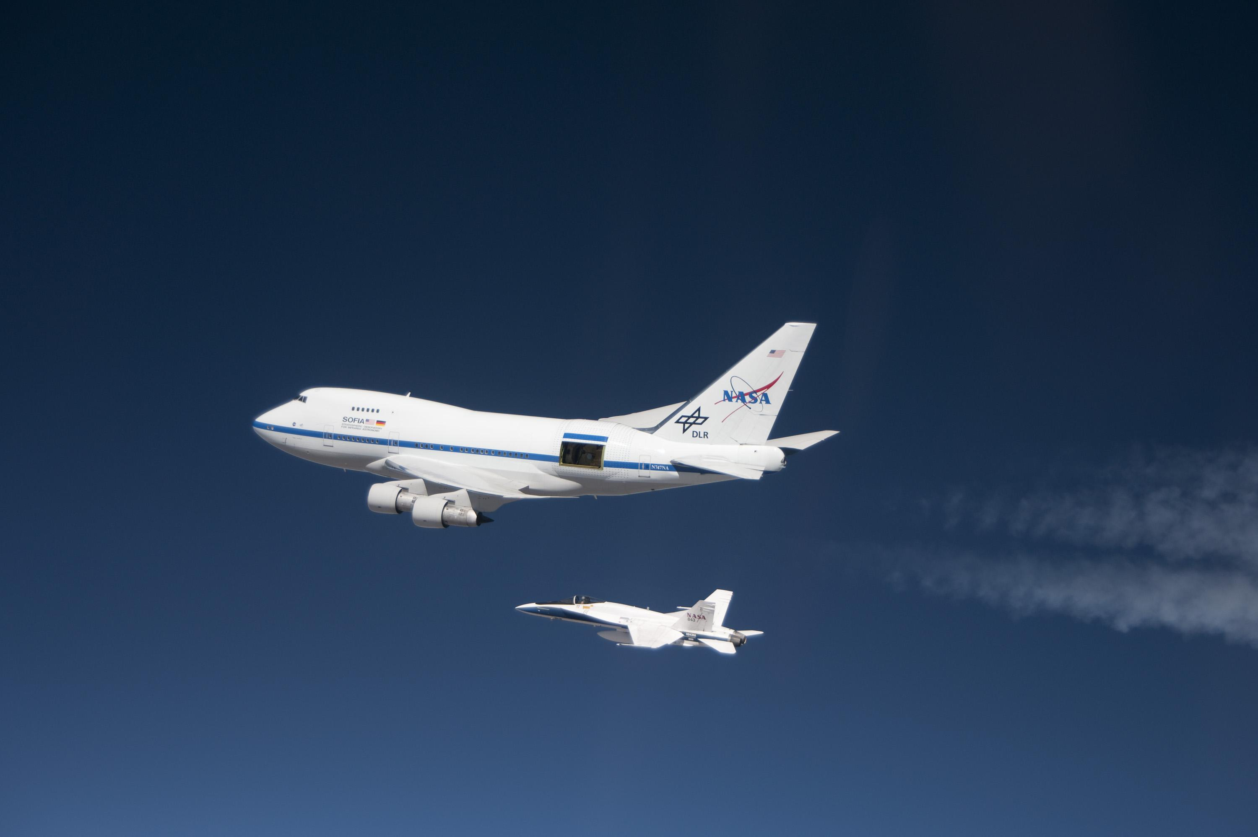
“6-37 micron Imaging of Orion BN/KL”
by
De Buizer et al. 2012, ApJL, 749, L23
with some additional results from
“6-37 micron Imaging of the Central Orion Nebula”
by
Shuping et al. 2012, ApJL, 749, L22

Slide 2
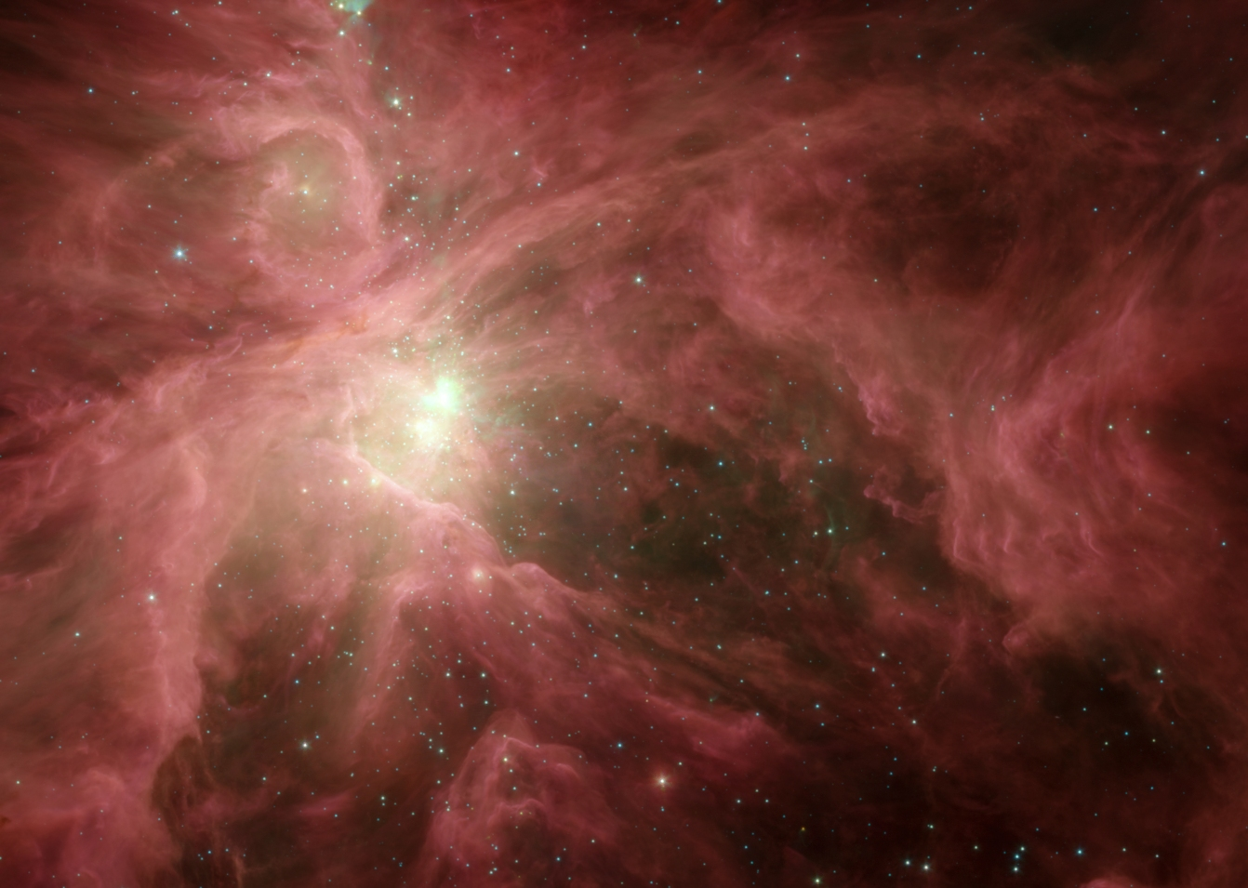
The central ~3’ region of the Orion nebula was observed with FORCAST on SOFIA
Filters: 6.6, 7.7, 19.7, 31.5, and 37.1 microns
Resolution at 37.1um ~4” (best ever achieved)
Short exposure times: 150-450s
Background Image:Spitzer
Notes:
The background image is the Spitzer infrared image of Orion. Blue highlighted filters signify the observations that at present can ONLY be performed with SOFIA and no other facility on the ground or in space. The central areas and BNKL itself are saturated. The green box indicates the area of the KAO image in the next slide.

Slide 3
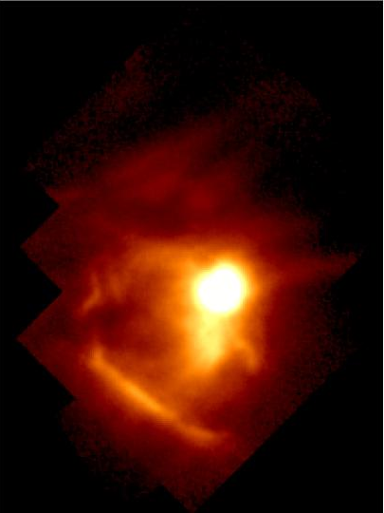
The central ~3’ region of the Orion nebula was observed with FORCAST on SOFIA
Filters: 6.6, 7.7, 19.7, 31.5, and 37.1 microns
Resolution at 37.1um ~4” (best ever achieved)
Short exposure times: 150-450s
KAO 38 um
(Stacey et al. 1995)
Background Image:Spitzer
Notes:
The region in the green box was imaged by SOFIA’s predecesor, the Kuiper Airborne Observatory (KAO) with Gordon Stacey’s QUIC instrument at 38 microns. The brightest emission is from the BNKL region and the Orion Bar is easily distinguished.

Slide 4
The central ~3’ region of the Orion nebula was observed with FORCAST on SOFIA
Filters: 6.6, 7.7, 19.7, 31.5, and 37.1 microns
Resolution at 37.1um ~4” (best ever achieved)
Short exposure times: 150-450s
KAO 38 um
FORCAST FOV
3’
3x better resolution
(Stacey et al. 1995)
Background Image:Spitzer
Notes:
This slide overlays the FORCAST approximately 3’x3’ field of view and points out that the SOFIA observations have a 3 times better resolution than the old KAO data.

Slide 5
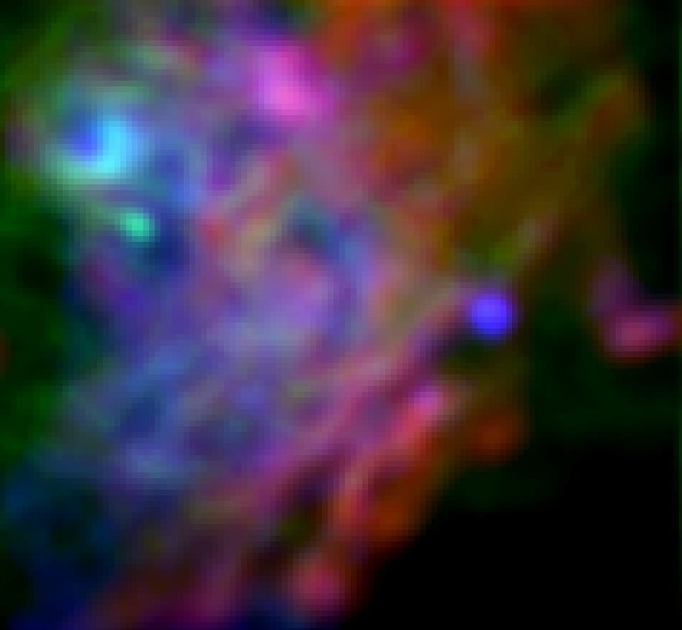
KAO 38 um
Ney-Allen Region
Blue=7um Green=19um Red=37um
Ney-Allen
SOFIA
θ¹ D
Trapezium
OMC1S-IRS1
(Stacey et al. 1995)
LV1
OMC1S-IRS2
Shuping et al. (2012)
Background Image:Spitzer
Notes:
This view shows the Ney Allen region and some of the sources that were detected and discussed in the ApJ Letter written by Ralph Shuping and collaborators. Also show for comparison are the optical locations of the Trapezium stars. The Ney-Allen nebula itself is the crecent-shaped extended source seen around theta 1D. Interestingly, this source is the dominant source of emission for this region at all wavelengths except for 37 microns. The morphology of the Ney-Allen nebula at these wavelengths are consistent with the previous interpretation that it is ambient dust swept up by the stellar wind of Theta 1D Ori. The OMC sources are young stellar objects, and LV1 is a proplyd. The beautiful multi-colored wrinkles in the background are thought to be undulations in the surface of the background photo-dissociated region, creating regions of different temperatures, and thus peaking at different wavelengths.

Slide 6
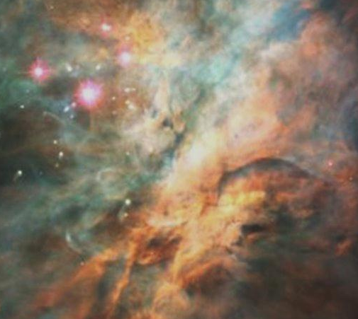
KAO 38 um
Ney-Allen Region
SOFIA
Optical/Hubble
Trapezium
OMC1S-IRS1
(Stacey et al. 1995)
LV1
OMC1S-IRS2
Shuping et al. (2012)
Background Image:Spitzer
Notes:
Blinking back and forth between the image on the previous slide and this one shows the differences in the Hubble optical images and the SOFIA mid-IR images.

Slide 7
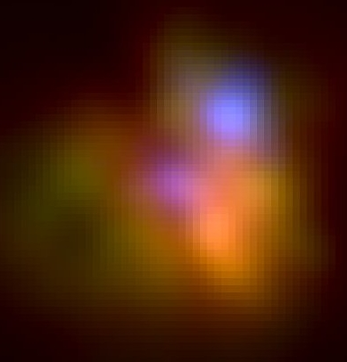
BN/KL Region
Blue=19um Green=31um Red=37um
KAO 38 um
SOFIA
BN
IRc2
IRc3
Source I
IRc4
(Stacey et al. 1995)
De Buizer et al. (2012)
Background Image:Spitzer
Notes:
This slide zooms in on the SOFIA observations of the BNKL region itself (results from this region are presented in the ApJ Letter written by James De Buizer and collaborators) . Major sources of emission are labeled. BN is identified and stands out as a hot. Blue source relative to the other emission in the region. The area around radio source I and IRc2 is redder, because the extinction toward this region is quite high. Within this redder region the embedded young stellar object that drive the outflow in the region is located. There is debate whether this outflow source is Source I or IRc2.

Slide 8
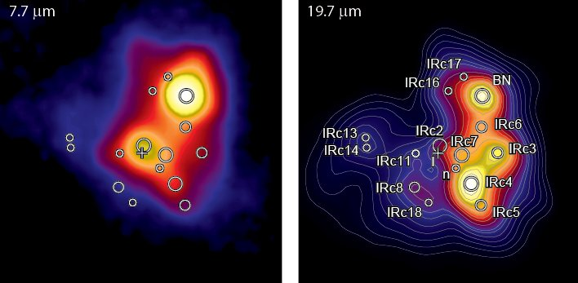
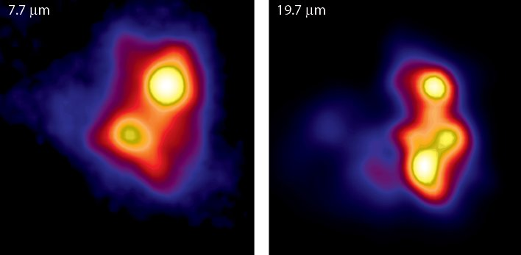
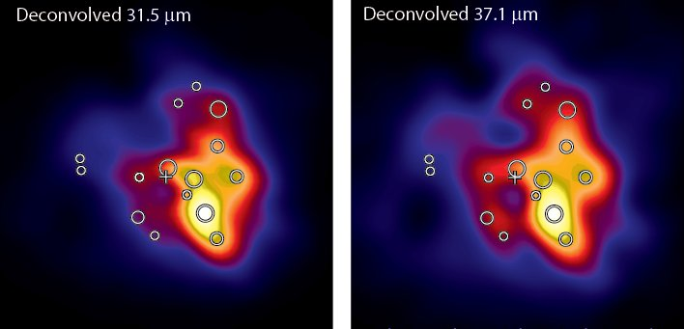
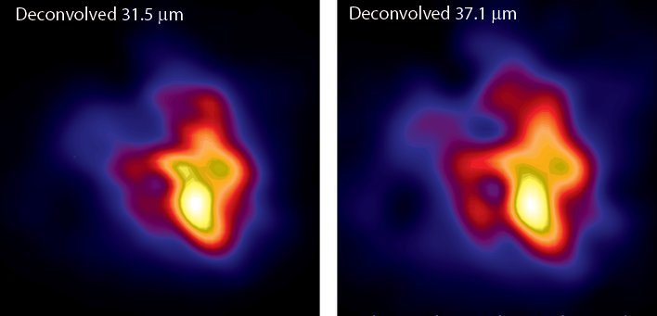
BN declines in
prominence at
longer λ’s
IRc4 dominates
at λ >31um
5”
A previously
unidentified area
of emission is
apparent at
λ >31um (SOF1)
De Buizer et al. (2012)
Notes:
One of the main questions regarding the BNKL region is: What are the main sources of luminosity in the region? There is still a lot of debate as to what IR sources in the area are actually self-luminous young stellar objects and which are simply externally heated knots of dust or holes in the overlying extinction where IR emission just happens to be escaping. This slide first shows the two wavelengths that were observed by SOFIA but that are achievable from the ground as well. All IR sources are labeled as circles, and radio source I is labeled as a cross. At 19um all structures on the image can be accounted for by already known IR sources (the 19.7um contours help illustrate this point). Then the two wavelengths that are only possible with SOFIA are shown. In these bottom two images the locations of all known IR sources are again overlaid. Then the pink boxes illustrate that BN, the brightest source at all IR wavelengths observable from the ground, loses brightness at longer wavelengths. The brightest source at longer wavelengths is actually IRc4, as demonstrated by the green boxes. Furthermore, it can be seen in the two longer wavelength images, and especially in the 37.1 um image, that there is a region of IR emission that has not before been identified. This region is contained within the large white circle where there are no labeled IR sources. This is a new source of IR emission that has been dubbed “SOF1”.

Slide 9
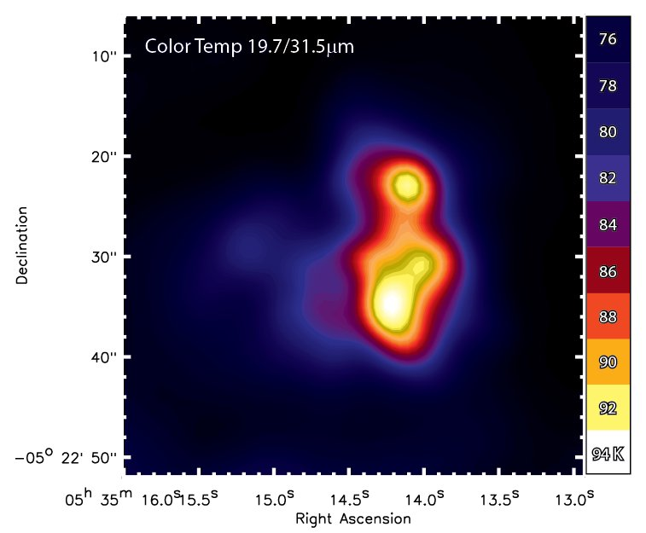
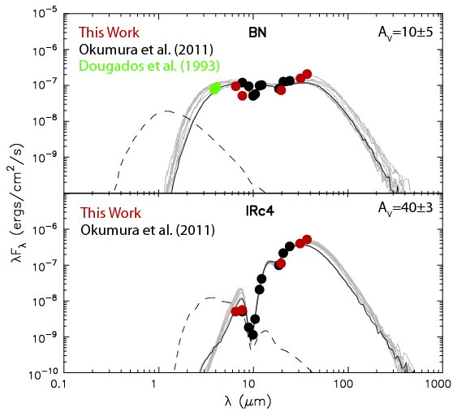
Like BN, IRc4 is a self-luminous source
L_{bol} = 1.3x10⁴ L_{sun}
IRc4 luminosity is too high to be caused by externally heating
BN+IRc4 account for ~50% of the ~10⁵ L_{sun} of the BN/KL region
L_{bol} = 2.1x10⁴ L_{sun}
De Buizer et al. (2012)
Notes:
Looking at the color temperature map made from the 19.7 and 31.5 um SOFIA images, it can be seen that there are two main temperature peaks, one at the location of BN and one at the location of IRc4. Generally, if there is a color temperature peak associated with a flux peak, this signifies that that flux peak is due the dust there being internally heated by a (proto)star. So at the wavelengths of SOFIA, we can confirm that there are at least two self-luminous sources of emission in the region, BN and IRc4. We used the measured SOFIA flux densities of BN and IRc4 along with flux densities from the literature and fit them with SED models of forming stars. These models show that IRc4 is VERY luminous; almost twice as luminous as BN and too luminous, in fact, to be an externally heated knot of dust, which up until now has been the prevailing opinion of IRc4.

Slide 10
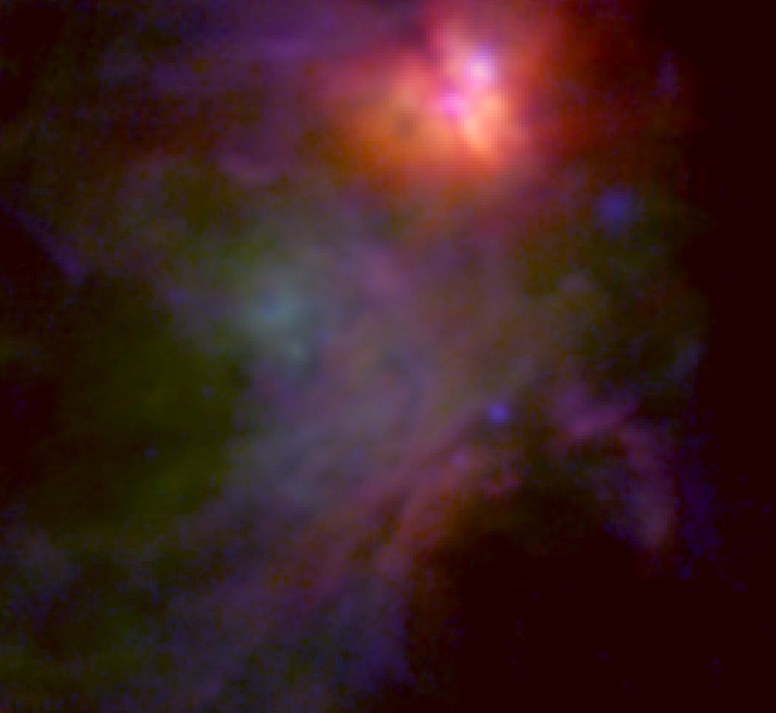
Conclusions
The central ~3’ region of the Orion nebula was observed with FORCAST on SOFIA
Filters: 6.6, 7.7, 19.7, 31.5, and 37.1 um
Resolution at 37.1um ~ 0.4”
Short exposure times: 150-450s
SOFIA/FORCAST observed the central 3’ of the Orion Nebula with the highest resolution ever at 31 and 37 microns
BN is not prominent at wavelengths 31 microns or longer
IRc4 is likely a self-luminous source with a luminosity of about 1/4 the entire KL Nebula
A previously unidentified area of emission, prevalent at wavelengths >31 microns appears to be associated with the outflow cavity
Background Image:Spitzer

