Slide 1
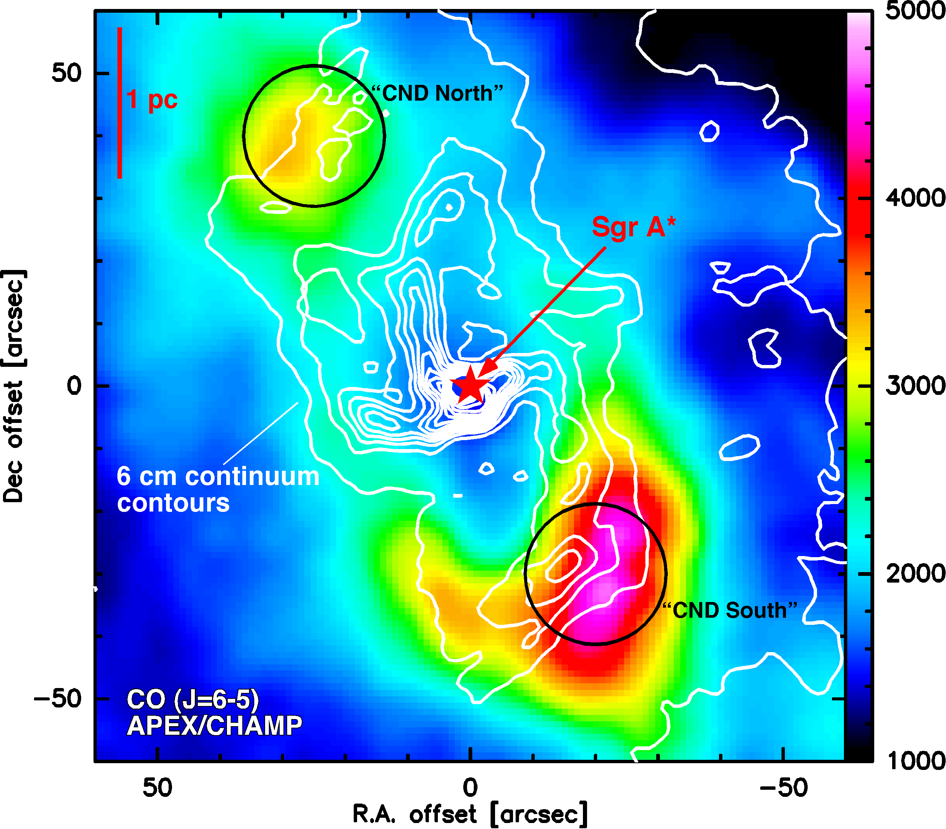
SOFIA studies the Galactic Circumnuclear Disk
Temperature and density measurements using multi-transition observations of CO
The Galactic Center provides a
nearby laboratory for the physics of active galactic nuclei
Tells us about processes around super-massive black holes
What is the state of the “Circumnuclear Disk” (CND)?
  Combining ground, space, and airborne observations allows tight constraints on the density and temperature of the gas in the CND
“GREAT confirms transient nature of the circumnuclear disk”
Requena-Torres et al., 2012, A&A, Special Issue
Notes:
The color map is a CO (J=6-5) map from APEX/CHAMP. While contours show 6cm radio-continuum emission (ionized gas). The two back circles indicate the pointings for CND-S and CND-N with sizes corresponding to the GREAT CO (J=11-10) beam of 22.5”

Slide 2
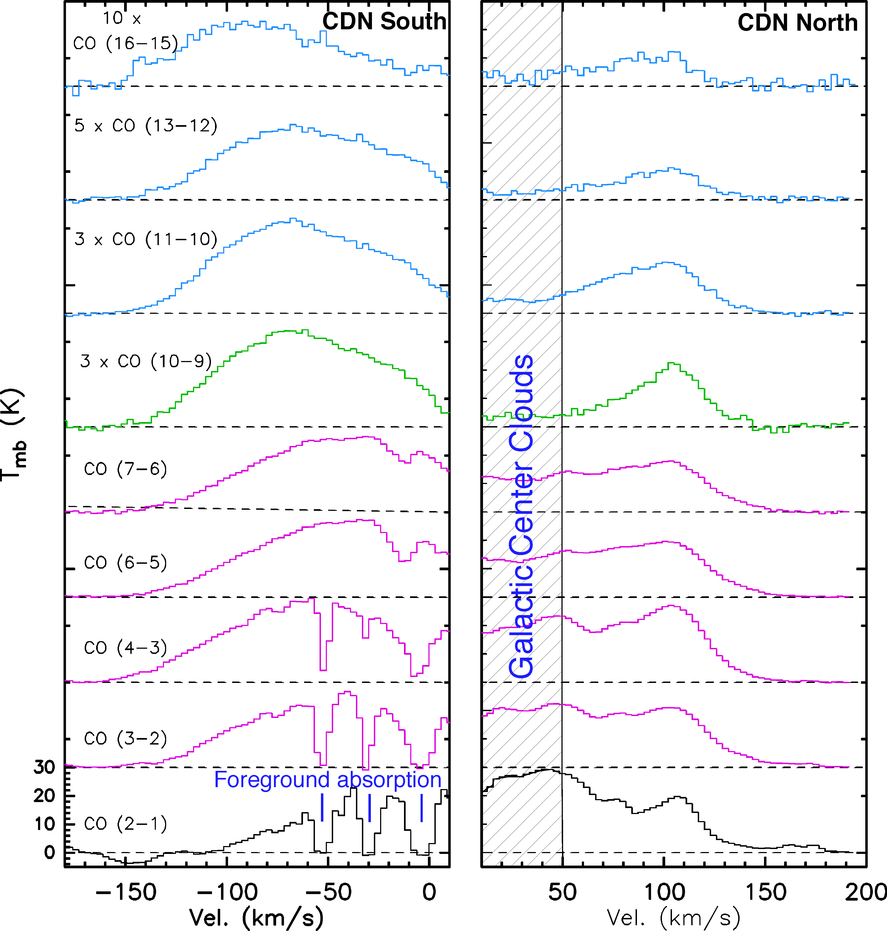
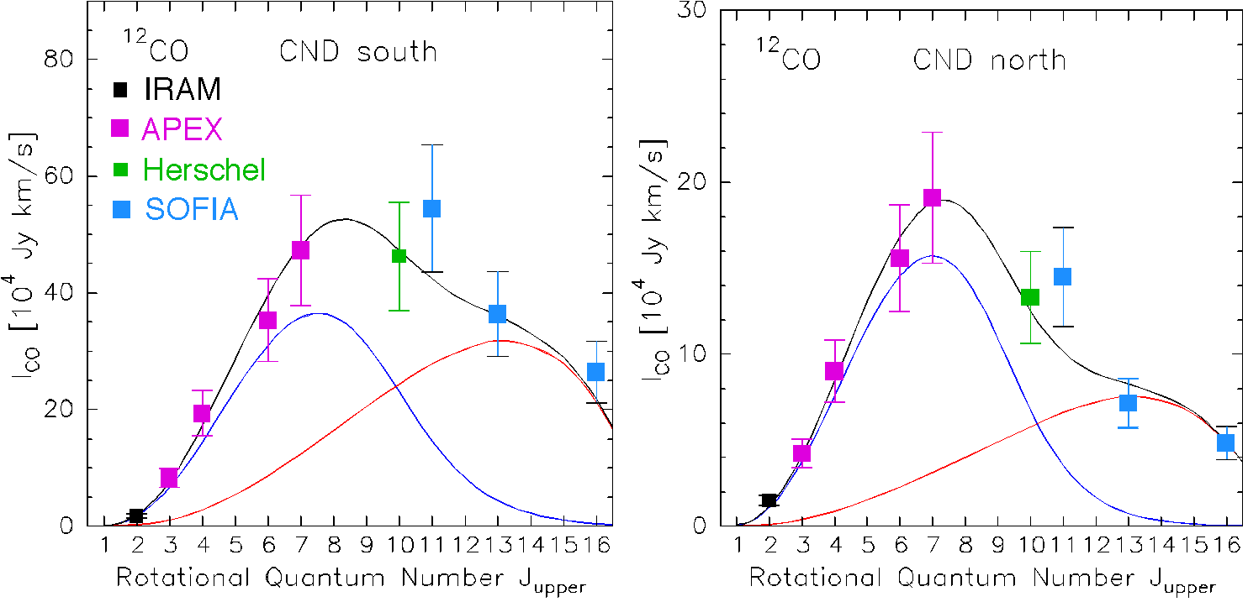
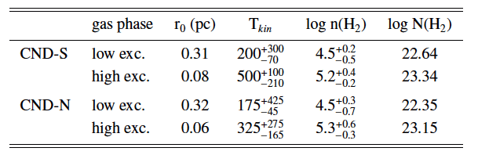
“GREAT confirms transient nature of the circumnuclear disk”
Requena-Torres et al., 2012, A&A, Special Issue
SOFIA/GREAT observations provide a critical set of high-J CO lines, showing the need for a second, high temperature gas component
The LVG modeling of the CO spectral energy distribution indicates clouds heated by shocks
The relatively low space densities derived imply that the gas is not gravitationally stable against tidal shear, which suggests that the CND clumps are transient features
The mass of the clumpy inner CND affects the accretion rate onto the central black hole.
LVG model results
Notes:
Left figure: All observations have been convolved to a common angular resolution of 22.5”. Towards CND-S Galactic foreground gas cause absorption lines. Towards CND-N, unrelated Galactic Center region clouds add emission. Both the foreground material and the GC clouds are much cooler than the CND gas and hence their influence goes away for high-J lines.
The model used is an LGV code with three free parameters: n(H2), T_kin and r_0 - the effective equivalent clump radius (in the diluted beam - filling factor). T_kin and r_0 are somewhat degenerate.
The line fluxes for the two model components are shown as full drawn lines in the figure (lower right) over-plotted on observations color coded by observatory

