Slide 1
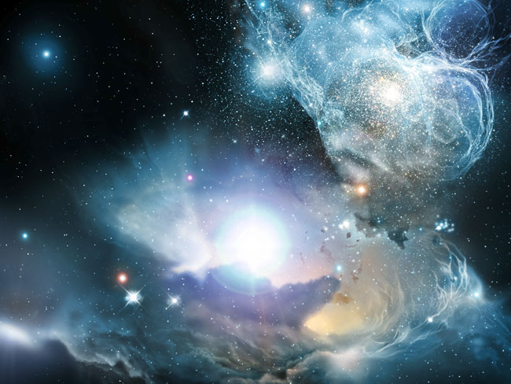

Clouds Near Quasars Redefined
[CII] Observations in Nearby Clouds Near the Lines of Sight Towards B0355+508 and B0212+735
Glück, C. B. et al., 2017, A&A, 600, 94.
Instrument: GREAT, Δv = 0.1 km/s at 1.9 THz
[CII] Spectra at CO-peak and CO-void Positions
*
Background
Interstellar clouds are classified as either diffuse, translucent, or dense with increasing column density. This classification has inherent effects on our understanding of the clouds and their environment, such as temperature, composition, and chemical interactions.
The nearby clouds near the lines of sight towards the quasars B0355+508 and B0212+735 were defined in the past as being warm, non-LTE diffuse clouds with temperatures above 30 K and typically T ~ 40–80 K. Small-scale variations in observed CO were attributed to chemistry variations. Theoretically, this would result in ~90% of carbon existing in the form of [C II], as the cooling in diffuse clouds is dominated by [C II].
GREAT is able to observe the [CII] line at an extremely high velocity resolution, making investigation of these clouds possible.
**
CO (J = 1–0) Emission Around B0212+735
*Liszt & Pety 2012
**Liszt & Lucas 1996, 2000
The critical observations performed by GREAT did not observe the expected [CII] emission in the clouds, which would have been a factor of ~3–15 above the 3σ diffraction limit for the cloud components in CO emissions. This lowers the feasible core temperature of the clouds from the expected 40–80 K down to 15 K. The results of this study therefore reframe our understanding of these clouds as being much colder and denser than previously conceived, from translucent to even moderately dense.
Pety & Liszt, in prep.
Background Image: A Primordial Quasar
Image Credit: Wolfram Freudling et al. (STECF), ESO, ESA, NASA

