Slide 1
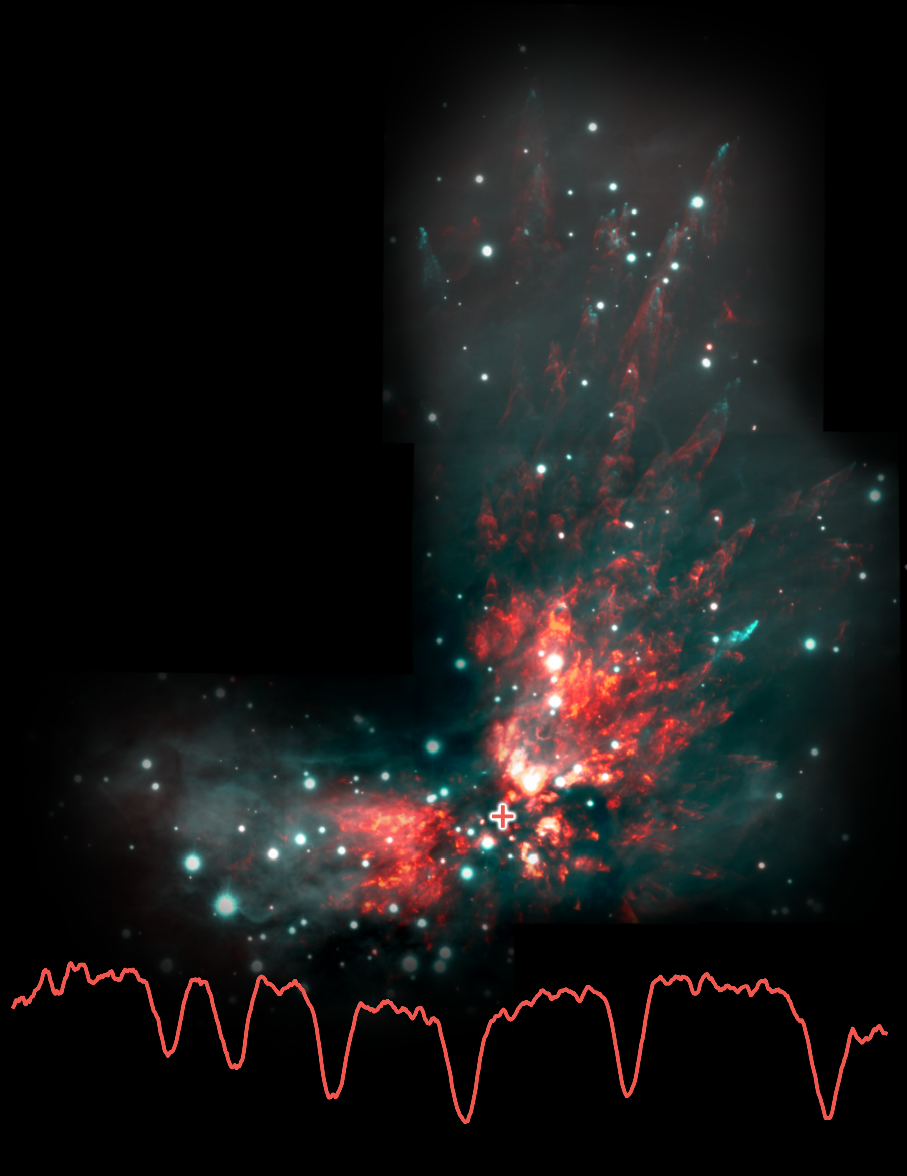


EXES Probes the Heart of Hot-Core Chemistry
The first comprehensive high-resolution molecular-line survey targeting the longer MIR from 12.5–28.3 µm with SOFIA/EXES opens up a new, largely unexplored discovery space.
SOFIA/EXES detected HNC, HCN, and H₁₃CN in an Orion hot core. These results probe a key stage in stellar evolution as young protostars heat their natal, icy mantles to unlock reservoirs of molecules.
This work is part of a wider mid-infrared survey that has detected a forest of molecular transitions. Researchers are not only building an inventory of molecules and creating a legacy archive, but also constructing a valuable reference database for future James Webb Space Telescope observations.
Paper: “The First Mid-infrared Detection of HNC in the Interstellar Medium: Probing the Extreme Environment toward the Orion Hot Core”
Nickerson, et al., 2021/01, ApJ, 907, 51.
Image credit: Orion: Bally et al. 2015; Gemini South GSAOI; Spectrum: Nickerson et al., 2021
Notes:
Paper DOI: http://doi.org/10.3847/1538-4357/abca36
High-res image link: https://www.sofia.usra.edu/sites/default/files/Public/SCI2021_007.png
Science Spotlight: https://www.sofia.usra.edu/multimedia/science-results-archive/exes-probes-heart-hot-core-chemistry

